Slide 1
Toxicology & You
(an introduction to toxicology)
A Small Dose of Toxicology
Chapter 1 – 3rd Edition
Steven G. Gilbert, PhD, DABT
www.asmalldoseoftoxicology.org

Slide 2
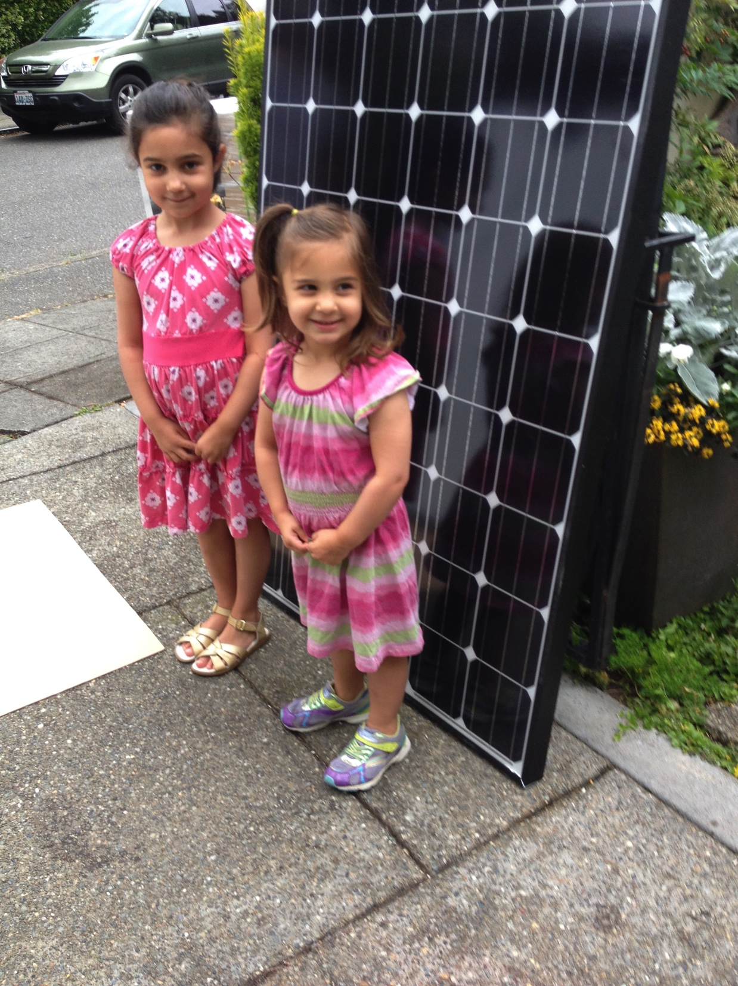
Inheriting The Future
Global Warming
Burning Coal
Coal Waste
Mercury from Coal to Fish
Nuclear waste
Chemical body burden
Chemical use
Sustainability
LEAD !! (2017)

Slide 3
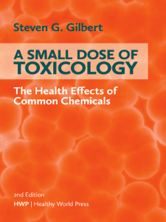
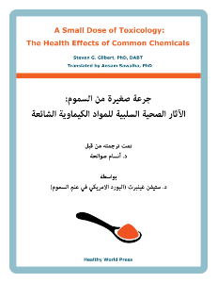
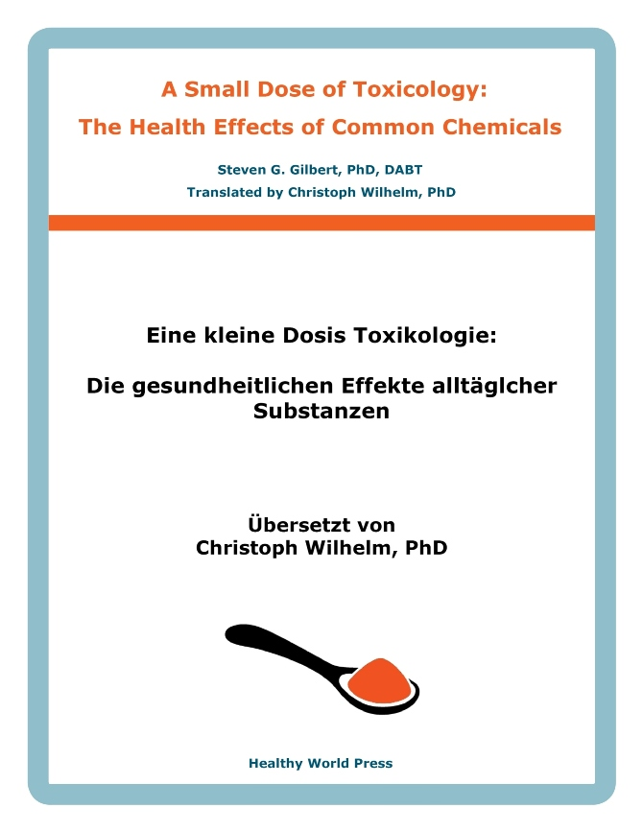
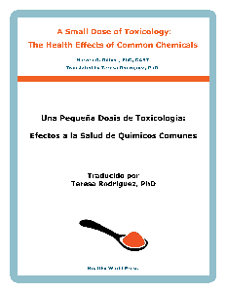
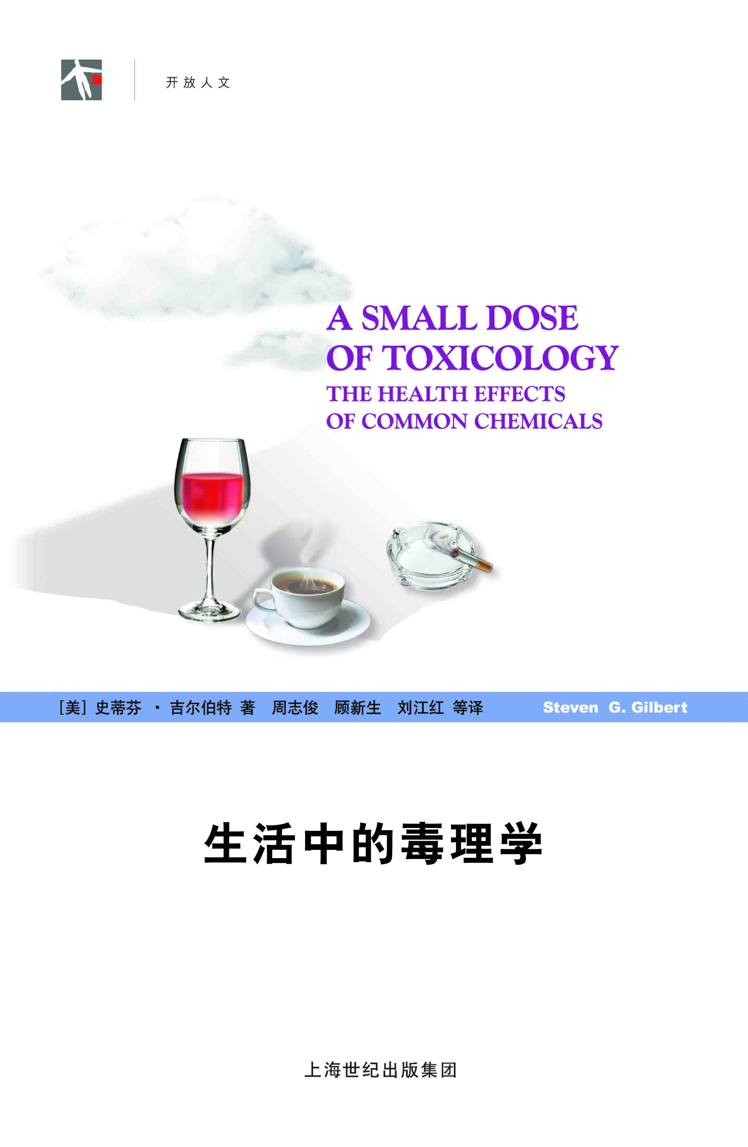
Small Dose of Toxicology
FREE
www.asmalldoseoftoxicology.org
English, Spanish, Arabic, German, Chinese

Slide 4
A Small Dose of Toxicology
FREE
www.asmalldoseoftoxicology.org
English, Spanish, Arabic, German, Chinese

Slide 5
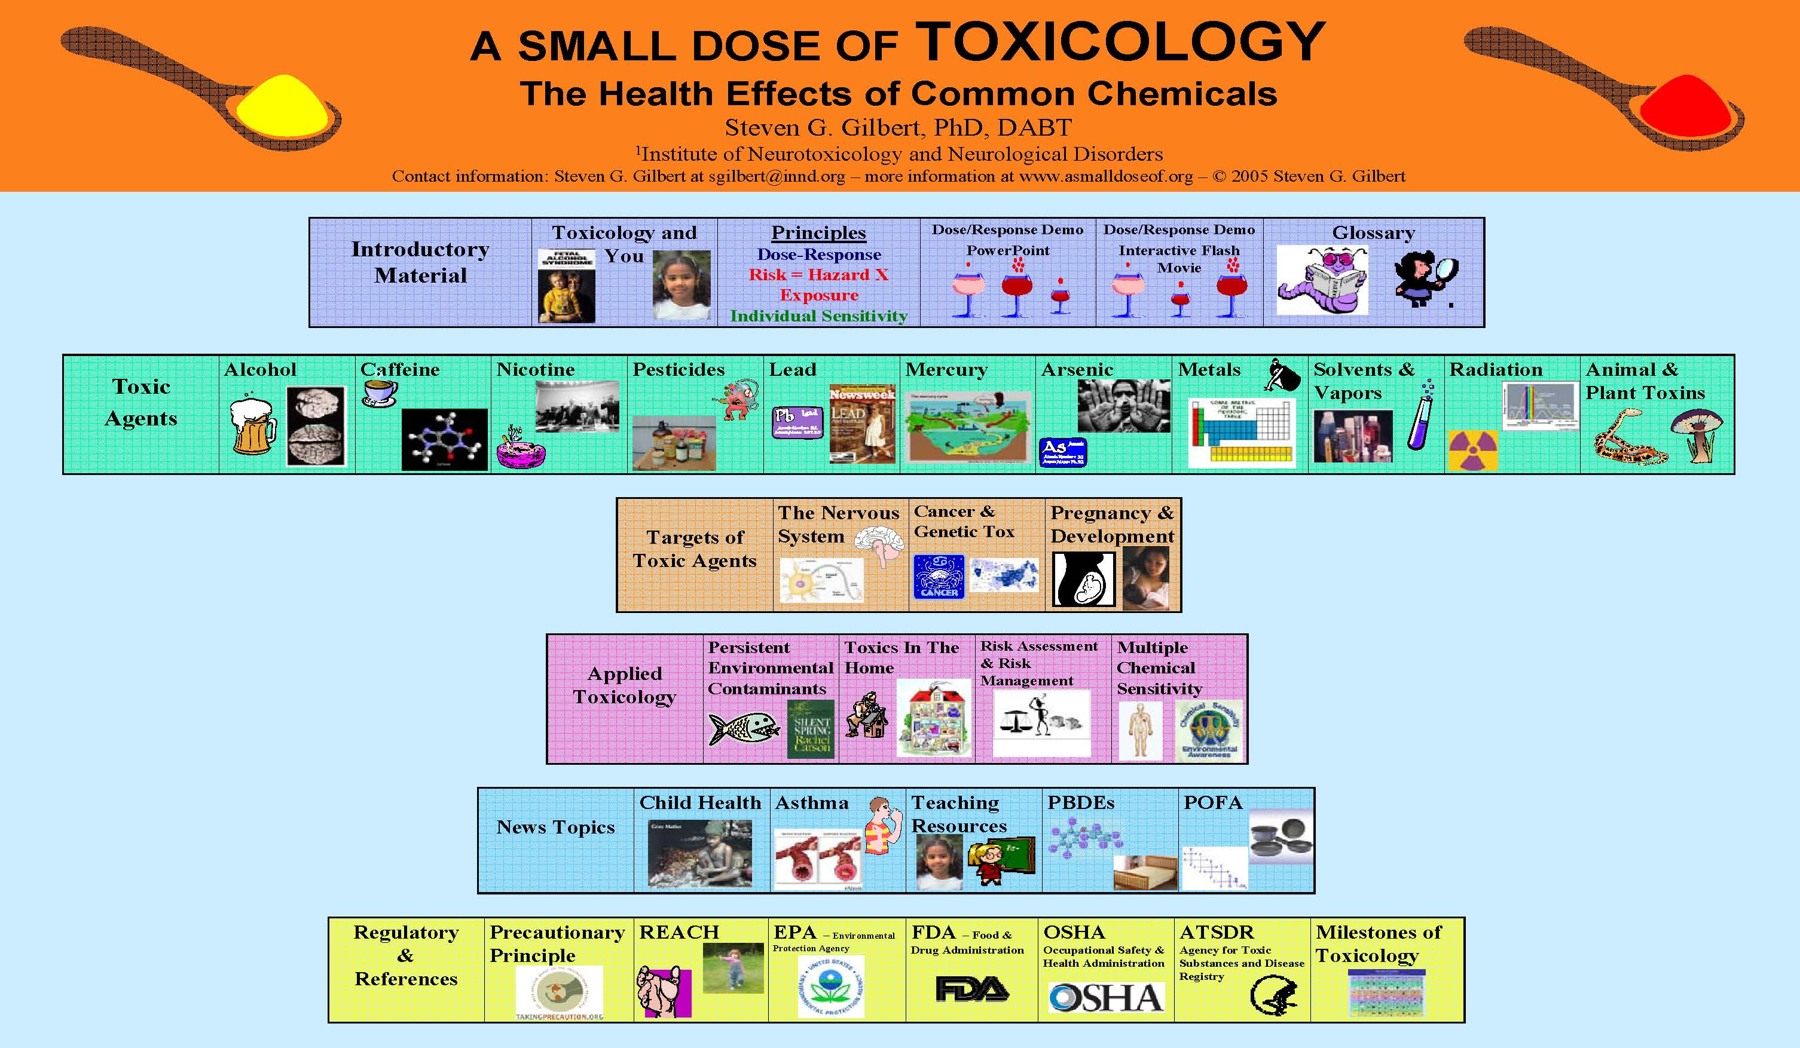
Small Dose of Toxicology

Slide 6
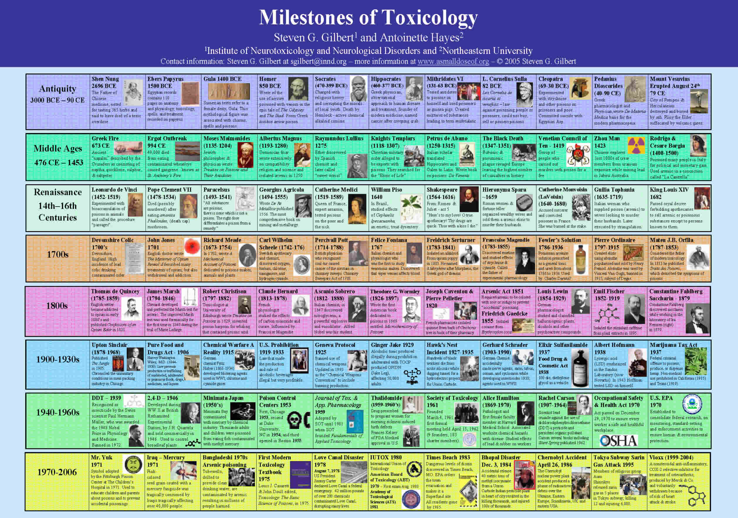
Milestones of Toxicology

Slide 7
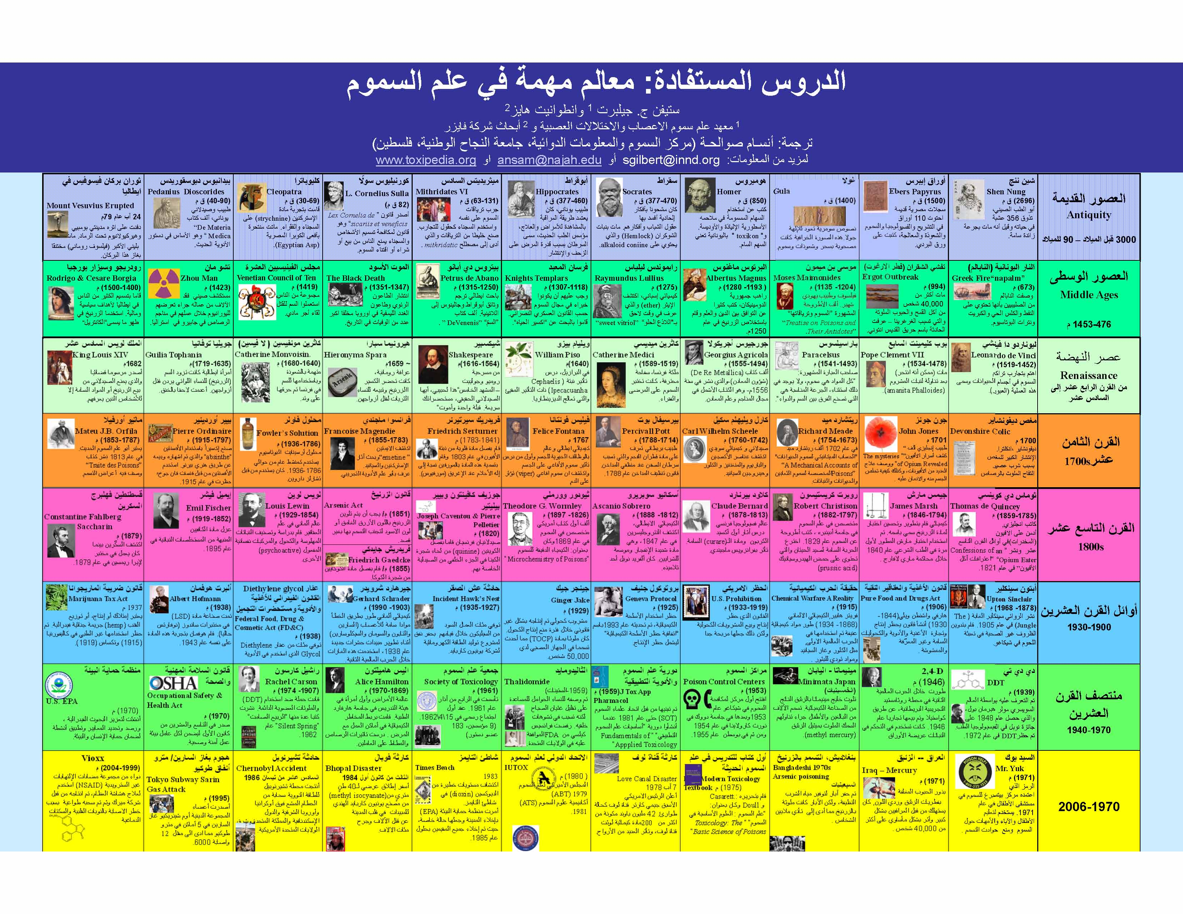
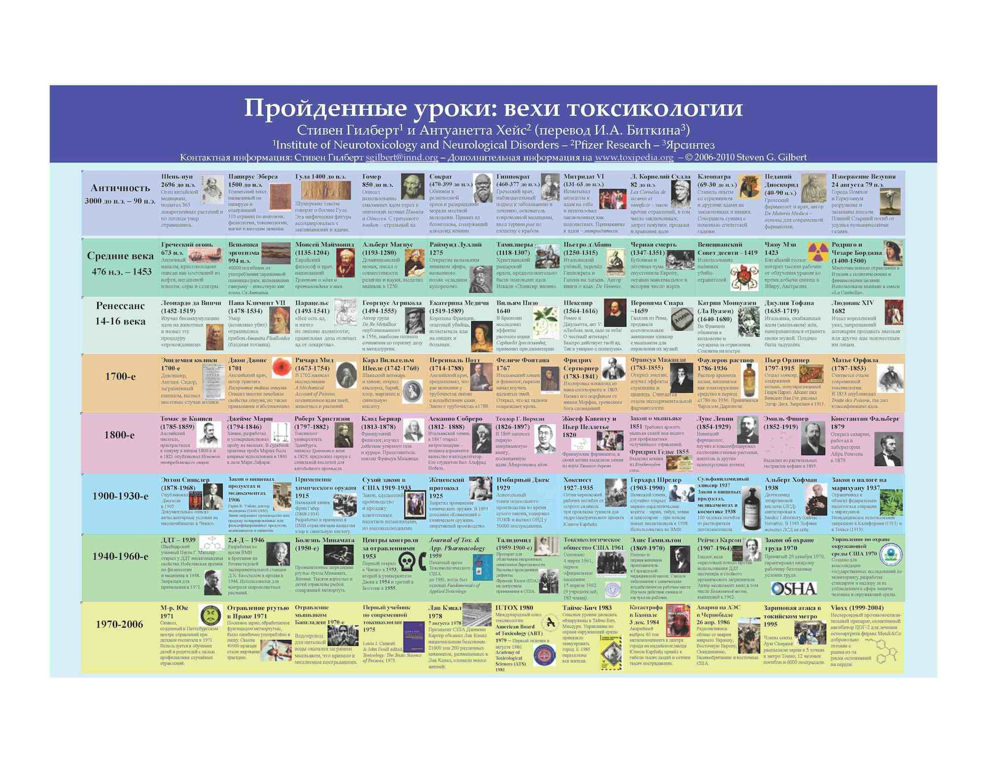
Milestones of Toxicology - Translations
Arabic
Also in:
Amharic
Arabic
Chinese (simple & traditional)
English (clickable)
French
German
Italian
Japanese
Korean
Portuguese
Russian
Spanish (clickable)
Turkish
Vietnamese
Russian

Slide 8
Power To Discover The Truth
“It is not the truth that makes you free. It is your possession of the power to discover the truth. Our dilemma is that we do not know how to provide that power.”
Richard Lewontin
(New York Review of Books, Jan 7, 1997)

Slide 9
What do these have in common?
Hong Kong
Princess Diana
Ambassador to Mexico
$100 Billion - $65 Billion
Food, noise
Dust
Lack of Sleep
11,000 Children
689,000 Children

Slide 10
Toxicology Definitions
The study of poisons
or
the adverse effects of chemical and physical agents on living organisms.

Slide 11
Toxicology Effects
Home environment
Current events
Workplace
School
Government Decisions
Global and local environment

Slide 12
Key Words
Dose / Response
Risk =
Hazard X Exposure
Individual Sensitivity

Slide 13
Ancient Awareness
399 BC Death of Socrates by Hemlock
Socrates was charged with religious heresy and corrupting the morals of local youth.
The active chemical used was the alkaloid coniine which, when ingested causes paralysis, convulsions and potentially death.

Slide 14
Historical Awareness
From Romeo and Juliet - act 5
Come bitter pilot, now at once run on
The dashing rocks thy seasick weary bark!
Here’s to my love! O true apothecary!
Thy drugs are quick. Thus with a kiss I die.
Shakespeare

Slide 15
Historical Events
Opium War of 1839-42
Great Britain had a monopoly on the sale of opium and wanted China to increase their purchase. A war was fought over opium sale with England getting control of Hong Kong.
Consider our societies current “wars on drugs”.

Slide 16
Adverse Effects
Obvious
Death, Cancer, Acid burn, Caffeine jitters
Subtle or Delayed
Decreases in learning and memory (lead), Increased likelihood of cancer associated with aging.

Slide 17
Chemical or Physical Agents
Chemical agents
Natural or manufactured
    Bacteria, plants and animals produce toxins (caffeine)
    Manufactured chemicals (pesticides)
Physical agents
Temperature (damage fish)
  Sound (damage hearing)

Slide 18
Environmental Health
“Conditions that ensure that all living things have the best opportunity to reach and maintain their full genetic potential.”
Steven G. Gilbert, 1999

Slide 19
Examples
Childhood lead exposure
Prenatal alcohol exposure
Mercury in gold mining
Methyl mercury in food supply
DDT use

Slide 20
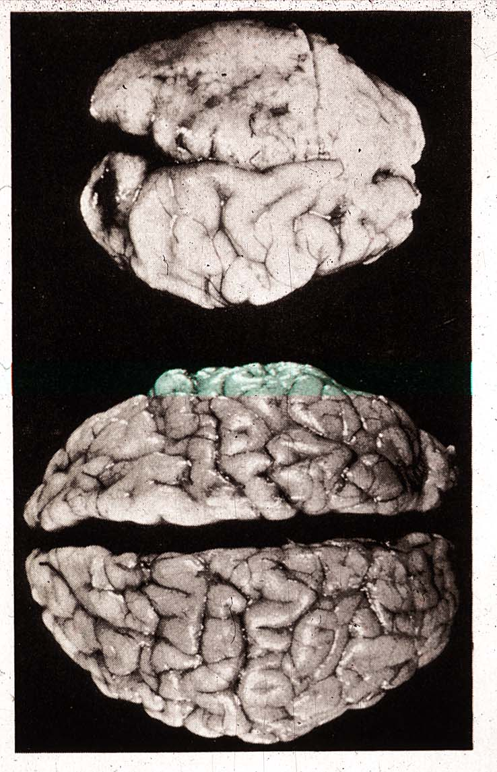
Effects of Prenatal Alcohol

Slide 21
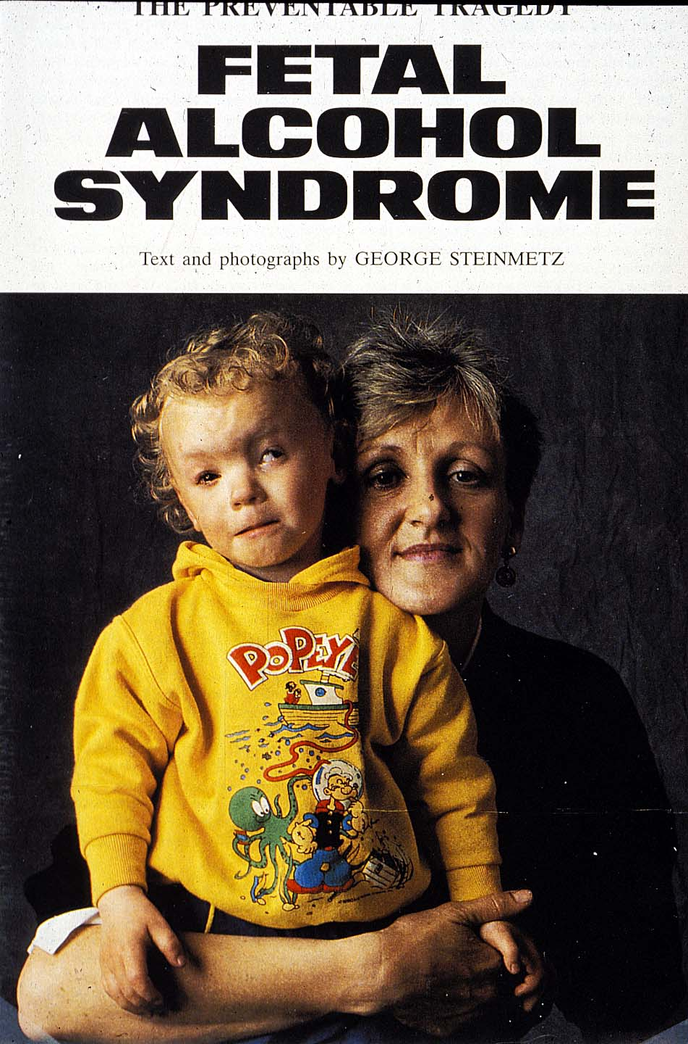
FAS Child

Slide 22
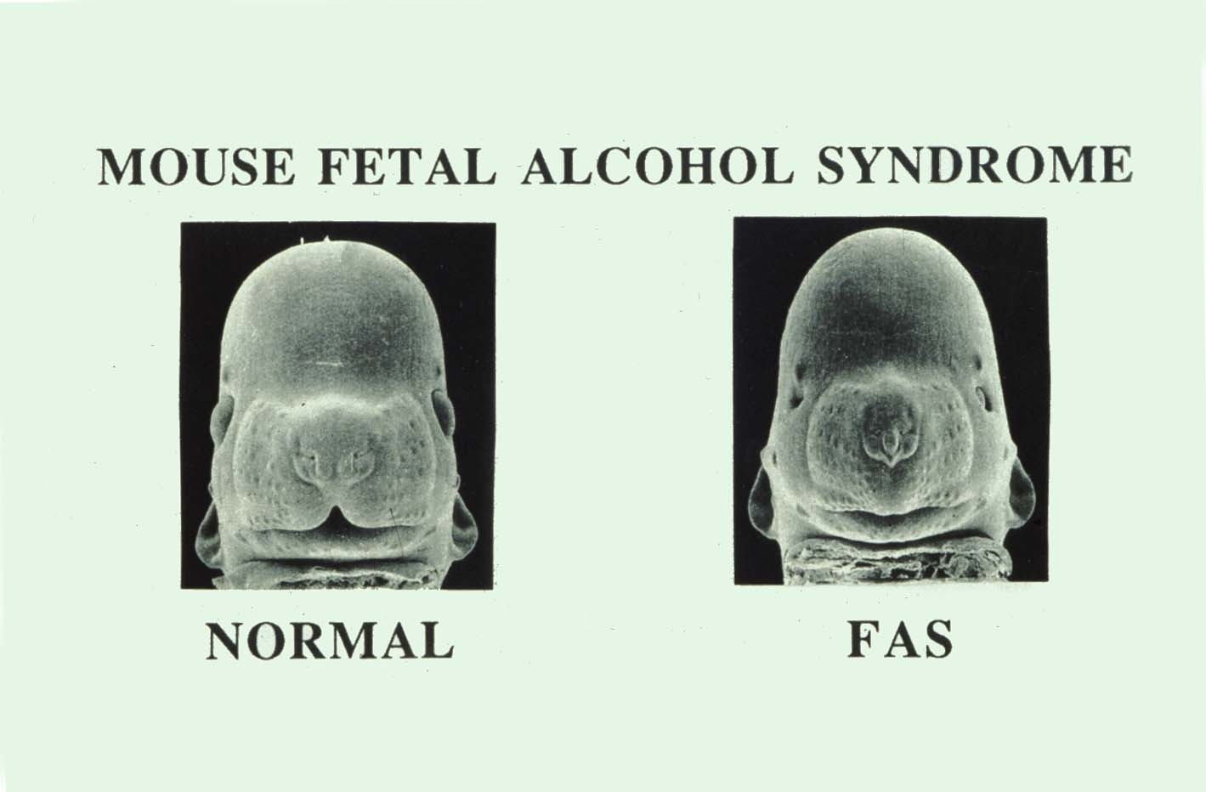
Mouse – Scanning EM

Slide 23
Lead

Slide 24
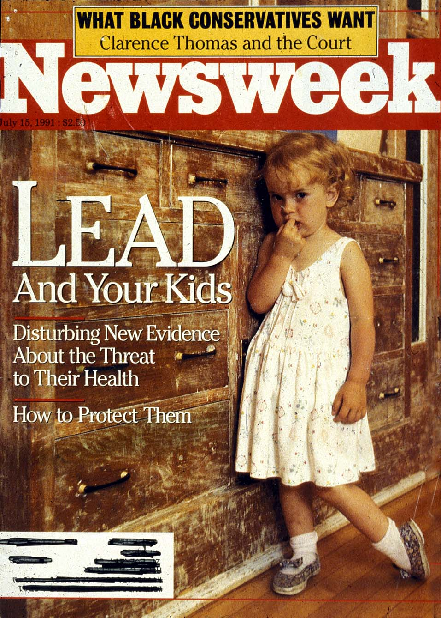
Lead In Homes

Slide 25
Lead History
Lead Makes the Mind Give Way
Greek 2nd BC

Slide 26
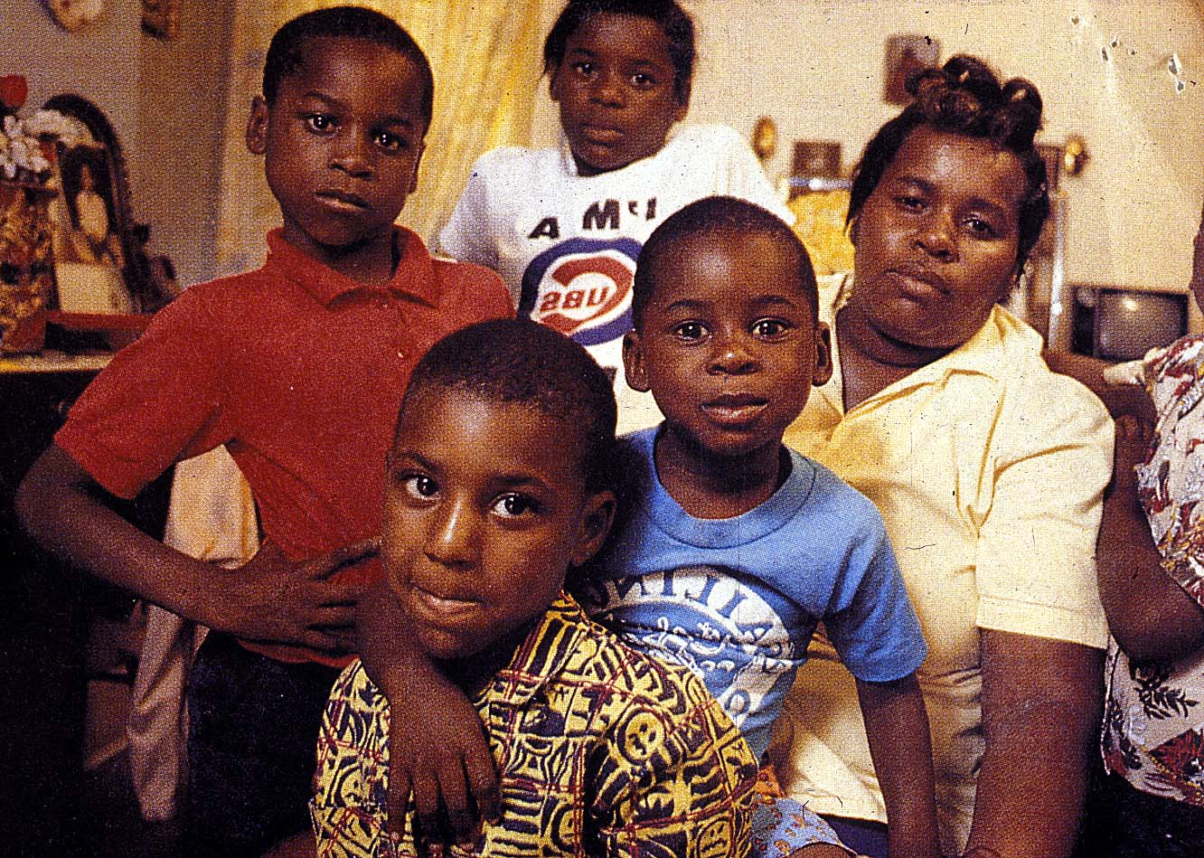
Lead in Families

Slide 27
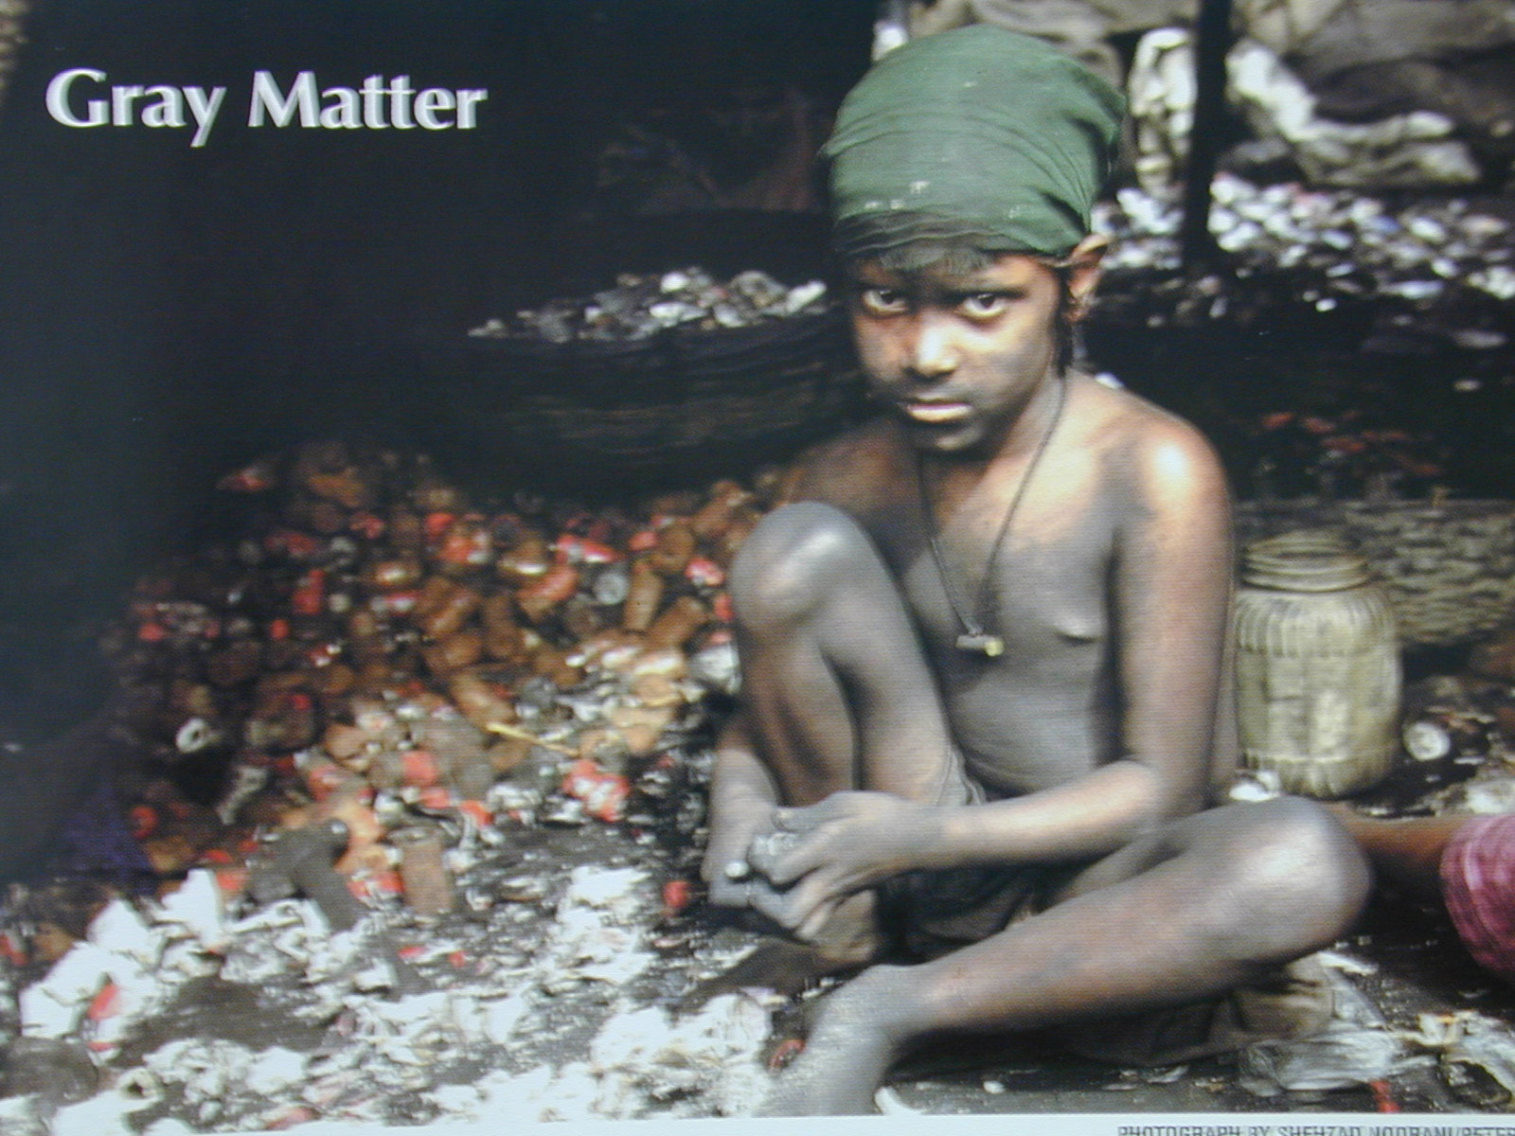
Recycling Lead

Slide 28
Agency Blood Lead Levels

Slide 29
Mercury

Slide 30
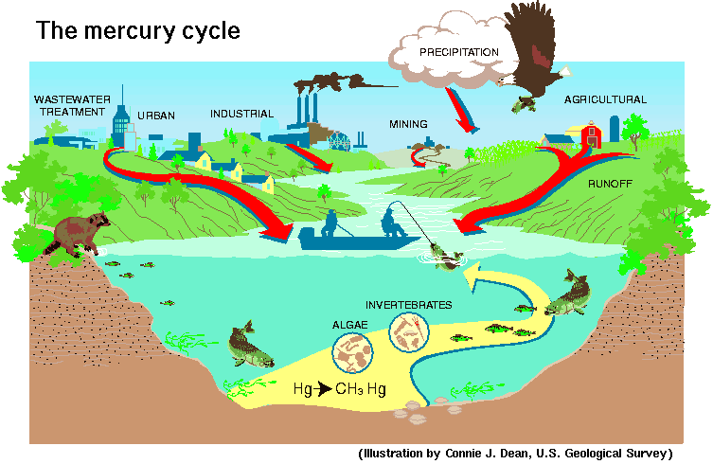
The Mercury Cycle

Slide 31
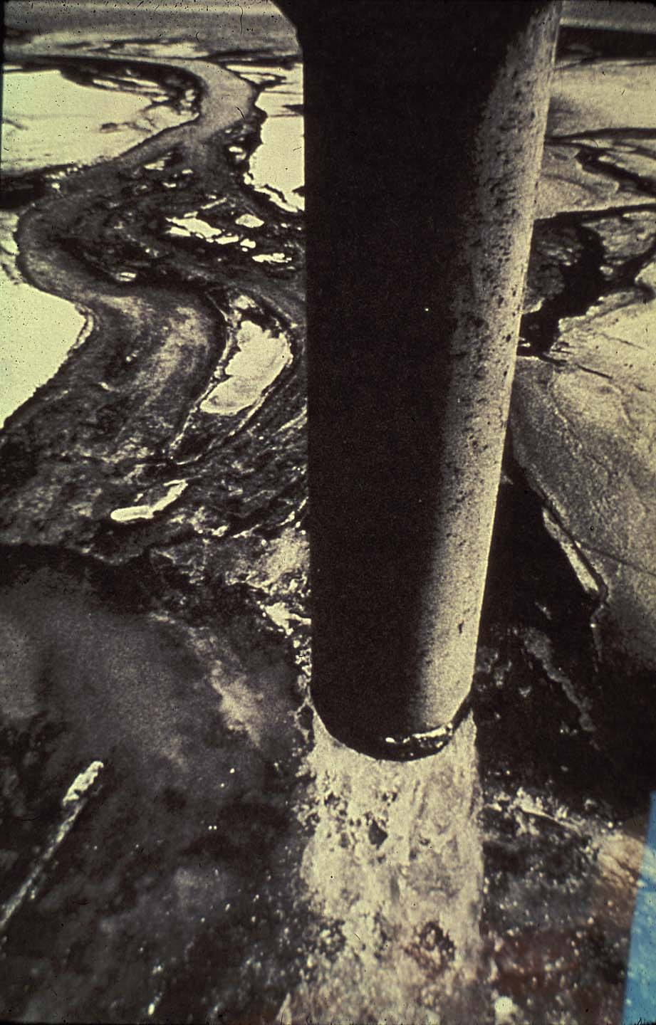
Polluting with HG

Slide 32
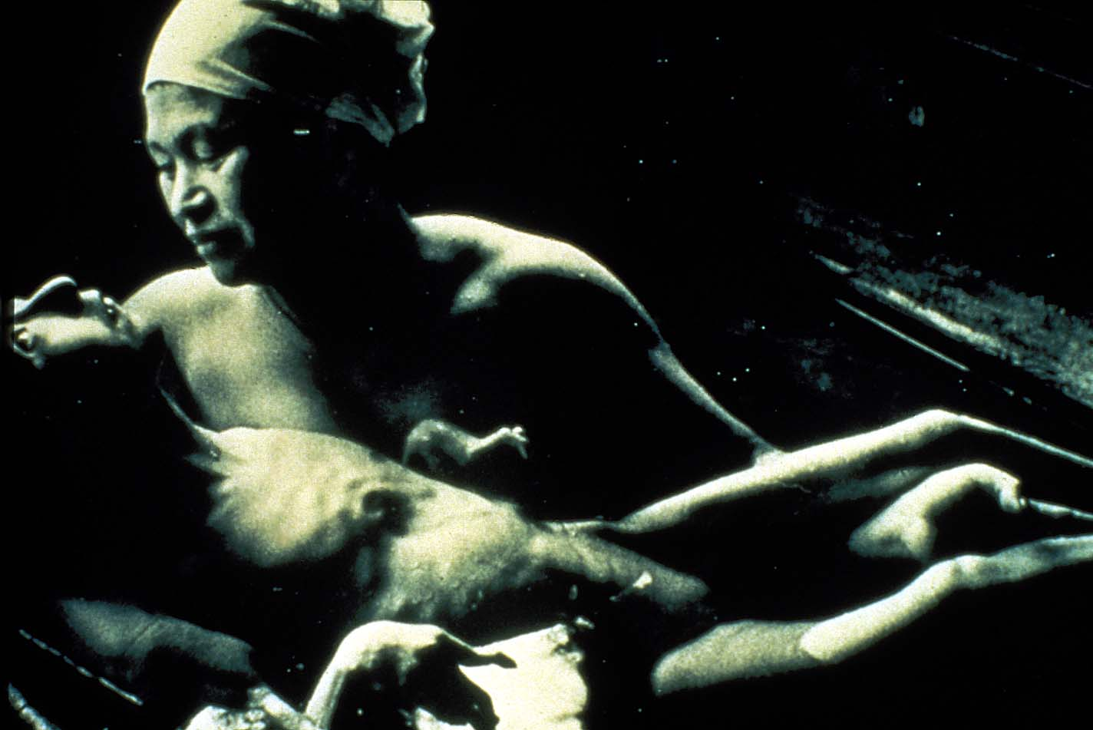
MeHg kid

Slide 33
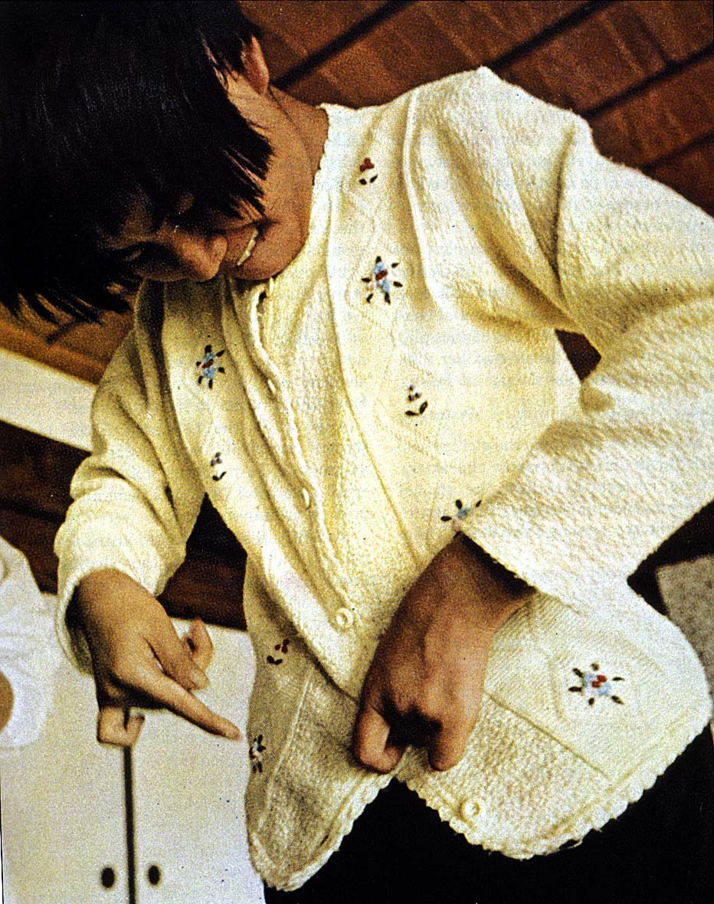
Adult MeHg

Slide 34
Toxicology and Government
FDA – Food and Drug Administration -
(www.fda.gov)
EPA – Environmental Protection Agency-
(www.epa.gov)
OSHA - Occupational Safety and Health Administration – (www.osha.gov)
CDC - Centers for Disease Control and Prevention – (www.cdc.gov)
CPSC - Consumer Product Safety Commission - (www.cpsc.gov)

Slide 35
A Small Dose of Toxicology

Slide 36
Authorship Information
This presentation is supplement to
“A Small Dose of Toxicology”
For Additional Information Contact
Steven G. Gilbert, PhD, DABT
E-mail: sgilbert@innd.org
Web: www.asmalldoseoftoxicology.org

