Slide 1
An Introduction To
Risk Assessment –
Risk Management and Precautionary Principle
A Small Dose of Risk Assessment

Slide 2

A Small Dose of Toxicology 3rd Edition
Free e-book
Healthy World Press
PDF and Power- power slides for each of
29 Chapters
See: www.asmalldoseoftoxicology.org

Slide 3

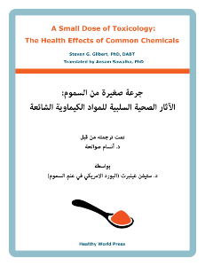

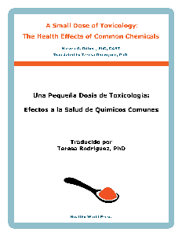
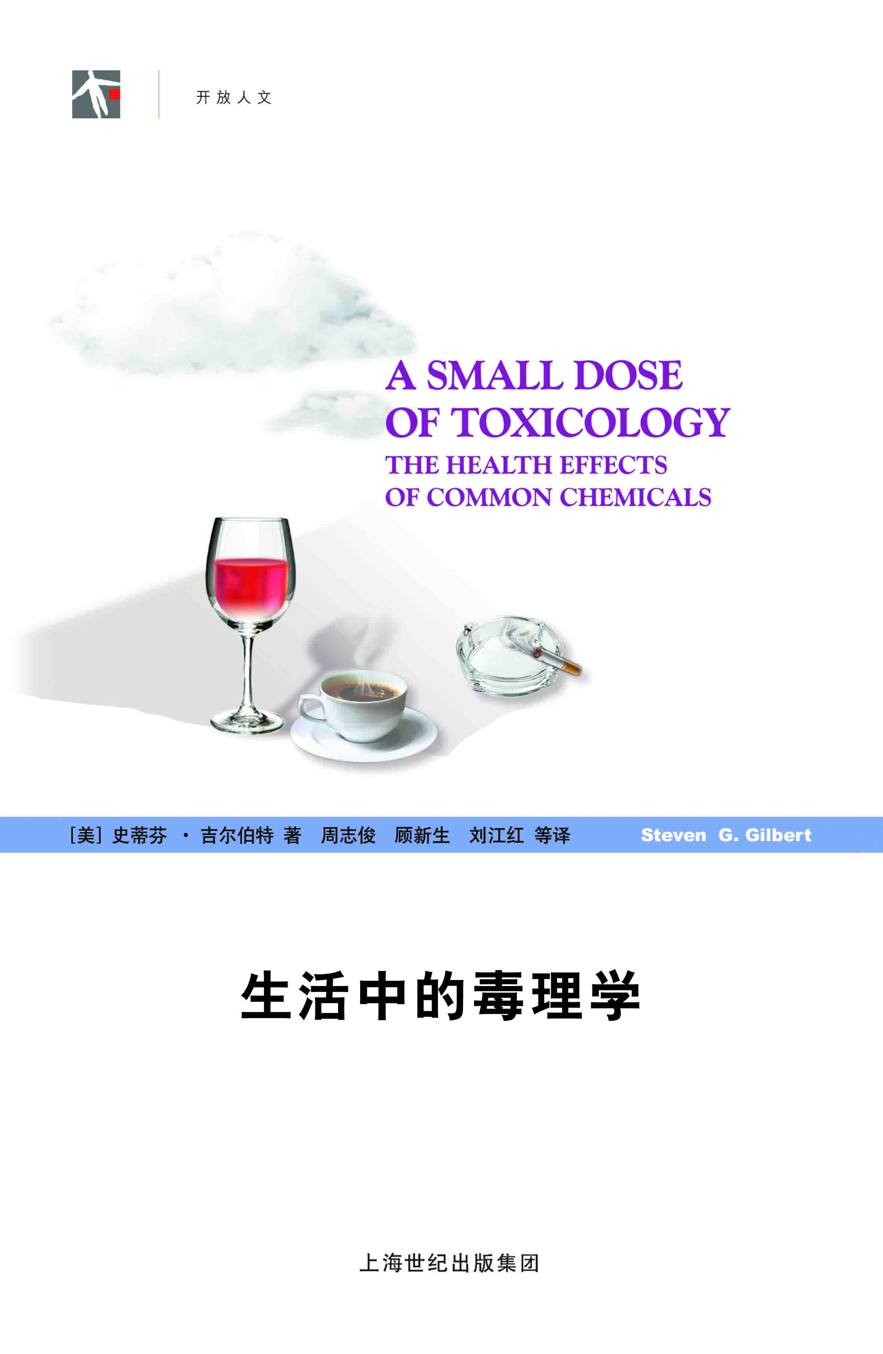
Small Dose of Toxicology
FREE
www.asmalldoseoftoxicology.org
English, Spanish, Arabic, German, Chinese

Slide 4
Decision Making
Risk Assessment and Risk Management in Context of Societal Issues

Slide 5

The First Bioethicist
Aldo Leopold
"A thing is right when it tends to preserve the integrity, stability, and beauty of the biotic community. It is wrong when it tends otherwise." - Aldo Leopold, 1949, A Sand County Almanac
---------- 1887 - 1948 ----------

Slide 6
Risk Assessment
"We should remember that risk assessment data can be like the captured spy: If you torture it long enough, it will tell you anything you want to know."
(William Ruckelshaus -1st administrator of U.S. EPA 1984.)

Slide 7
Managing the Commons
Garrett Hardin
The Tragedy of the Commons (Science, 1968)
Extensions of “The Tragedy of the Commons“ (Science, 1998)
Elinor Ostrom –
Revisiting the Commons: Local Lessons, Global Challenges (Science, 1999)

Slide 8

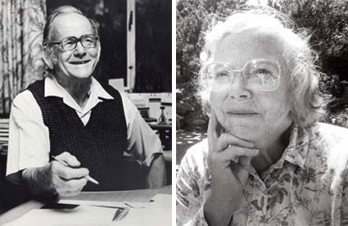
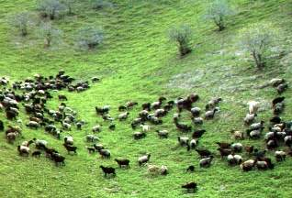
“The Commons”
The Tragedy of the Commons
By Garrett Hardin, Science, 1968

Slide 9
The Tragedy
Cattle
Farmers
Return on Investment
Return for me
Not the commons
Society suffers

Slide 10
No Technical Solutions
“It is our considered professional judgment that this dilemma has no technical solution.”

Slide 11
Problems – Solutions?
Tick-tack-toe
Nuclear disarmament
Bioterrorism
Fish from the sea
Cancer
Lead and kids
Fetal alcohol syndrome
Commons ….

Slide 12
Toxicology Issues / Solutions?
Cancer (soot & benzene ….)
Radiation exposure
Plant and animal toxins
Pesticides
Drugs
Lead and Mercury
Fetal alcohol syndrome
….

Slide 13
Freedom?
What does toxicology say about managing the commons?
Restriction of Freedom?
Responsibility knowing the problem?

Slide 14
Environmental Health
What is the goal of risk management?
“Conditions that ensure that all living things have the best opportunity to reach and maintain their full genetic potential.”
Steven G. Gilbert, 1999

Slide 15
Examples of Risk
Risk Management Examples
Alcohol
Lead
Mercury

Slide 16
Ethyl Alcohol
H
H
H
C
C
OH
H
H

Slide 17
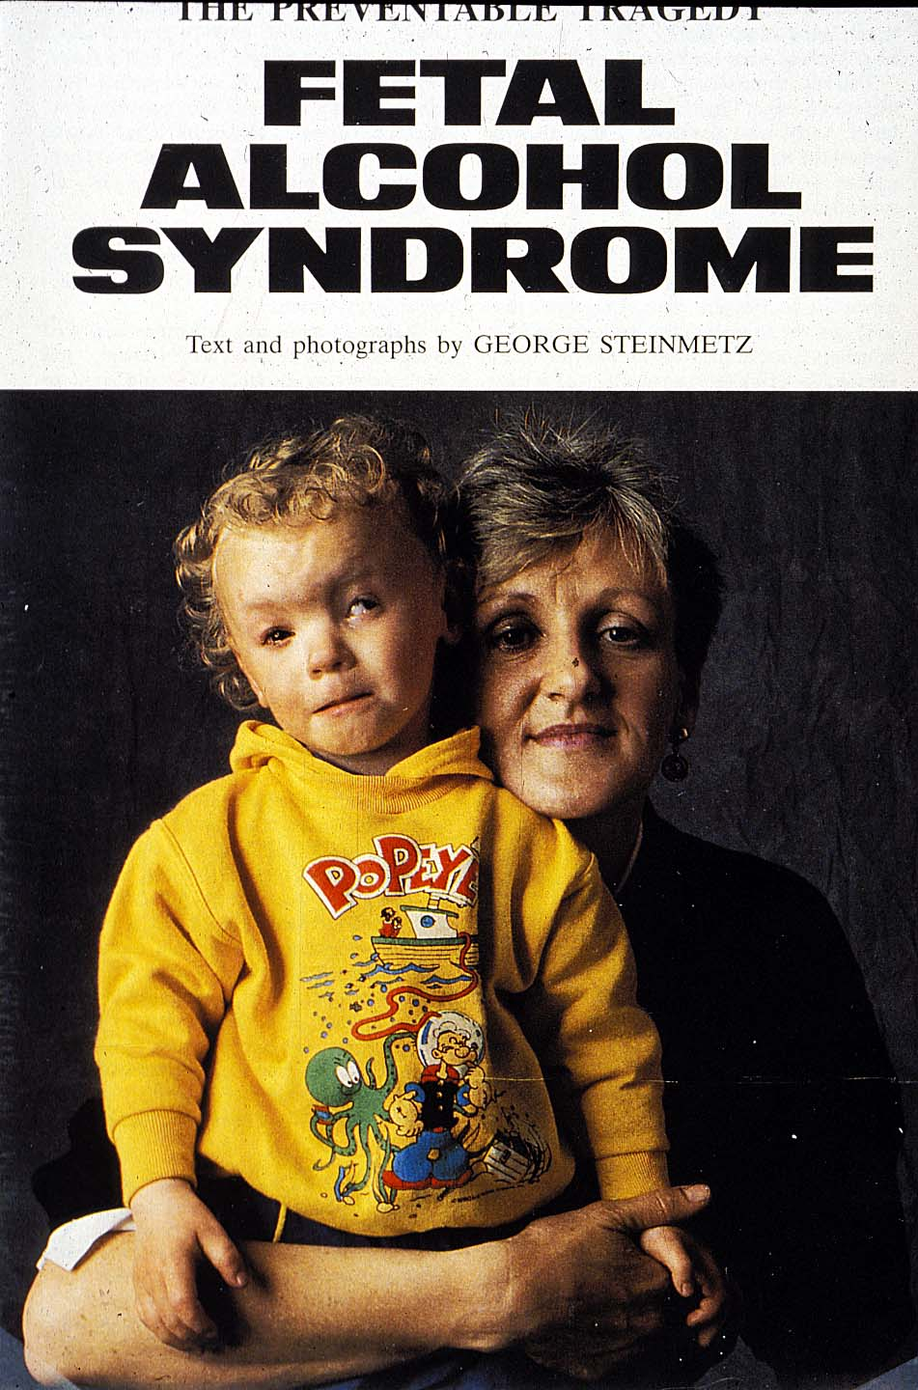
FAS Child

Slide 18
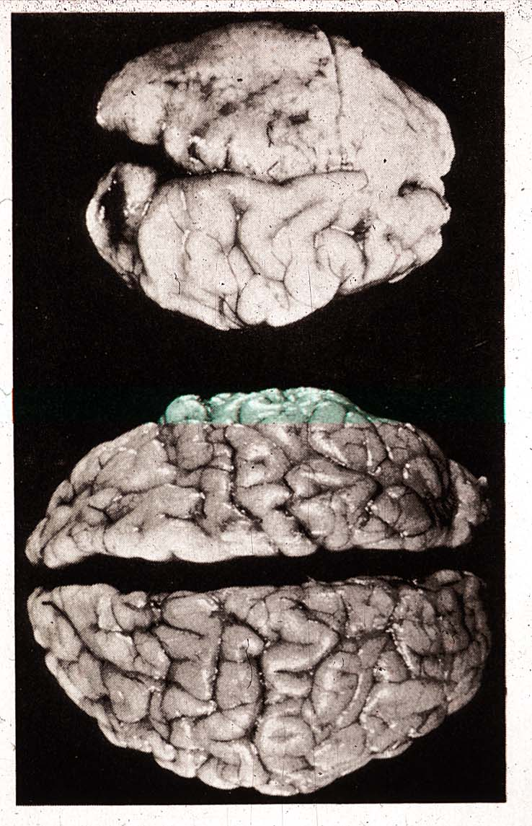
Effects of Prenatal Alcohol

Slide 19
Fetal Alcohol Syndrome (FAS)
1968 - Researchers at the Univ. of Nantes
Early 1970’s FAS – Univ. of Washington
4,000-12,000 infants per year in US
1 to 3 births per 1,000 world wide??
Most common preventable cause of adverse CNS development

Slide 20
Fetal Alcohol Effect (FAE)
Milder form of FAS
7,000-36,000 infants per year in US
World wide?
Characteristics
Growth deficiency
Learning dysfunction
Nervous systems disabilities

Slide 21
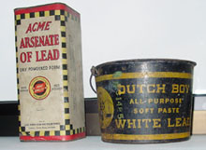
Risking a Small Does of Lead
Pesticide and Paint

Slide 22
Awareness of Lead
6500 BC. - Lead discovered in Turkey
500 BC-300 AD.- Roman lead smelting produces dangerous emissions (wine)
100 BC. - Greek physicians give clinical description of lead poisoning
2 BC "Lead makes the mind give way.“
1920’s - Lead in gasoline, lead in paint

Slide 23
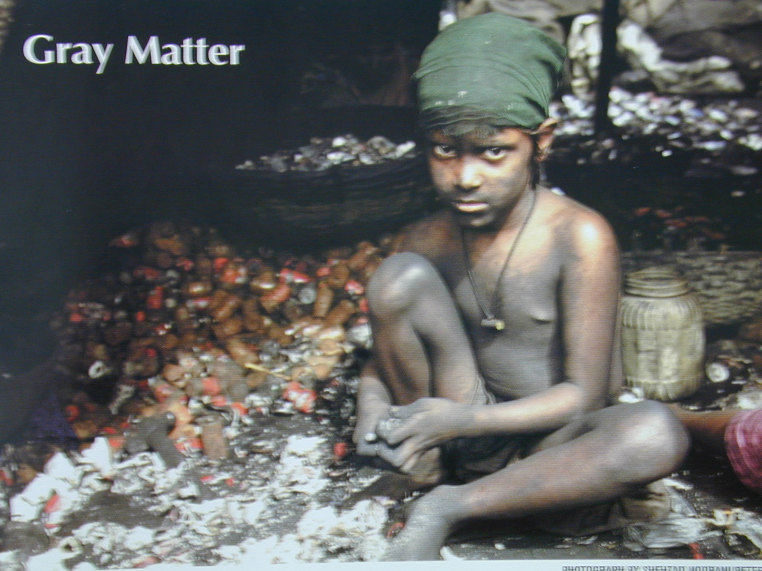
Recycling Lead

Slide 24
What Is This?
Hg
CH₃

Slide 25
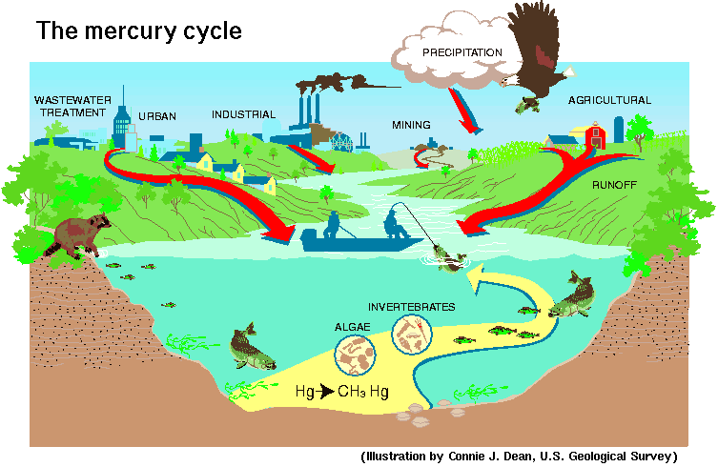
The Mercury Cycle

Slide 26
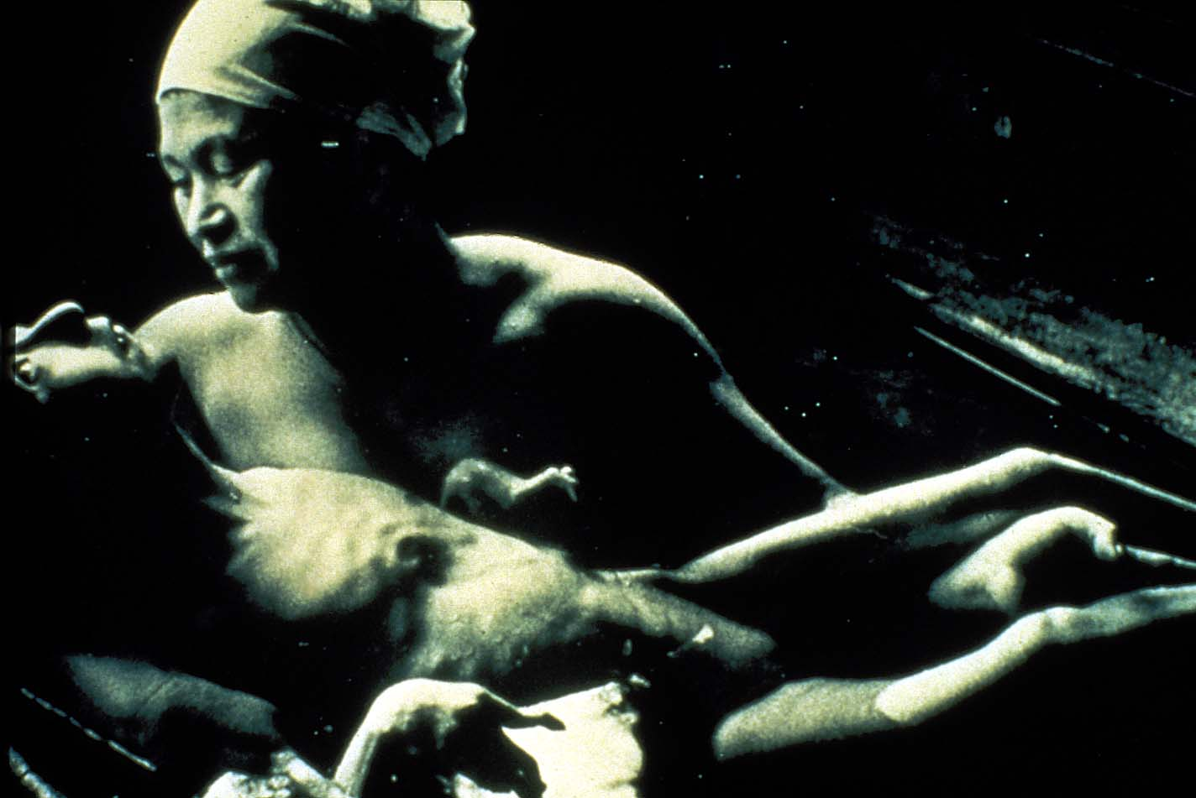
Fetal Effects of MeHg

Slide 27
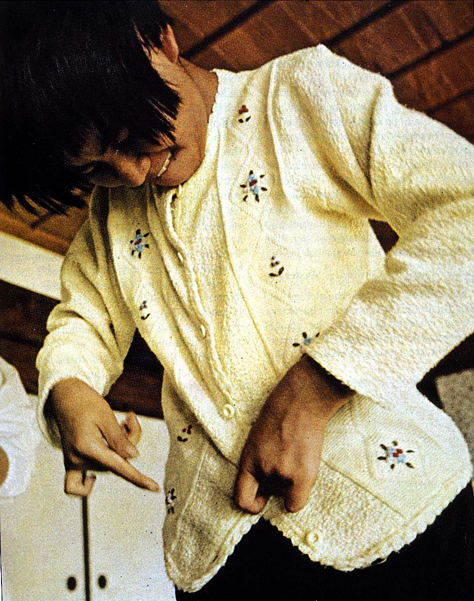
Life-Long Effects of MeHg

Slide 28
Precautionary Principle
"When an activity raises threats of harm to the environment or human health, precautionary measures should be taken even if some cause and effect relationships are not fully established scientifically."
- Wingspread Statement on the Precautionary Principle, Jan. 1998

Slide 29
Key Words of Toxicology
Dose / Response
Hazard X Exposure = Risk
Individual Susceptibility

Slide 30
Early Risk Assessment
“What is food to one man may be fierce poison to others.”
Lucretius (c. 99 B.C.–c. 55 B.C.)

Slide 31
Perspective
"If someone had evaluated the risk of fire right after it was invented, they may well have decided to eat their food raw."
Julian Morris of the Institute of Economic Affairs in London

Slide 32
Perspective
“One death is a tragedy.
A million deaths is a statistic.”
Joseph Stalin

Slide 33
Historical Awareness
1775 – Percivall Pott – Occupational – cancer of scrotum in chimney sweeps
1895 – Bladder cancer in workers in aniline dye industry

Slide 34
Recent Awareness
1938 - Founding of American Conference of Governmental Industrial Hygienists (ACGIH).
1941 - Chemical Substances Committee established to investigate and recommend exposure limits for chemical substances.
Threshold Limit Values (TLVs) for 148 chemicals (exposure limits)

Slide 35
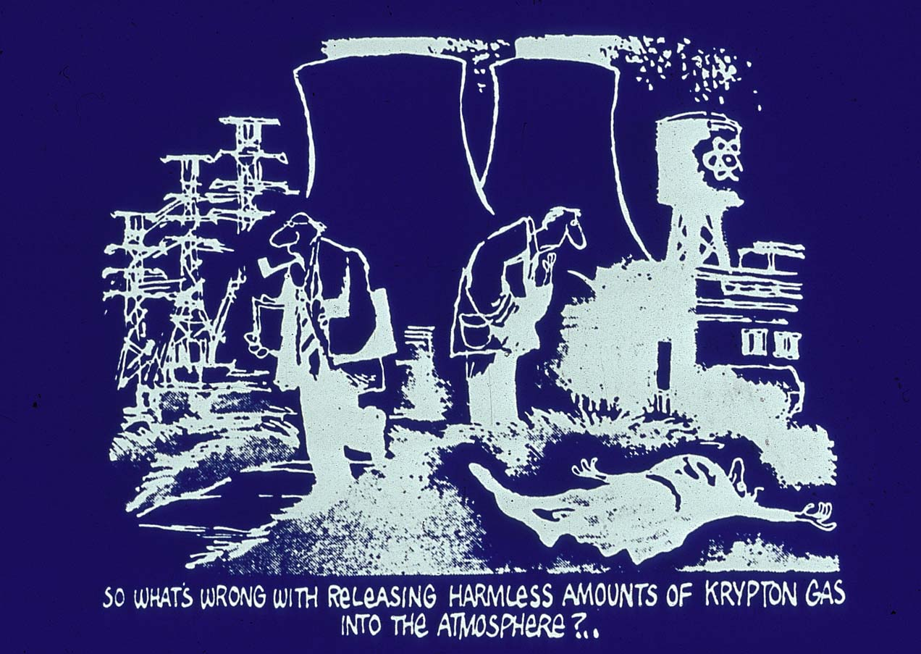
Superman

Slide 36
Risk of What?
Obvious
Death, Cancer, Acid burn, Birth defect, asthma,
Subtle
Decreases in learning and memory (lead), Sensitivity of the individual (child)

Slide 37
Risk Assessment
Process of estimating association between an exposure to a chemical or physical agent and the incidence of some adverse outcome.

Slide 38
Risk Management
Policy developed to deal with hazards identified through risk assessment
Process of evaluating alternative regulatory options and selecting among them

Slide 39
Framework for RA and RM
Epidemiology
Toxicology
In vitro tests
Structure/Activity Analysis
Potency
Exposure
Susceptibility
Information
Regulation
Substitution
Identify hazards
Characterize risks
Control risks

Slide 40
Objective of Risk Assessment
Evaluate the risks
  Environmental contaminant, drugs, pesticides, industrial chemical
Evaluate uncertainty of data
Set target levels of exposure
  Food, air, water, work place
Provide information to agencies
  Regulatory agencies, Manufacturers, Environmental/Consumer Agencies

Slide 41
Steps in Risk Assessment
Hazard Identification
Exposure Assessment
Dose-Response Assessment
Risk Characterization

Slide 42
Hazard Identification
Review human and animal data to determine if a chemical or agent has biological effects

Slide 43
Hazard Identification
Research
  Structure-Activity Analysis
  Short-term Screening Tests
  Animal Bioassays
  Human Epidemiological Data

Slide 44
Structure-Activity Analysis
Does structure resemble that of a known toxic agent?
Computer modeling

Slide 45
Short-term Screening Tests
Cell Culture, Tissue Culture
Does the chemical or agent adversely effects cells?

Slide 46
Animal Bioassays
Animal Studies
Does the chemical or agent causes effect animals?
What is the potentially for human toxicity?

Slide 47
Toxicity Endpoints
Carcinogenicity
Mutations
Altered immune function
Teratogenicity
Altered reproductive function
Neuro-behavioral toxicity
Organ-specific effects
Ecological effects (wildlife, environmental persistence)

Slide 48
Pros and Cons - Animals
Advantages
Monitor progress of toxicity/carcinogenicity
Can directly link with exposure
Can be used to predict human risks
Disadvantages
Can be very expensive (>$1 M)
Can take many years

Slide 49
Human Epidemiological
Human Studies
Does the chemical or agent causes adverse effect in human populations?

Slide 50
Pros and Cons - Humans
Advantages
Yields information in humans
Yields associations relevant to “real world” exposures
Disadvantages
Can be very expensive (large N, many years)
Lack control relative to lab
Many confounding variables

Slide 51
Human Variability
Human Subject Variability
Lifestyle – risk of exposure to ….
Occupation – risk of exposure to ….
Breathing & digestion – uptake of chemicals
Metabolism & kidney function – elimination
Age, gender & disease – susceptibility to toxicity

Slide 52
Examples of Variability
Children spend more time on floor – more hand to mouth behavior than adults
Occupation – exposure to other chemicals
Rate of breathing higher in children than adults
Lung function and susceptibility are altered by smoking or asthma
Disease effects liver function
The overall dose-response behavior is subject to both intra-individual and inter-individual variability.

Slide 53
Uncertainty
Measurements error in experiments
Extrapolation from animal studies to human
Sample sizes for animal and human studies
Selection of endpoint
Intra and inter subject variability

Slide 54
Exposure Assessment
Route of exposure (skin, oral, inhalation)
Amount of exposure (dose)
Duration of exposure
To whom (animals, humans, environment)

Slide 55
Exposure Issues
Home environment
Current events
Workplace
School
Government Decisions (war)
Global and local environment

Slide 56
Dose-Response Assessment
How much exposure to a chemical or agent will cause what effect?

Slide 57
Chemical Potency
Response
ED50
Threshold (NOAEL
Dose

Slide 58
Risk Characterization
Risk = Hazard X Exposure
Hazard (including sensitive populations)
  May require low dose extrapolation
Exposure
  Route of exposure, amount, duration
    dermal, oral, inhalation, injection

Slide 59
Risk Management
Uncertainty
Perception
Comparison
Education
Regulation

Slide 60
Uncertainty
How do you know?
How good is the data?

Slide 61
Use of Uncertainty Factors
Divide Dose by Power of 10
Human variability
Interspecies extrapolation
Children
Subchronic to chronic extrapolation
Absence of a NOAEL
Database uncertainty

Slide 62
Use of Uncertainty Factors
Animal Dose Response Data
NOAEL (No Observed Adverse Effect Level)
Divide by 10
(Account for inadequate animal data)
Divide by 10
(Animal to Human Extrapolation)
Divide by 10
(Human Variability or Individual Sensitivity)
Reference Dose (RfD) Or Acceptable Daily Intake (ADI)

Slide 63
Reducing Uncertainty
Upstanding mechanism of action
Physiologically based pharmacokinetic models (distribution and metabolism)
Sample size

Slide 64
Comparing Risks
By probability
By expected value
By outrage
By exposure
By experts

Slide 65
Annual Risk Of Death In The U.S.
HAZARD RISK PER MILLION
All causes 9,000.0
Motor vehicle accidents 210.0
Work accidents 150.0
Homicides 93.0
Drowning 37.0
Poisoning, Solids/liquids 17.0
Railroads 0.9
Civil aviation 0.8
Bits and stings 0.2
“TO LIVE, IS TO RISK DYING”

Slide 66
Characteristics of Risk
Characteristic Level Examples
Knowledge Little known Food additives
Much known Alcoholic drinks
Newness Old Guns
New Space travel
Voluntariness Not voluntary Crime
Voluntary Rock climbing
Control Not controllable Natural disasters
Controllable Smoking
Dreadedness Little dread Vaccination
Great dread Nerve gas
Catastrophic Not likely Sunbathing
potential Likely War
Equity Distributed Skiing
Undistributed Hazardous dump
Adapted from Kraus and Slovic (1988), Risk Anal., 8: 435.

Slide 67
Risk Perceptions
Unknown
w
Lead
w
Food coloring
w
DNA Research
Knowable
Saccharin
w
Nuclear Power
w
Newness
Lack of scientific knowledge
Exposure is unknown/unknowable
Microwave ovens
w
w
Asbestos
w
Aspirin
Herbicides
w
Pesticides
w
Dread
Little Dread
Dreaded
Catastrophic potential
Involuntariness
Personal risk
Inequity
w
Anesthetics
w
Power Tools
w
Smoking
Alcohol
w
w
Dynamite
w
w
Warfare
Motor vehicles
w
Handguns
Known

Slide 68
Differences in Risk Perception
Rank by Risk Analyst
Rank by non-Risk Analyst
Activity/Agent
Motor Vehicles 1 2
Smoking 2 4
Alcohol 3 6
Handguns 4 3
Surgery 5 10
Motorcycles 6 5
X-rays 7 22
Pesticides 8 9
Electric Power 9 18
Swimming 10 19
Nuclear Power 20 1
Adapted from Slovic et al. (1979), Environ., 21: 14.

Slide 69
Precautionary Principle
"When an activity raises threats of harm to the environment or human health, precautionary measures should be taken even if some cause and effect relationships are not fully established scientifically."
- Wingspread Statement on the Precautionary Principle, Jan. 1998

Slide 70
A Small Dose of Risk Assessment

Slide 71
Authorship Information
This presentation is supplement to
“A Small Dose of Toxicology”
For Additional Information Contact
Steven G. Gilbert, PhD, DABT
Web: www.asmalldoseoftoxicology.org

Slide 72
Case Study
LEAD

Slide 73
Ancient Awareness
"Lead makes the mind give way."
Greek
Dioscerides - 2nd BC

Slide 74
CDC Blood Lead Levels

Slide 75
Lead - Absorption
ORALLY CONSUMED LEAD ABSORBED
CHILDREN – 30-50% OF LEAD
ADULTS – 5-10% OF LEAD
Increased During Pregnancy

Slide 76
Half-life Of Lead
• 25 DAYS -- BLOOD
• 40 DAYS -- SOFT TISSUE
• 20 YEARS -- BONE

Slide 77
Children Vulnerability
CHILDREN are more vulnerable exposure than ADULTS
SIZE
CONSUME MORE FOOD
INHALE MORE AIR
DEVELOPING NERVOUS SYSTEM

Slide 78
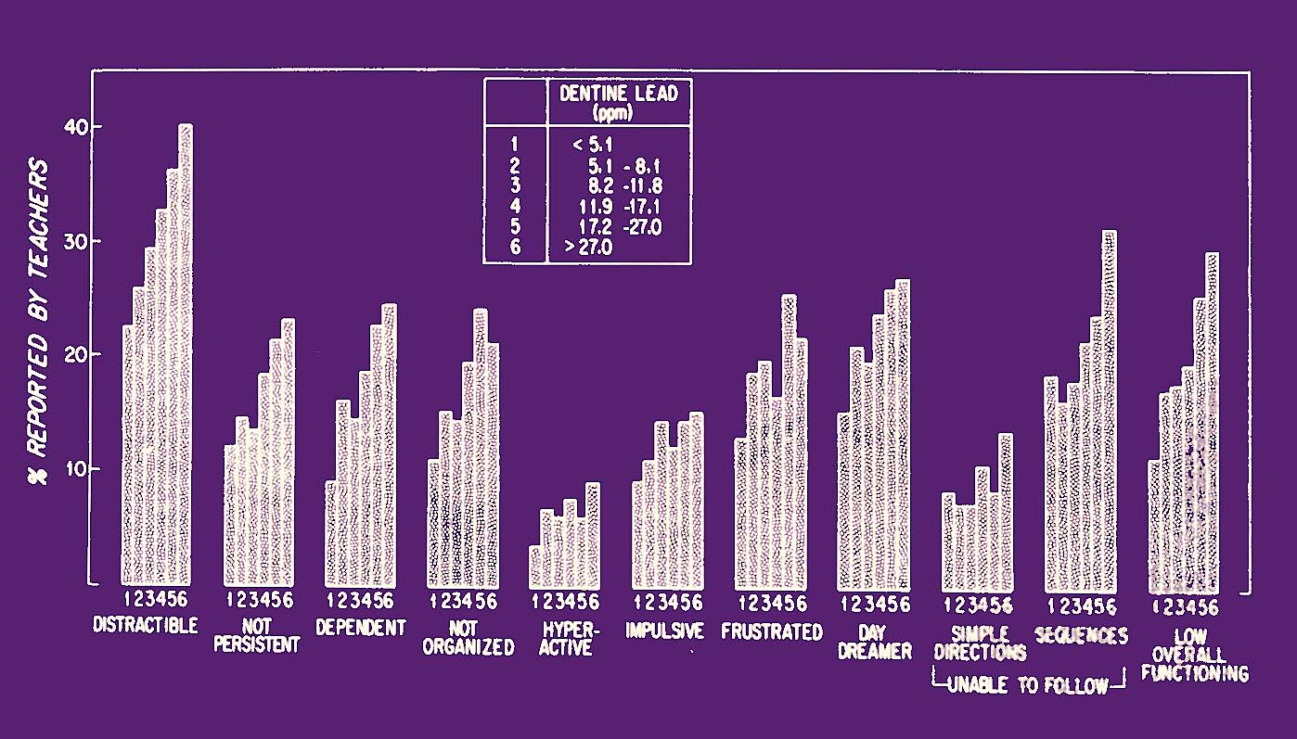
Needleman, NEJM, 1979

Slide 79
Case Study
Mercury

Slide 80

Hg – Like Water

Slide 81
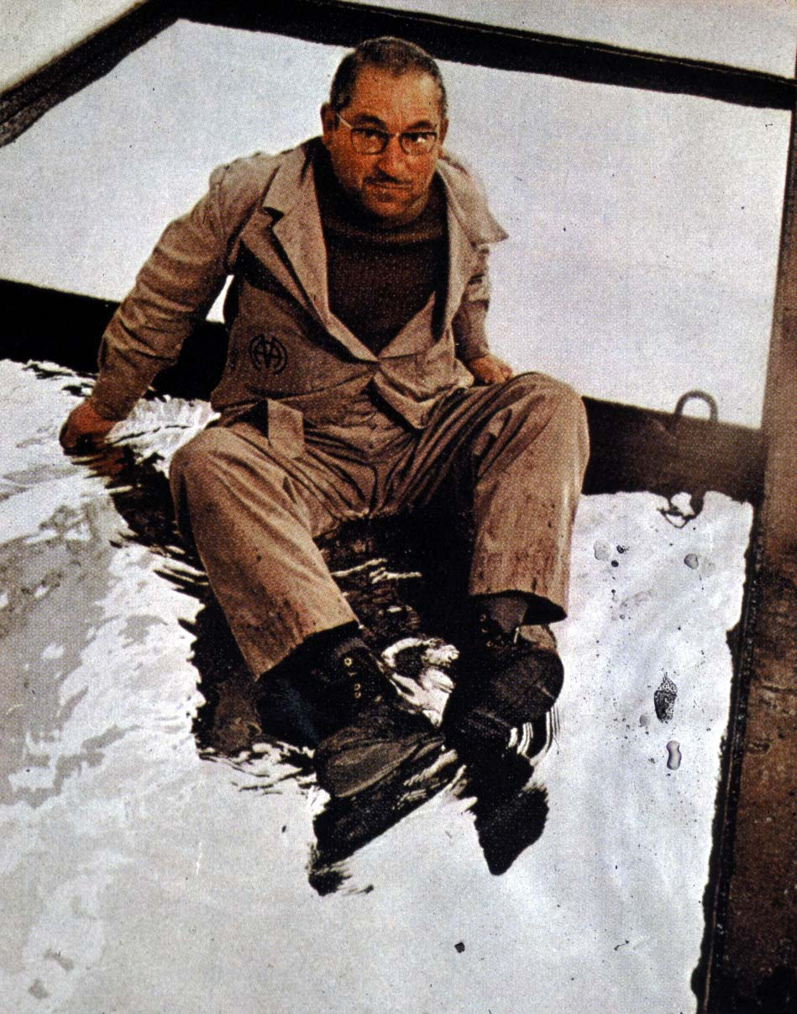
Hg – Solid Enough to Sit On

Slide 82
Outbreaks of MeHg Poisoning
Place | Year | Cases
Minamata | 1953-60 | 1000
Nigata | 1964-65 | 646
Guatemala | 1963-65 | 45
Ghana | 1967 | 144
Pakistan | 1969 | 100
Iraq | 1956 | 100
Iraq | 1960 | 1,002
Iraq | 1971 | 40,000
On-going | 2001 | ???

Slide 83
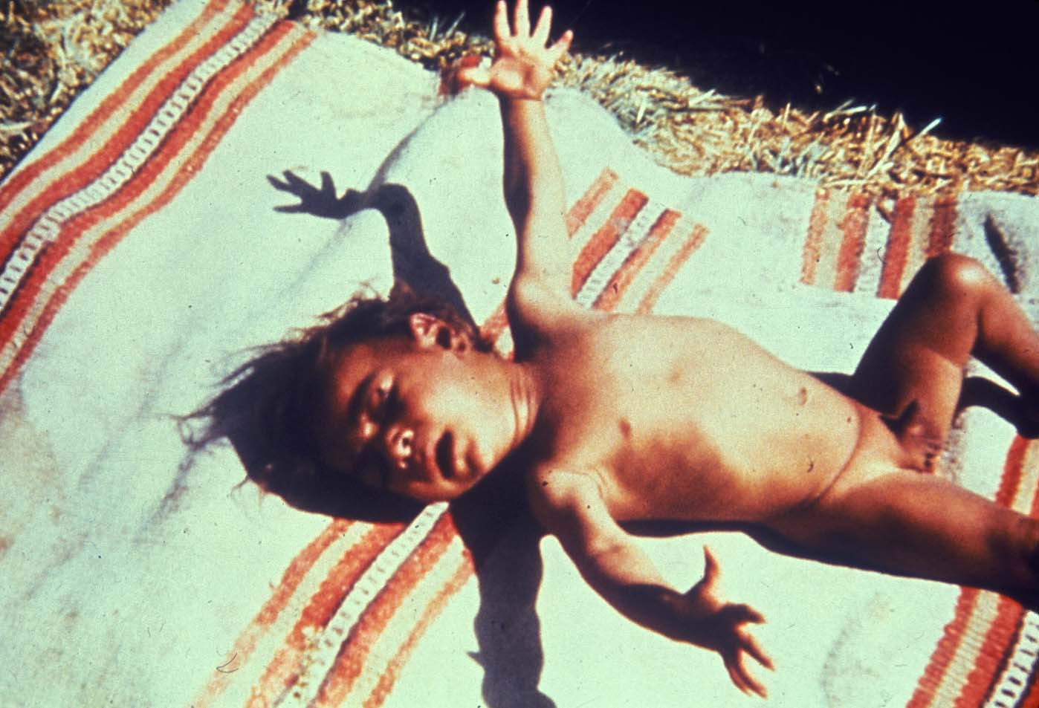
Iraq Infant - Effects of Mercury

Slide 84
Mercury to Methyl Mercury
Inorganic - elemental mercury vapor Hg⁰
Biotransformation
Organic - Methylmercury - CH₃Hg⁺
Bioaccumulation

Slide 85
Mercury Release
50-75% mercury of released in the environment related to human activities

Slide 86
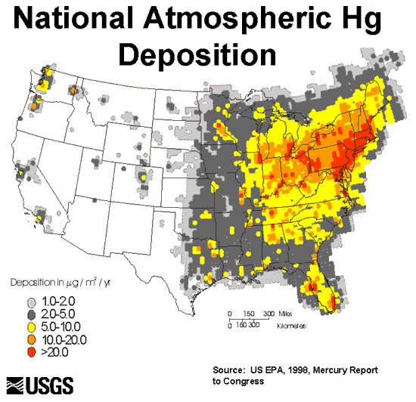
Atmospheric Hg

Slide 87
Biotransformation of Mercury
Inorganic
Mercury
Discharge
Ambient Water
Sediments
Biomethylation
Methyl-Mercury
Bioaccumulation
Edible Fish
Methyl-Mercury
In Humans
Exposure

Slide 88
Neurobehavioral Effects
Blindness - Deafness
Cerebral Palsy - Seizures
Abnormal reflexes & muscle tone
Retarded motor development
Visual and Auditory Deficits
Delayed motor development
Altered DRH performance

Slide 89
Effects On The Brain
Decrease in Brain Size
Cell loss
Disorganization of cells
Cell migration failures

Slide 90
Animal - Risk Assessment
MONKEY - 25 µg/kg - LOAEL
RAT - 10 µg/kg - LOAEL
RAT - 50 µg/kg - replicated

Slide 91
Animal - Risk Assessment
2.5 µg/kg - NOAEL (animals)
0.25 µg/kg - Human
0.025 µg/kg - Sensitive populations
(the rule of dividing by 10)

Slide 92
Human - Risk Assessment
• 10-20 ppm hair - LOAEL •
• 40-80 ppb blood - LOAEL •
• 0.645 µg/kg •
• 0.06 µg/kg - RfD •

Slide 93
Mercury Fishing Advisories
In 2000, 41 States have over 2000 fish consumption advisories
An increase form 27 in 1993
Pregnant women, nursing mothers, women who intend to have children, and children under 15

Slide 94
Recommendations
Reduce environmental release
Restrict global production and sale
Advise women of child bearing age
Research mechanisms of action
Assess neurodegenerative effects

Slide 95
MeHg Consumption Limits
US EPA – 0.1 ug/kg-day
US FDA – 1 ppm (mg/kg) in tuna

Slide 96
Mercury A Global Issue
Mercury distribution and exposure is a global problem

Slide 97
A Small Dose of Risk Assessment

Slide 98
Authorship Information
This presentation is supplement to
“A Small Dose of Toxicology”
For Additional Information Contact
Steven G. Gilbert, PhD, DABT
Web: www.asmalldoseoftoxicology.org

