Slide 1
An Introduction to the History of Toxicology and Lessons Learned
A Small Dose of ToxHistory
Chapter 5 – 3rd Edition
Steven G. Gilbert, PhD, DABT
www.asmalldoseoftoxicology.org

Slide 2
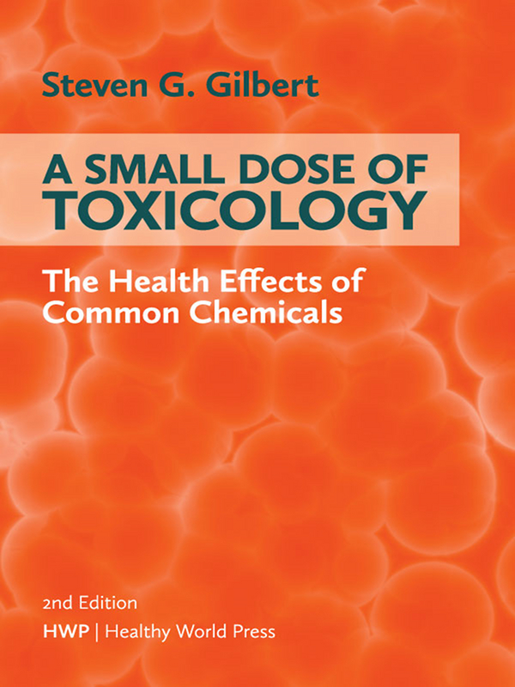
A Small Dose of Toxicology 3rd Edition
Free e-book
Healthy World Press
PDF and Power- power slides for each of
29 Chapters
See: www.asmalldoseoftoxicology.org

Slide 3

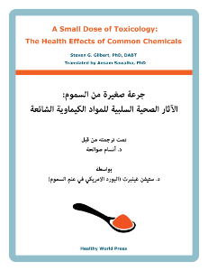
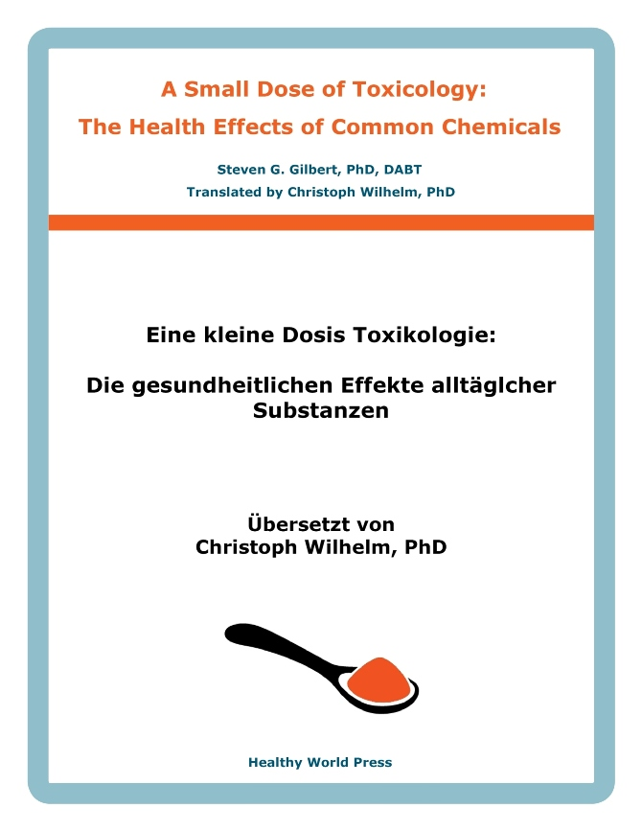
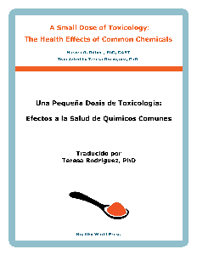
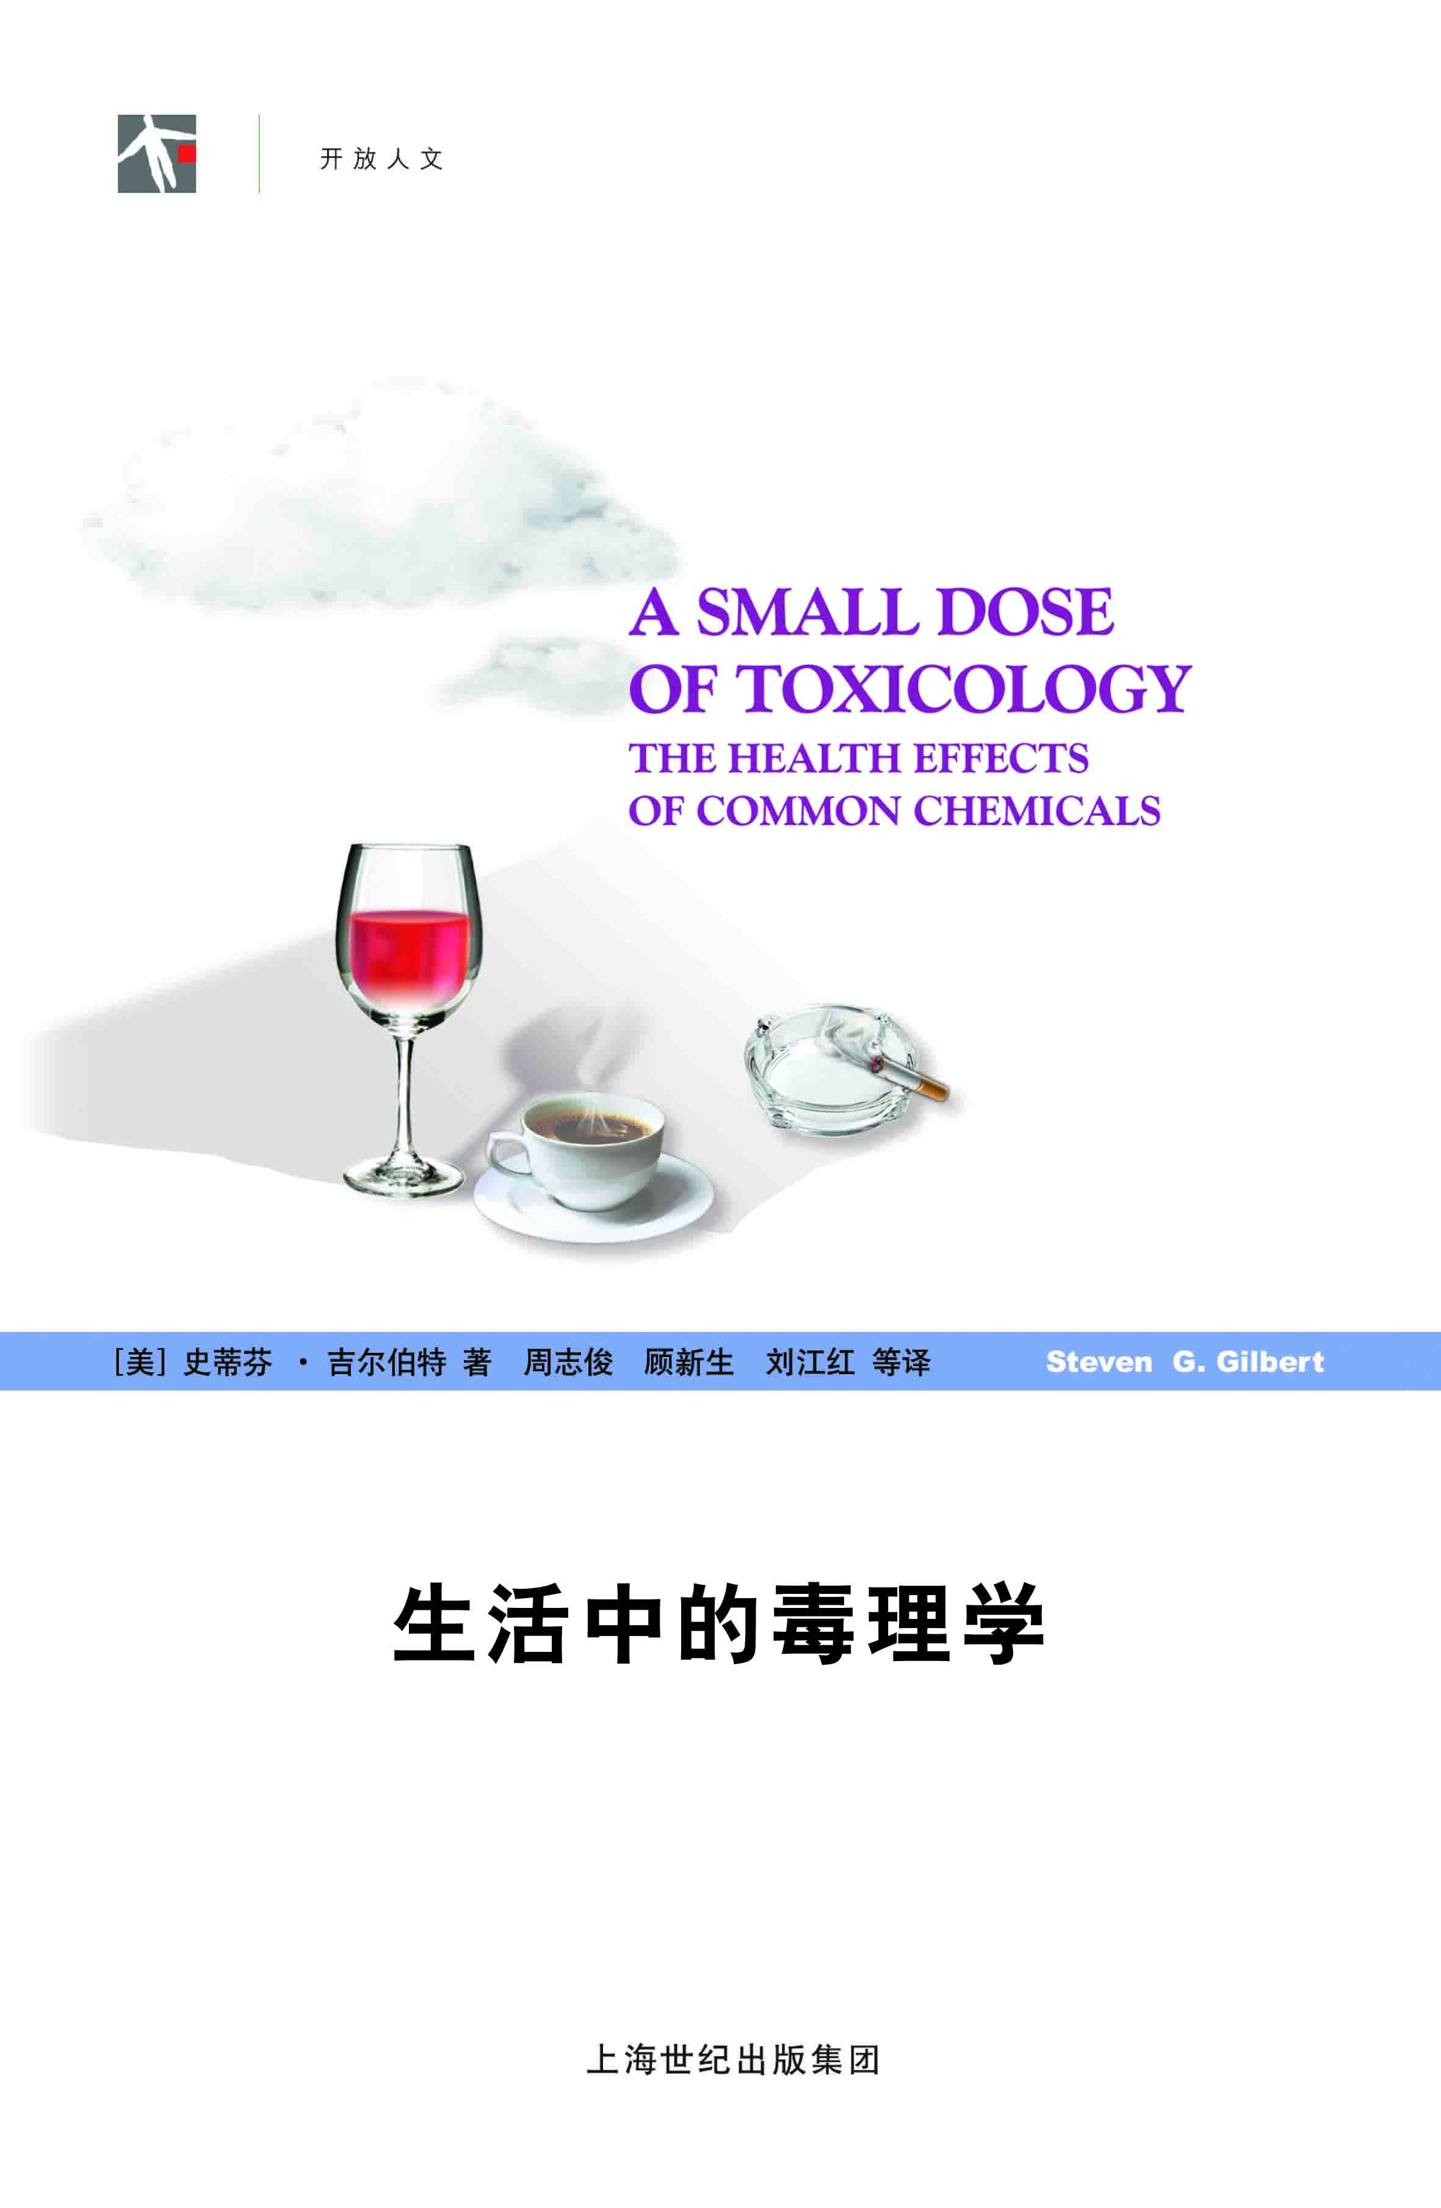
Small Dose of Toxicology
FREE
www.asmalldoseoftoxicology.org
English, Spanish, Arabic, German, Chinese

Slide 4

Inheriting The Future & The Past
Global Warming
Burning Coal
Coal Waste
Mercury from Coal to Fish
Nuclear waste
Chemical body burden
Chemical use
Sustainability
LEAD !! (2017)

Slide 5
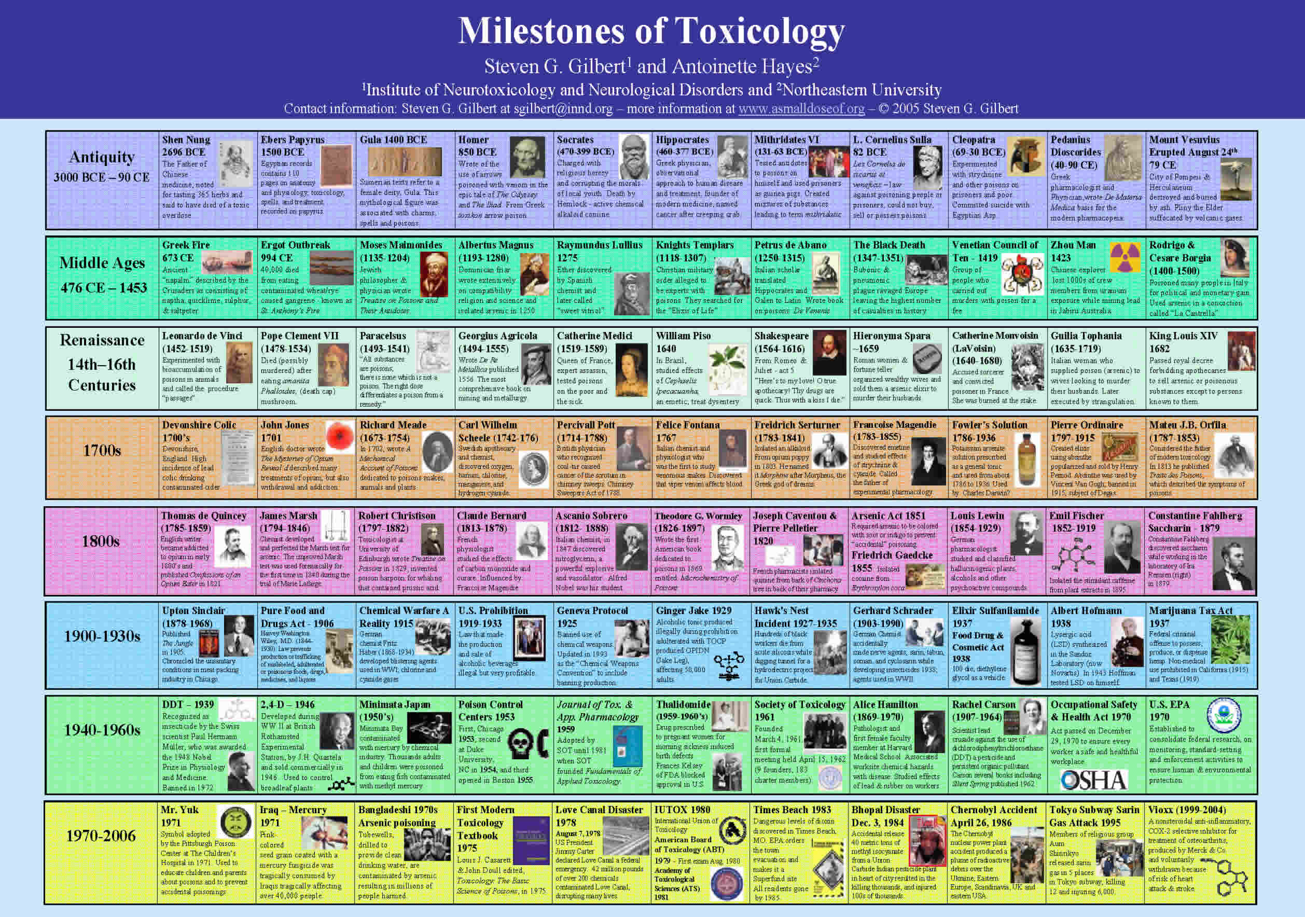
Milestones of Toxicology

Slide 6
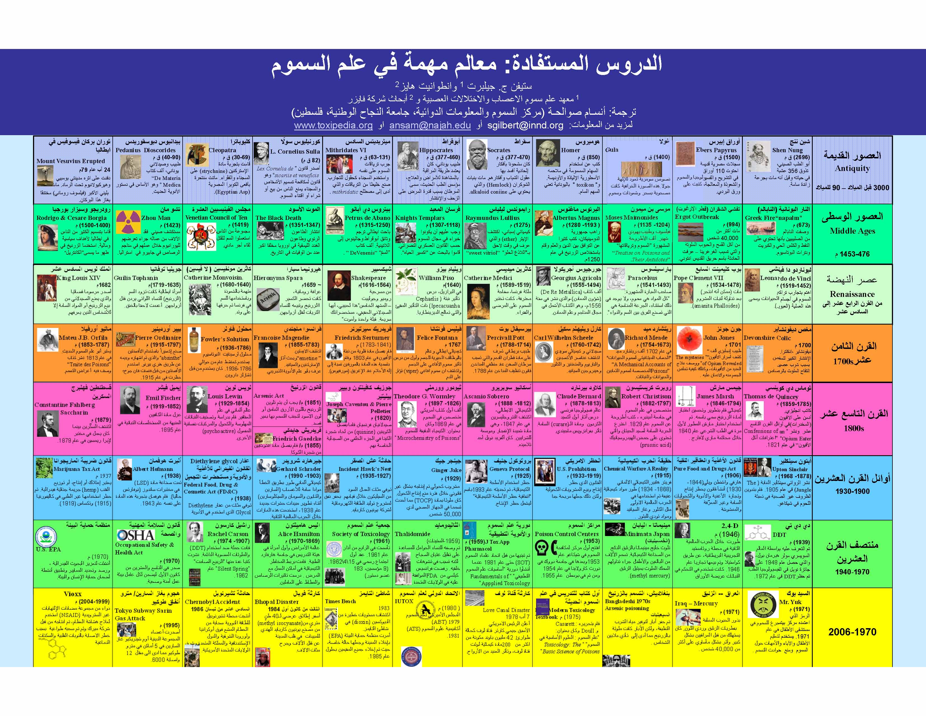
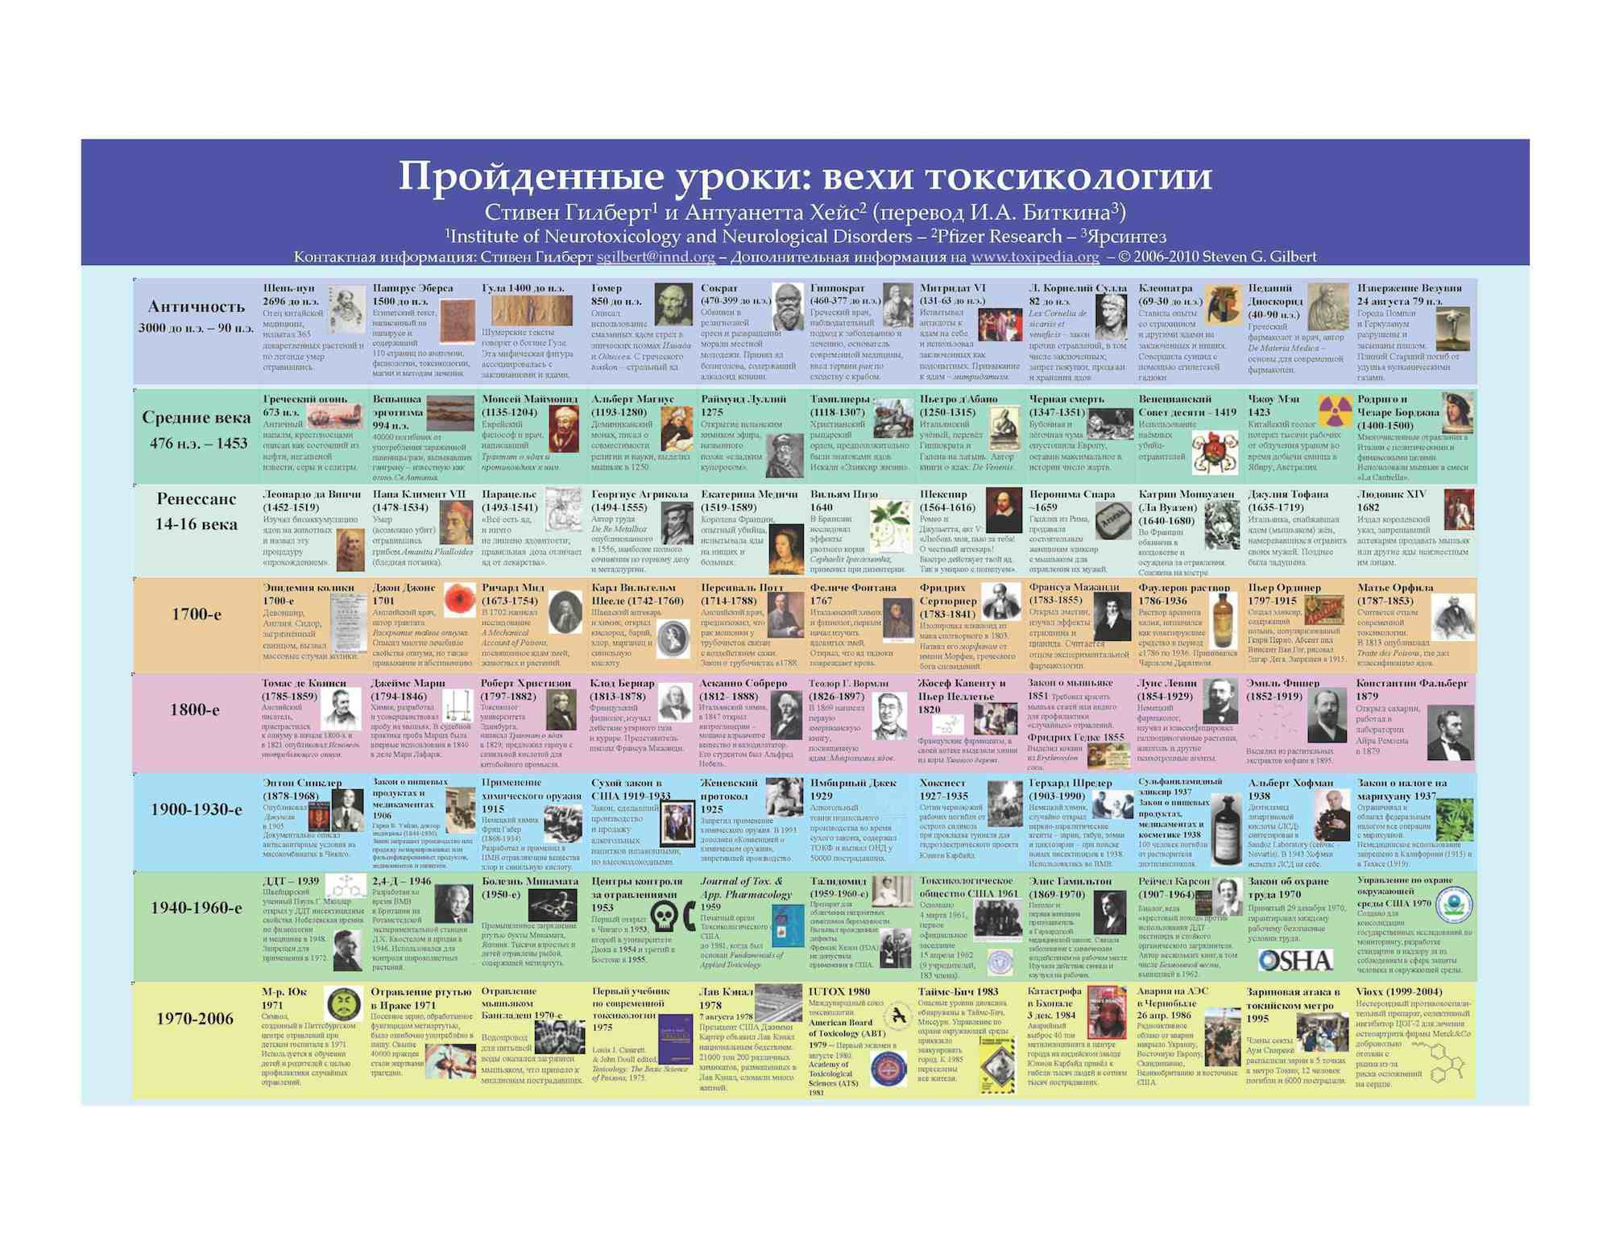
Milestones of Toxicology - Translations
Arabic
Also in:
Amharic
Arabic
Chinese (simple & traditional)
English (clickable)
French
German
Italian
Japanese
Korean
Portuguese
Russian
Spanish (clickable)
Turkish
Vietnamese
Russian

Slide 7
Power To Discover The Truth
“It is not the truth that makes you free. It is your possession of the power to discover the truth. Our dilemma is that we do not know how to provide that power.”
Richard Lewontin
(New York Review of Books, Jan 7, 1997)

Slide 8
Shen Nung - Chinese
the Father of Chinese medicine
Born - (approximately 2695 BCE)
tasted 365 herbs and dying from a toxic overdose
wrote an early treatise On Herbal Medical Experiment Poisons

Slide 9
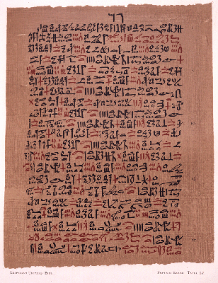
Ebers papyrus - Egyptian
ancient Egyptian record dated from about 1500 BC
110 pages on anatomy physiology, toxicology, spells, and treatment
documents a wide range of toxic substances

Slide 10
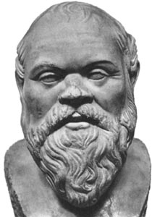
Ancient Awareness
399 BC Death of Socrates by Hemlock
Socrates was charged with religious heresy and corrupting the morals of local youth.
The active chemical used was the alkaloid coniine which, when ingested causes paralysis, convulsions and potentially death.

Slide 11
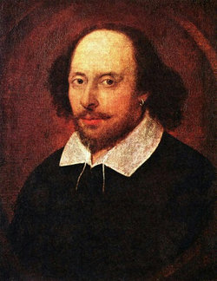
Historical Awareness
From Romeo and Juliet - act 5
Come bitter pilot, now at once run on
The dashing rocks thy seasick weary bark!
Here’s to my love! O true apothecary!
Thy drugs are quick. Thus with a kiss I die.
Shakespeare (1564-1616)

Slide 12
Historical Events
Opium War of 1839-42
Great Britain had a monopoly on the sale of opium and wanted China to increase their purchase. A war was fought over opium sale with England getting control of Hong Kong.
Consider our societies current “wars on drugs”.

Slide 13
Lead - Ancient Awareness
6500 BC. - Lead discovered in Turkey, first mine.
500 BC-300 AD.- Roman lead smelting produces dangerous emissions.
100 BC. - Greek physicians give clinical description of lead poisoning
"Lead makes the mind give way.” Greek Pedanius Dioscerides - 2nd BC

Slide 14
Mithridates VI (131-63 BCE)
Mithridates VI, who was the King of Pontus in Asia Minor 120 BCE to 63 BCE, took increasing concentrations of various poisons in an effort to protect himself from poisoning attacks. Legend has it that Mithridates attempted suicide by poison but failed and ultimately died by the sword.

Slide 15
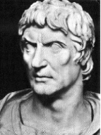
Sulla (138-78 BCE)
Some of the first laws related to toxicology were directed at poisons. Sulla (138-78 BCE) created laws such as the Lex Cornelia de sicariis et veneficis, which made it illegal to poison people, including prisoners, as well as making it illegal to buy, sell, or purchase poisons.

Slide 16
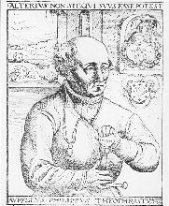
Paracelsus (1493-1541)
As scientific methodology advanced, the toxicological sciences became more rigorous. Paracelsus, sometimes called the "father" of toxicology, articulated the now famous saying that “the dose makes the poison”.

Slide 17
Percivall Pott (1714-1788)
The first association of an occupational exposure to cancer was made in 1775 by Percival Pott, an English surgeon. He observed that exposure to soot was related to scrotal cancer in chimney sweeps.

Slide 18
Alice Hamilton, MD (1869-1970)
Alice Hamilton - Pathologist and first female faculty member at Harvard
Medical School. Associated worksite chemical hazards with disease. Studied effects of lead & rubber on workers

Slide 19

Rachel Carson (1907-1964)
Rachel Carson
Scientist, lead crusade against the use of dichlorodiphenyltrichloroethane (DDT) a pesticide and persistent organic pollutant. Carson several books including Silent Spring published 1962.

Slide 20
Milestones of Toxicology
Find many more examples from the below poster.

Slide 21
Milestones of Toxicology

Slide 22
A Small Dose of Toxicology

Slide 23
Authorship Information
This presentation is supplement to
“A Small Dose of Toxicology”
For Additional Information Contact
Steven G. Gilbert, PhD, DABT
E-mail: sgilbert@innd.org
Web: www.asmalldoseoftoxicology.org

