Slide 1
An Introduction To The Health Effects of Pesticides
A Small Dose of Pesticide

Slide 2
Definition - Simple
The function of a pesticide is to kill or harm some form of life.

Slide 3
Definition - EPA
“…a pesticide is any substance or mixture of substances intended for preventing, destroying, repelling, or mitigating any pest.”
“…a pest is any harmful, destructive, or troublesome animal, plant or microorganism.”
US Environmental Protection Agency (EPA)

Slide 4
Definition - FIFRA
“… any substance or mixture of substances intended for preventing, destroying, repelling or mitigating any insects, rodents, nematodes, fungi, or weeds or any other form of life declared to be pests. … and any substance or mixture of substances intended for use as a plant regulator, defoliant or desiccant.”
Federal Insecticide, Fungicide, and Rodenticide Act (FIFRA – 1947)

Slide 5
Ancient Awareness
History records many examples of plagues and efforts to control them
1000 BC China Sulfur used as a fumigant to kill bacteria and fungus
Sulfur is widely used to day, e.g. protecting wine barrels and in wine.

Slide 6
Historical Awareness
1690 – Nicotine - water extracted from tobacco leaves sprayed on plants as insecticide
1700’s – Strychnine – extracted from plant used to kill rodents
1800’s – Arsenic trioxide – weed killer
1800’s – Rotenone – extracted from plants as insecticide
1800’s – Pyrethrum – extracted from chrysanthemum as insecticide
1900’s – lead arsenate – orchard insecticide

Slide 7
Historical Events
1930’s – “ginger jake paralysis” – during prohibition, alcoholic Jamaican ginger
1962 – “Silent Spring” by Rachel Carson exposed the hazards of DDT
1975 – Works made ill from Kepone manufacture in Hopewell, Virginia

Slide 8
Chlordane
“Chlordane America’s leading lawn and garden insecticide. Used extensively by pest control operators for termite control, because of its long lasting effectiveness.”
Velsicol Chemical Corporation – Advertisement – 1959
U.S. EPA lists chlordane as a persistent bioaccumulative toxic. In 1978, EPA cancelled use of chlordane on food crops and 1988 all use was banned.

Slide 9
What Is This?
H
Cl
C
Cl
CCl₃

Slide 10
DDT
H
Cl
C
Cl
CCl₃
Organochlorine insecticide
1945 control of mosquitoes
Effective but very persistent
Very soluble in fat
Damaged bird eggs

Slide 11
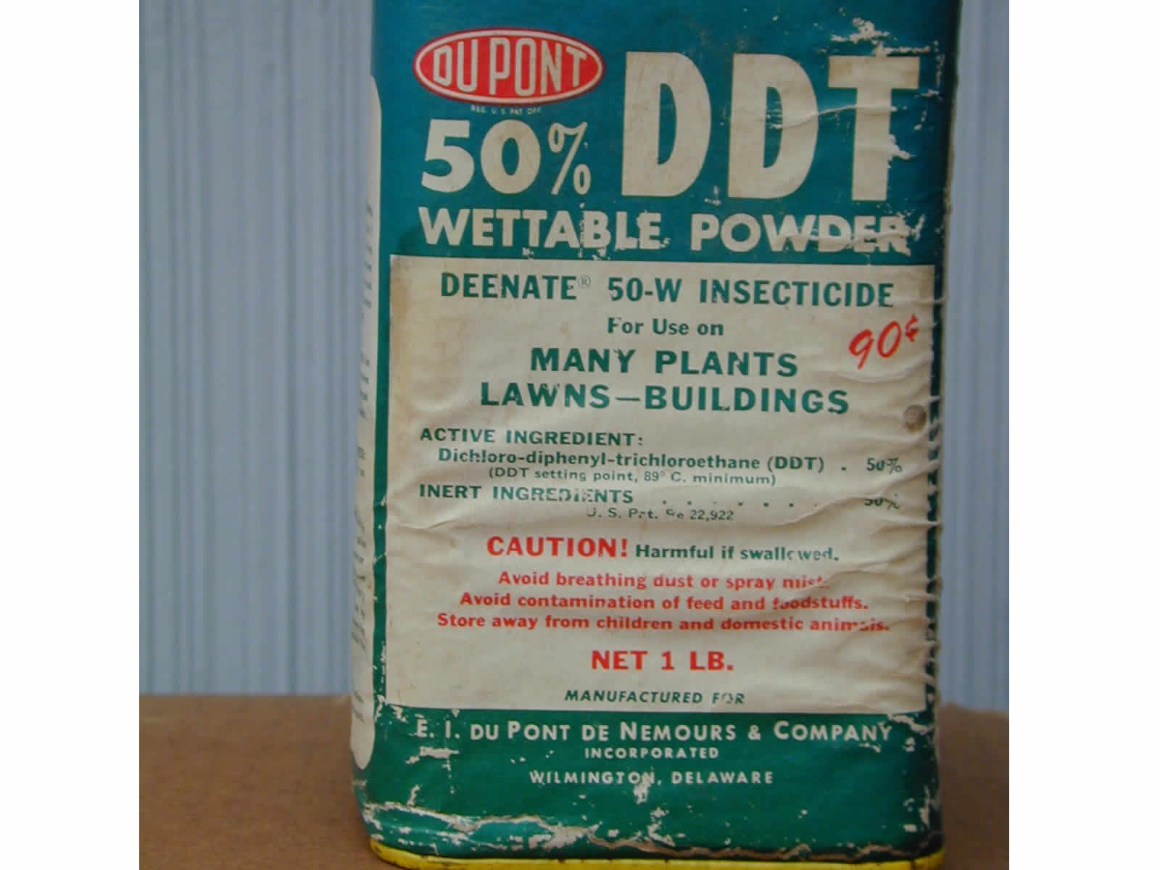
DDT Container

Slide 12
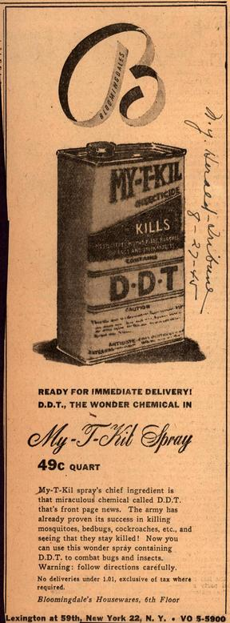
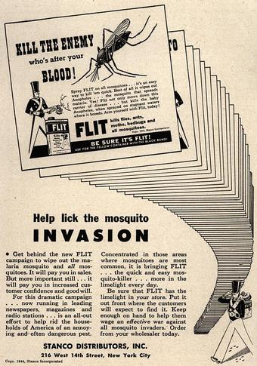
DDT Advertisement

Slide 13
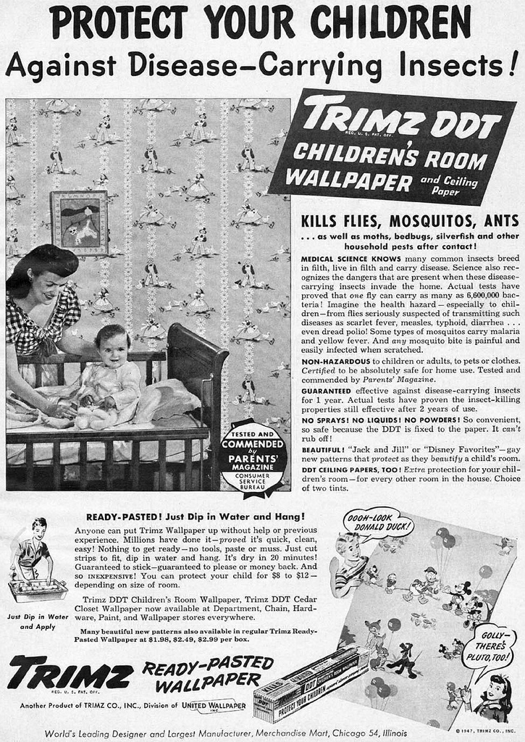
DDT Advertisement

Slide 14
Use in the US and Globally
How many pounds of pesticide are use each year in the US? In the world?
How many dollars is this?

Slide 15
US Total - 1997
Billions of
Type
Pounds
Percent
Conventional Pesticides
0.97
21
Other pesticides chemicals
0.26
6
Subtotal (Agriculture Based)
1.23
27
Wood preservatives
0.66
14
Specialty biocides
0.27
6
Chlorine/hypochlorites
2.46
53
Grand Total
4.63
100
Chlorine/hypochlorites: water disinfectants
Source: EPA OPP, 1997

Slide 16
US & World Use - 1997
Agriculture Based Pesticides
Volume of Active Ingredient (Millions & Billions of Pounds)
 | U.S. Market |  |  | World Market
Pesticide Class | (M lb.) | (%) |  | (B lb.) | (%)
Herbicides | 531 | 47% |  | 2.01 | 39%
Insecticides | 93 | 8% |  | 0.89 | 17%
Fungicides | 70 | 6% |  | 0.52 | 10%
Other¹ | 439 | 39% |  | 1.71 | 33%
Total | 1,133 | 100% |  | 5.13 | 100%
¹Other - Dose not cover industrial wood preservatives, specialty biocides and chlorine/hypochlorites
Source: EPA OPP, 2007 - http://www.epa.gov/pesticides/pestsales/07pestsales/table_of_contents2007.htm

Slide 17
US & World Use - 2007
Agriculture Based Pesticides
User Expenditures (Billions of Dollars)
 | U.S. Market |  |  | World Market
Pesticide Class | ($ B) | (%) |  | ($ B) | (%)
Herbicides | $5.86 | 47% |  | $15.51 | 40%
Insecticides | $4.34 | 35% |  | $11.16 | 28%
Fungicides | $1.38 | 11% |  | $9.22 | 23%
Other¹ | $0.89 | 7% |  | $3.56 | 9%
Total | $12.47 | 100% |  | $39.45 | 100%
¹Other - Dose not cover industrial wood preservatives, specialty biocides and chlorine/hypochlorites
Source: EPA OPP, 2007 - http://www.epa.gov/pesticides/pestsales/07pestsales/table_of_contents2007.htm

Slide 18
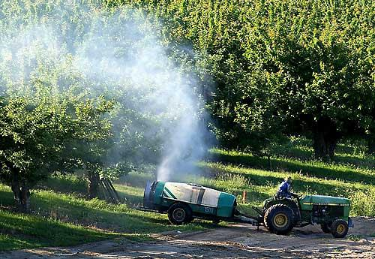
Pesticide Application

Slide 19
Problems
Bioaccumulate – example DDT, PCB
35,000 or more commercial products that use pesticides
Many pesticides are neurotoxic (affect the nervous system)
Many kill desirable insects or plants
Contaminate streams and lakes

Slide 20
Absorption
Ingestion
Inhalation (lung)
Skin (dermal)

Slide 21
Home Exposure
Accidental ingestion
Lawn and garden use
Insect control
Food supply
Water supply

Slide 22
Occupational Exposure
Farms & Farm worker
Pesticide applicator
Manufacture
Mixing and handling
Landscapers
Many more ……

Slide 23
Other Exposure
Dietary exposure
  Pesticide residues on crops
Community exposure
  Airborne drift from commercial app
Contaminated drinking water
  Leaching from soils to ground water

Slide 24
Classes Of Pesticides
Insecticides (kill insects)
  Organochlorines
  Organophosphates
  Carbamates
  Synthetic Pyrethroids
Herbicides (kill plants)
Rodenticides (kill rodents)
Fungicides (kill fungus)
Fumigants (kill whatever)

Slide 25
Insecticides
Insecticides (kill insects)
  Organochlorines
  Organophosphates
  Carbamates
  Synthetic Pyrethroids

Slide 26
Mechanism of Action
Oganochlorines & Pyrethroids
- Enzymes, axonal membranes
(Na⁺, K⁺, Ca⁺⁺, Cl⁻)
Organophosphates &
Carbamates
- excess acetylcholine

Slide 27
Organochlorines
Examples
  DDT, methoxychlor, aldrin, dieldrin, endrin, heptachlor, kepone, lindane, chlordane
Toxicity
  Acute toxicity variable, CNS – convulsions, coma
Environmental characteristics
  Highly persistent in environment, fat soluble, bioaccumulation, biomagnification
  Mostly banned in US and Europe

Slide 28
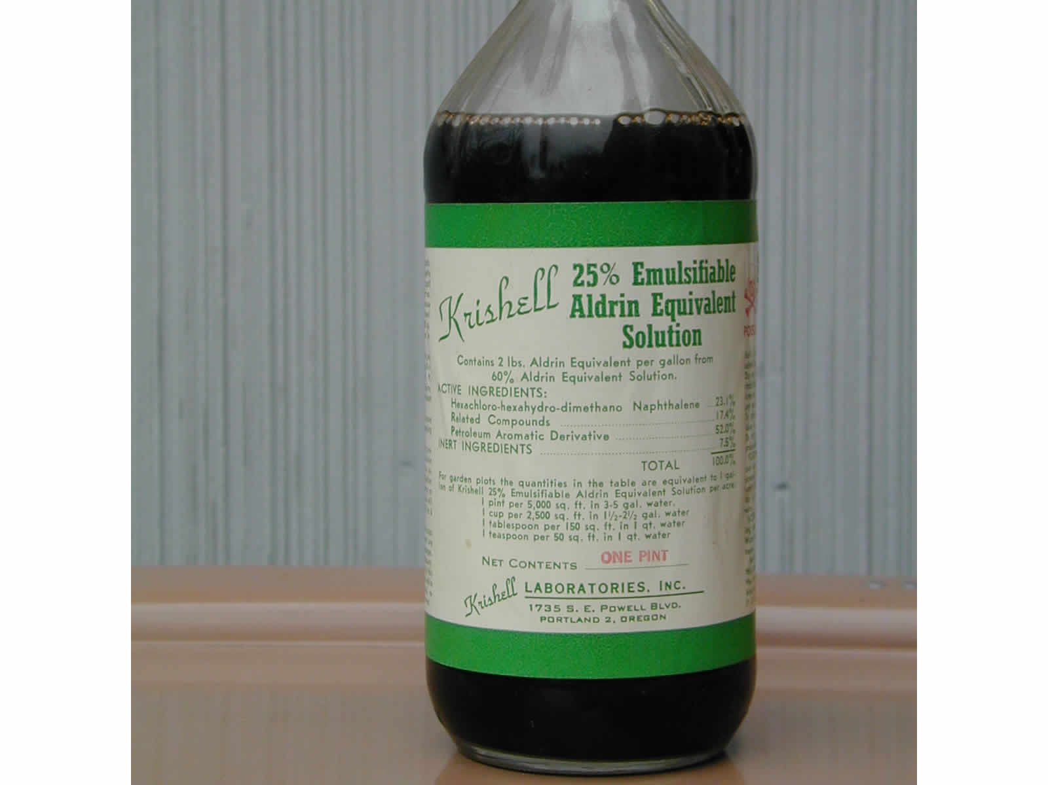
Aldrin Bottle

Slide 29
Organophosphates-1
Examples
  Malathion, parathion, guthion, diazinon, TPN, TOCP, nerve gases – tabun, sarin, soman, VX
Toxicity
  Acute toxicity highly variable – Parathion, TPN, sarin very toxic, malathion much less
Environmental characteristics
  Rapidly degrade in outdoor environment (last longer in doors), do not bioaccumulate

Slide 30
Organophosphates-2
Mechanism of toxicity
  Inhibition of acetylcholinesterase (AchE) in nerve tissue
Symptoms
  Over-stimulation of parasympathetic nervous system --- salivation, constricted pupils, diarrhea, sweating, muscle twitching, CNS disturbances – coma and death
Treatment
  Reverse AchE inhibition effects – use Atropine to block Ach receptors or AchE inhibiton with 2-PAM

Slide 31
Organophosphates-3
Other Toxic Effects
  Delayed peripheral neuropathy (TOCP)
  Not a carcinogen or teratogen
  Possible long term neurological consequences from repeated exposures

Slide 32
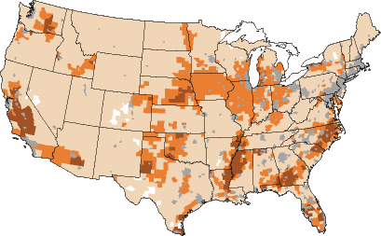
Organophosphates Map
Organophosphorus pesticide occurrence and distribution in surface and ground water of the United States, 1992-97
http://ga.water.usgs.gov/publications/abstracts/ofr00-187.html

Slide 33
Carbamates
Examples
  Sevin (carbaryl), Baygon (propoxur), Temik (aldicarb)
Toxicity
  Aldicarb very toxic, others less toxic
Mechanism and signs of toxicity
  Similar to organophosphates
Environmental characteristics
  Not persistent in environment

Slide 34
Pyrethroids
Synthetic Pyrethroids
  Based on naturally occurring pyrethrums – from chrysanthemum flowers
  Discovered by Chinese in 100 AD
  First commercial use in 1800’s
  First synthetic pyrethroids in 1980
  Relatively low animal toxicity
  Effects movement of cellular Na⁺ (sodium)
  Use Growing rapidly

Slide 35
Herbicides (Kill Plants)
Silvex, 2,4-D, D,4,5-T
    Most widely used
    Possible carcinogen
    Once contaminated with TCDD (dioxin)
Paraquat & diquat
    Serious toxicity following accumulation in lungs – production of oxygen “free radicals” – often fatal once started
Atrazine
    Inhibits photosynthesis, used on corn
    76 million lbs per year, hazardous to frogs

Slide 36
Herbicides 2,4-D
Cl
O
=
Cl
O
CH₂
C
OH
One of the most widely used herbicides

Slide 37
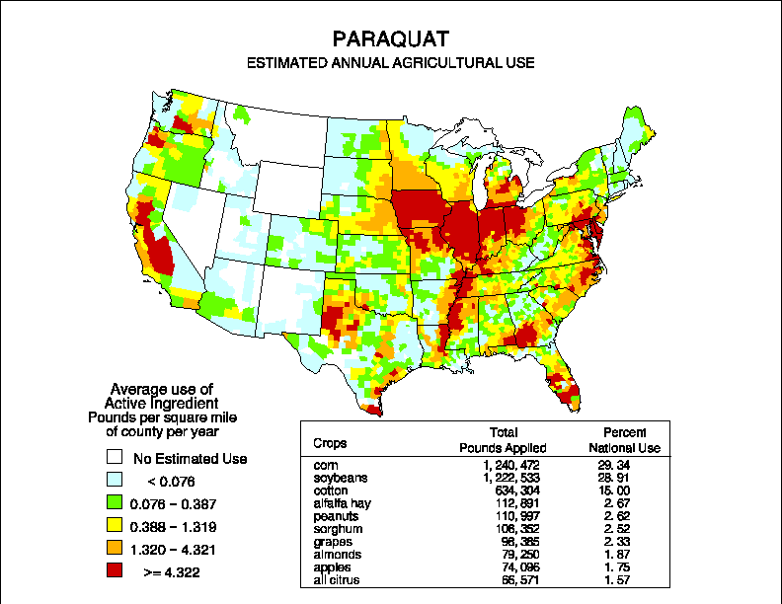
Paraquat Use
http://ca.water.usgs.gov/pnsp/use92/pquat.html

Slide 38
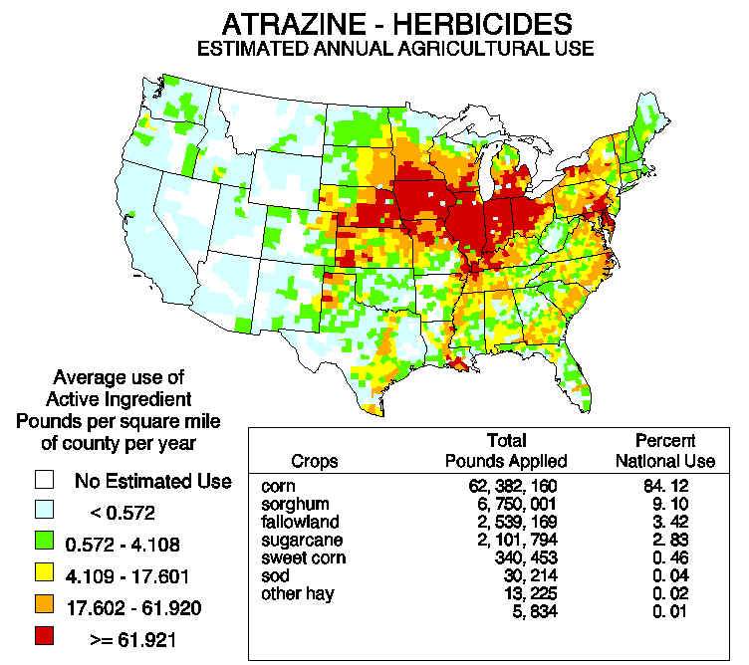
Atrazine Use

Slide 39
Rodenticides (kill rodents)
Botanicals
    Red squill – effects heart
    Strychnine – blocks glycine receptors in spinal cord - convulsions
Inorganics
    Phosphorous – GI track
    Thallium – hair loss, nervous system
    Zinc phosphide – GI track
Anticoagulants
    Warfarin – inhibits blood clotting
    Vacor – newer blood clot inhibitors

Slide 40
Fungicides (kill fungi/mold)
Early Examples
  Sulfur, cooper sulfate
  Mercury based compounds
Hexachlorobenzene
Pentachlorophenol
Dithiocarbamates

Slide 41
Regulatory Status
1947 Federal Insecticide, Fungicide, and Rodenticide Act (FIFRA)
Food and Drug Administration
1972 – EPA takes over FIFRA – expanded registration and safety requirements
1996 – Food Quality Protection Act

Slide 42
Integrated Pest Management (IPM)
Focus – long-term prevention of pest problems
Reduce or eliminate chemical pest control methods
Monitor for the presence of pests before treating
Nonchemical strategies (make habitat less attractive, physical controls)
Learn about your pests

Slide 43
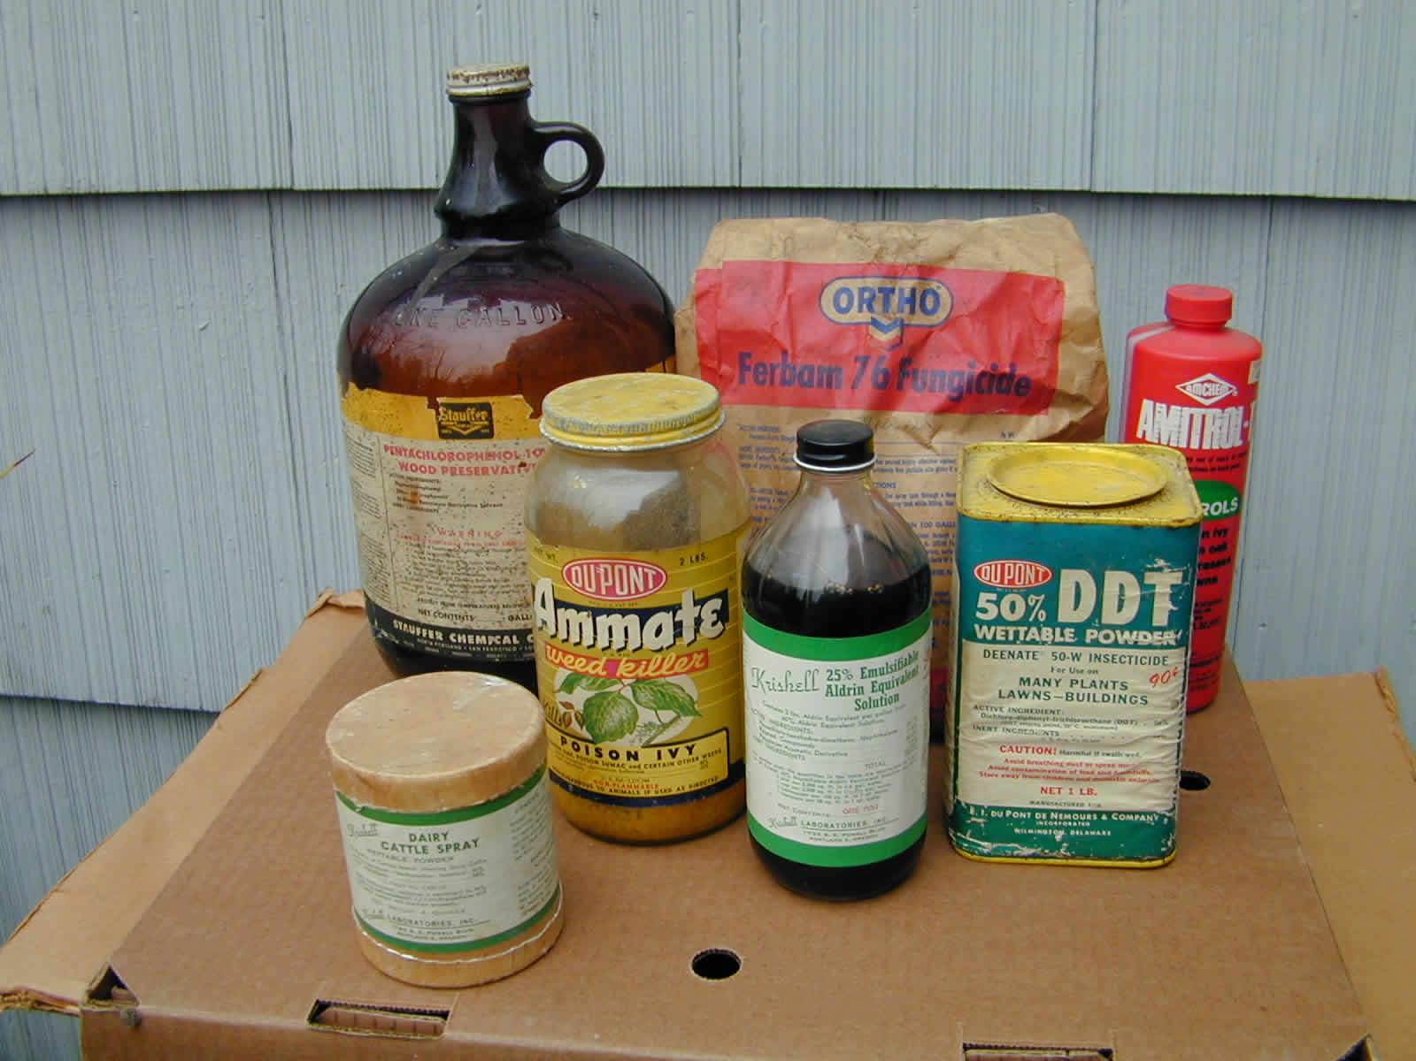
Home Pesticides

Slide 44
Summary
Reduce use
Reduce Exposure
Seek alternatives
  Integrated Pest Management (IPM)
Beware of local and global use

Slide 45
A Small Dose of Pesticide

Slide 46
Authorship Information
This presentation is supplement to
“A Small Dose of Toxicology”
For Additional Information Contact
Steven G. Gilbert, PhD, DABT
E-mail: sgilbert@innd.org
Web: www.asmalldoseoftoxicology.org

