Slide 1
An Introduction To The Health Effects of Lead or
Should the CDC Lower the Blood lead action lever from
10 to 2 mcg/dl?
A Small Dose of Lead
Chapter 12 – 3rd Edition
Steven G. Gilbert, PhD, DABT
www.asmalldoseoftoxicology.org
A Small Dose of Lead 09.14.20

Slide 2
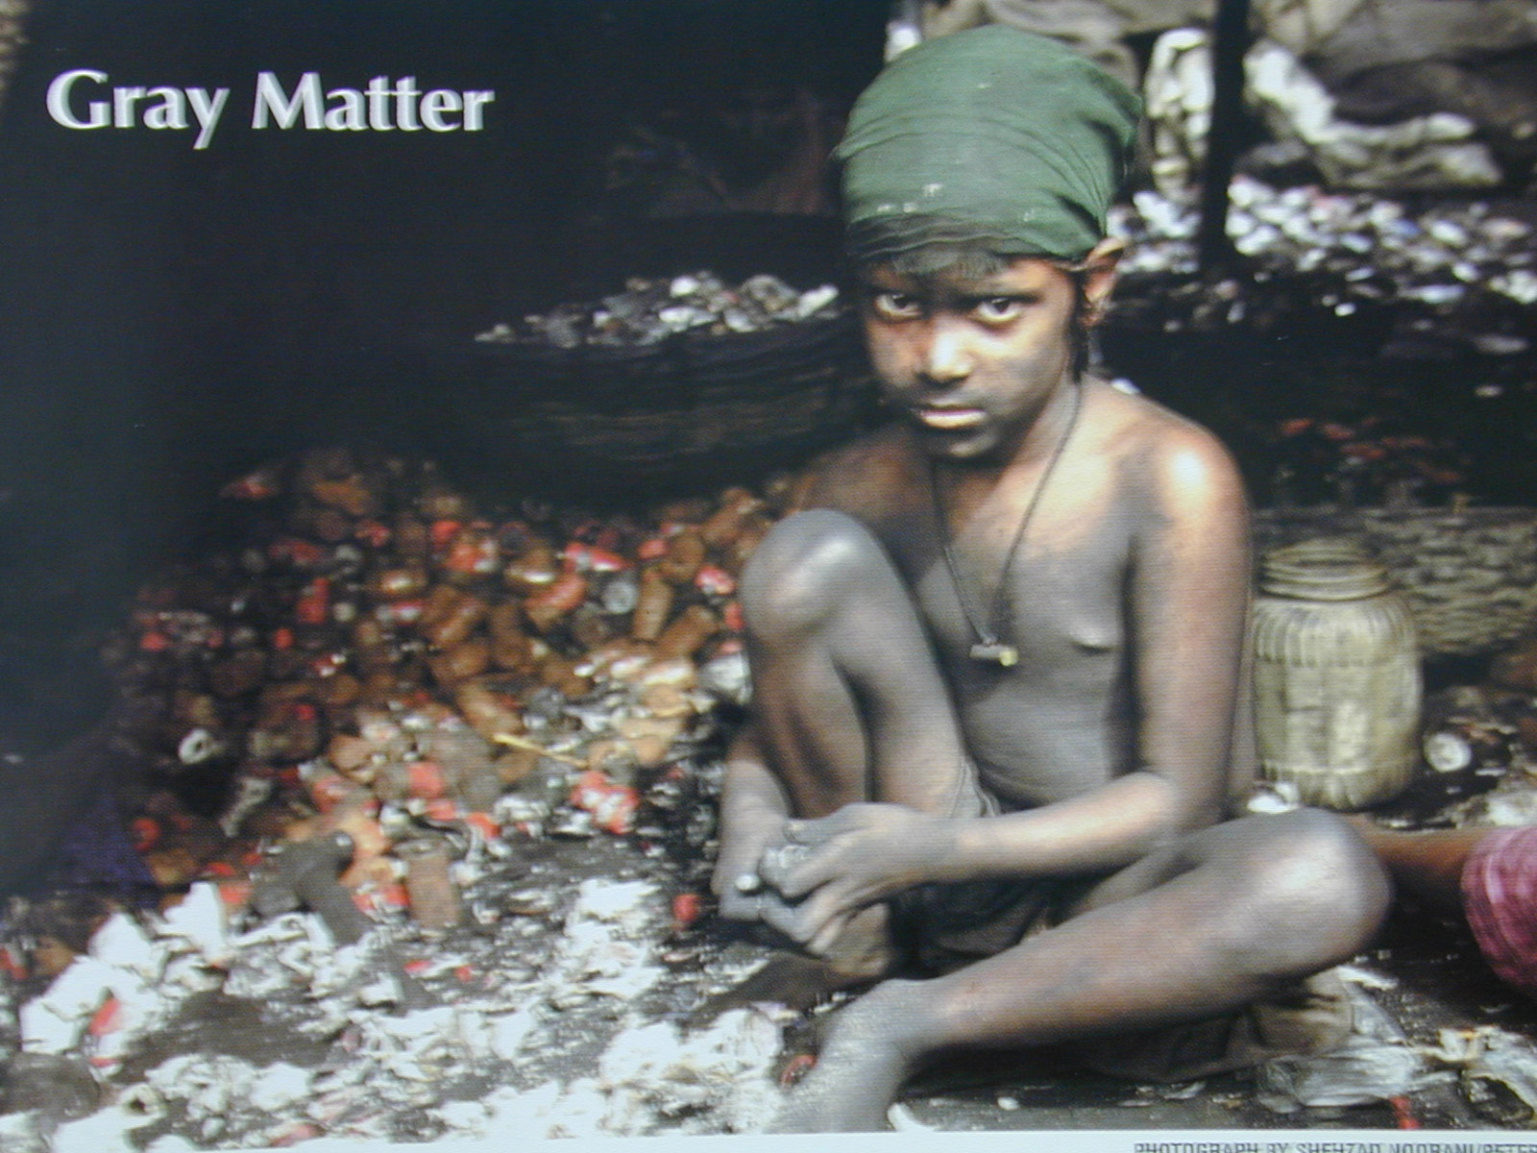
Recycling Lead

Slide 3
Canfield et al…, 2003
“Conclusions: Blood lead concentrations, even those below 10 mgc/dL, are inversely associated with children’s IQ scores at three and five years of age, and associated declines in IQ are greater at these concentrations than at higher concentrations. These findings suggest that more U.S. children may be adversely affected by environmental lead than previously estimated.”
Canfield et al. 2003, NEJM, 384

Slide 4
Human & Environmental Health
“To ensure that all living things have the best opportunity to reach and maintain their full genetic potential.”
Steven G. Gilbert, 1999

Slide 5
Key Words of Toxicology
Dose / Response
Hazard + Exposure = Risk
Individual Susceptibility

Slide 6
What Is Plumbun?
Plumbing is derived from plumbun, Latin for lead

Slide 7
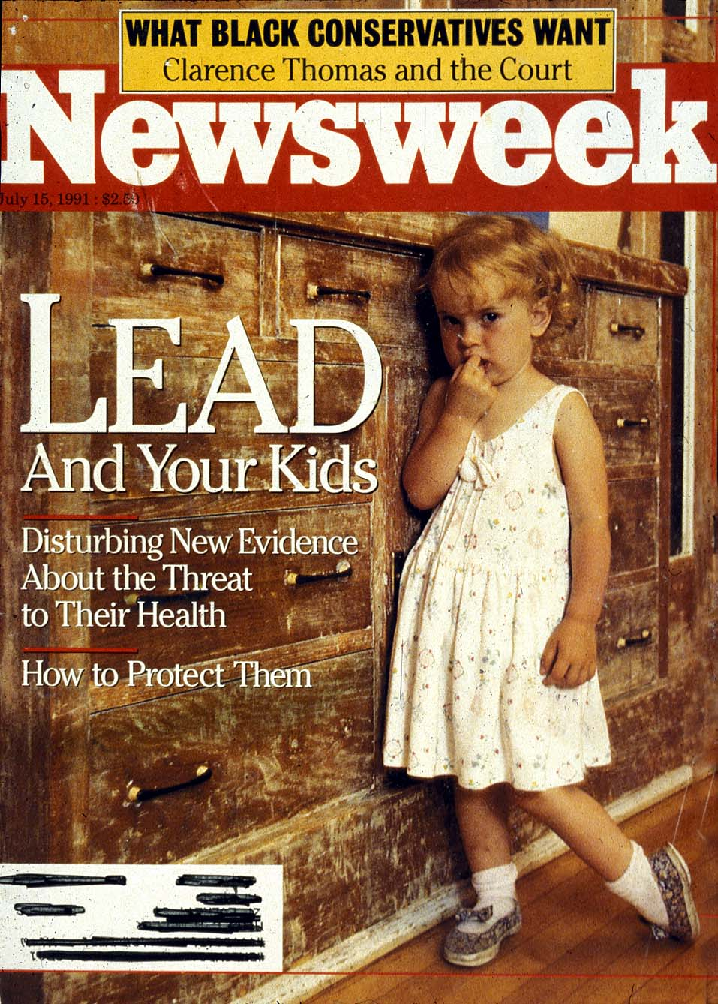
Lead In Homes

Slide 8
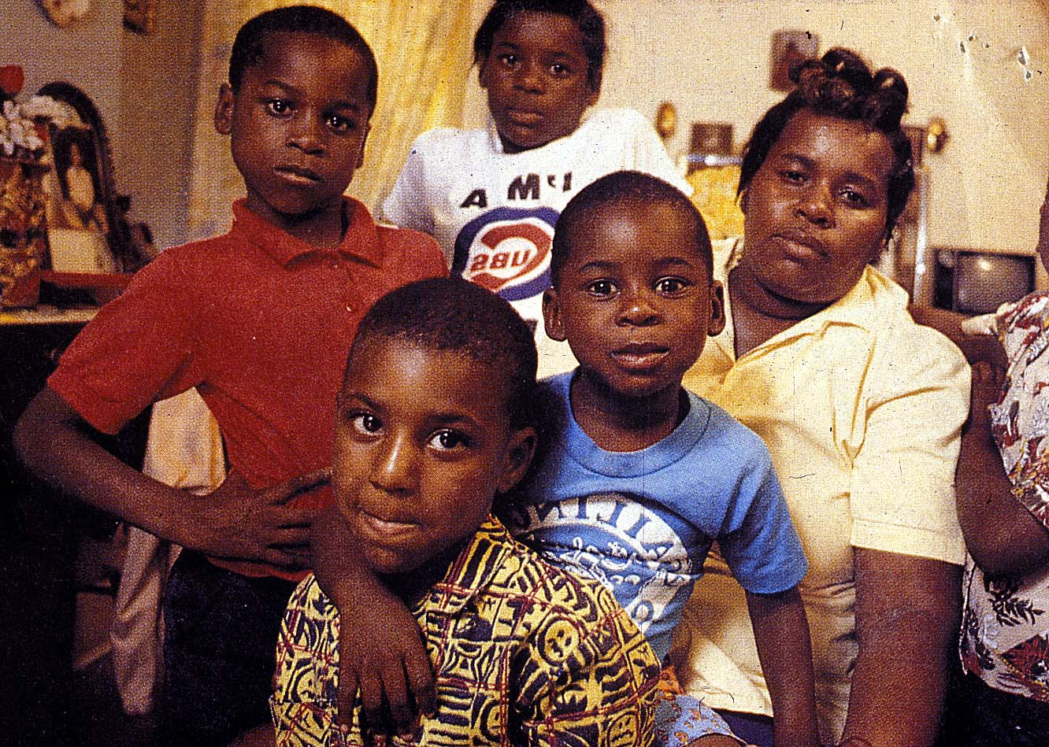
Lead in Families

Slide 9
Ancient Awareness
6500 BC. - Lead discovered in Turkey, first mine.
500 BC-300 AD.- Roman lead smelting produces dangerous emissions.
100 BC. - Greek physicians give clinical description of lead poisoning.

Slide 10
Ancient Awareness
"Lead makes the mind give way."
Greek
Dioscerides - 2nd BC

Slide 11
Historical Awareness
“If we were to judge of the interest excited by any medical subject by the number of writings to which it has given birth, we could not but regard the poisoning by lead as the most important to be known of all those that have been treated of, up to the present time.”
Orfila, 1817

Slide 12
L. Sullivan, 1991
“Lead Poisoning remains the most common and societal devastating environmental disease of young children.”
Public Health Service - L. Sullivan, 1991

Slide 13
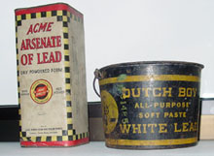
Lead Based Paint Products

Slide 14

Lead Industry Advertisements
History of Lead Industry Advertisements (LINK)
http://www.cincinnatichildrens.org/research/project/enviro/hazard/lead/lead-advertising/default.htm

Slide 15
Lead In Gasoline
1854 - Tetraethyl lead discovered by German chemist
1921 - Midgley discovers that tetraethyl lead curbs engine knock
1922 - Public Health Service warns of dangers of lead production, leaded fuel
1923 - Leaded gasoline goes on sale in selected markets
1936 - 90 percent of gasoline sold in US contains Ethyl
1972 - EPA gives notice of proposed phase out of lead in gasoline.
1986 - Primary phase out of leaded gas in US completed
1994 - Study shows that US blood-lead levels declined by 78 percent from 1978 to 1991
2000 - European Union bans leaded gasoline

Slide 16
History Of Lead Toxicology
Investigator Date Blood Findings
Dioscerides 2nd BC 100 "Lead makes the mind give way."
B. Franklin 1763 100 "Dry gripes"
A.J. Tuner 1894 80 Childhood plumbism
R. Byers 1943 80 Long-term sequelae
CDC 1973 40 Undue lead exposure
CDC 1975 30 Undue lead exposure
CDC 1985 25 Undue lead exposure
WHO 1986 20 Undue lead exposure
EPA 1986 15 Undue lead exposure
Fulton et al. 1987 15 IQ Deficits
Hansen et al. 1987 15 IQ Deficits
CDC 1990 10 Undue lead exposure

Slide 17
Agency Blood Lead Levels

Slide 18
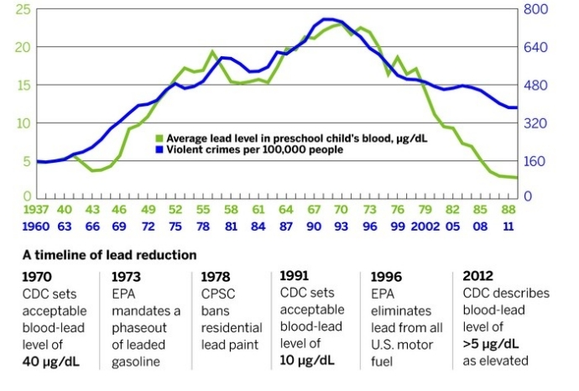
BLL & Violent Crimes

Slide 19
Health Effects
Encephalopathy
Colic
Frank Anemia
Hemoglobin Synthesis
Peripheral Neuropathies
Infertility (MEN)
Systolic Blood Pressure (MEN)
Nerve Conduction Velocity
Erythrocyte Protoporphyrin
DEVELOPMENTAL TOXICITY
IQ, Memory, Learning
Growth

Slide 20
Common Lead Uses
Lead acetate (Pb (C2H3 O2)2· 3H2O)
  White, crystalline substance
  Sugar of lead has a sweet taste
  Paint
Lead tetraethyl (Pb(C2H 5)4)
  antiknock compound added to gasoline
  significant contributor to air pollution

Slide 21
Sources Of Lead
Lead Paint
Dust, Soil
Water
Industry
Hobbies
Traditional Ethnic Remedies

Slide 22
Lead in Jewelry
California Suing Major Retailers Over Lead in Jewelry Allegations
California is suing 13 major retailers alleging they broke state law by not warning customers that some of their jewelry contains lead. Private lawsuits containing similar allegations have been filed against a further 11 retailers.
Named in the state's suit were Macy's, Target, Wal-Mart, Kmart, J.C. Penney, Mervyn's, Nordstrom, Ross, Sears, Express, Claire's, Toys "R" Us and Burlington Coat Factory, along with some of their affiliates and parent companies, according to The San Jose Mercury News. (June 24, 2004)

Slide 23
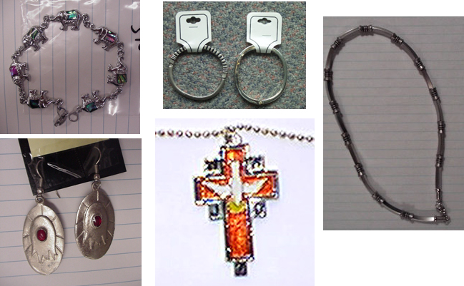
Lead in Jewelry
http://www.leadinspector.com/

Slide 24
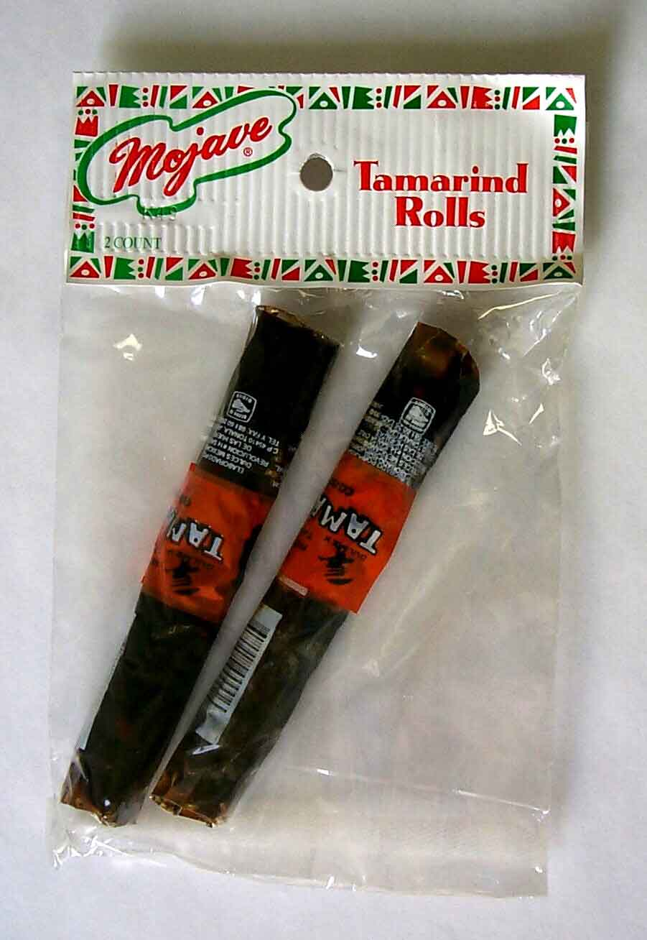
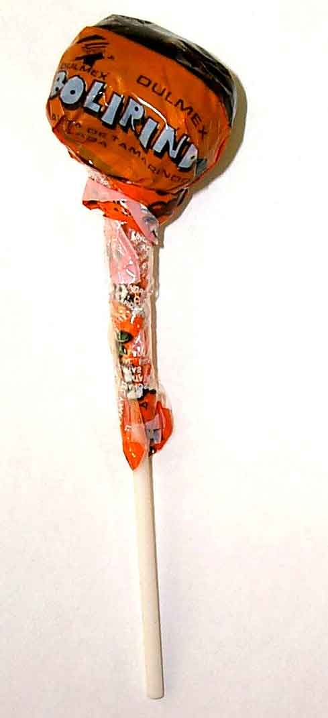
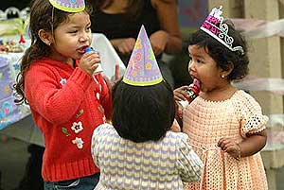
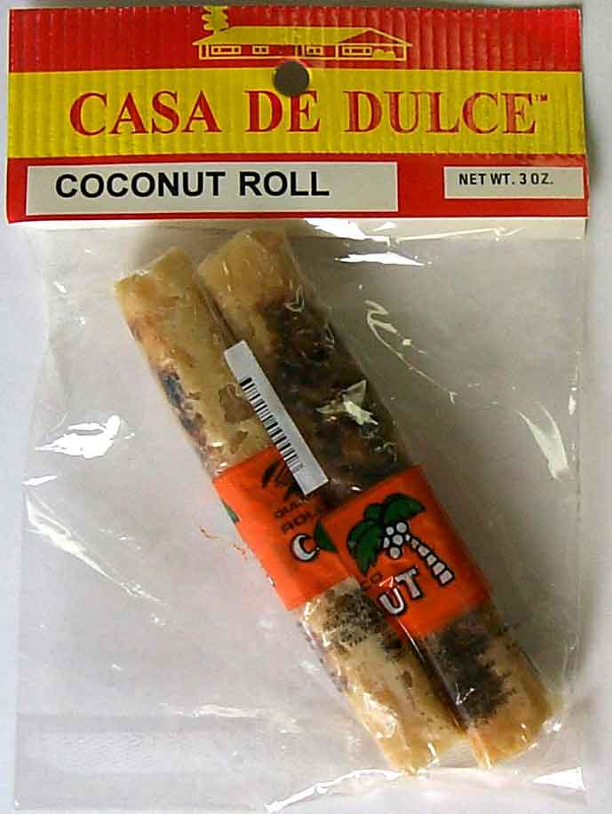
Children & Candy & Lead
Data from WA DOH (http://www.doh.wa.gov/EHSPHL/Epidemiology/NICE/Lead/candy.htm)

Slide 25
WA State Guidelines
The Washington State Department of Health advises consumers not to eat candy from Mexico or southeast Asia that contains tamarind or chili powder.
(http://www.doh.wa.gov/EHSPHL/Epidemiology/NICE/Lead/candy.htm)
California also has documented lead in candy.
See the Orange County Register series on lead in candy: http://www.ocregister.com/investigations/2004/lead/index.shtml

Slide 26
Lead in WA Candy
Data from WA DOH (http://www.doh.wa.gov/EHSPHL/Epidemiology/NICE/Lead/candy.htm)

Slide 27
Lead in Pottery – Action Levels
US Food and Drug Administration (FDA) action levels for the lead content of the leachate:
Cups, mugs, and pitchers: 0.5 ppm
Large hollowware (serving dishes): 1 ppm
Small hollowware (bowls): 2 ppm
Plates, saucers, and other flatware: 3 ppm

Slide 28
Lead in WA Pottery
Data from WA DOH (http://www.doh.wa.gov/EHSPHL/Epidemiology/NICE/Lead/pottery.htm)

Slide 29
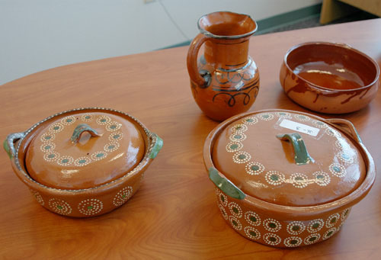
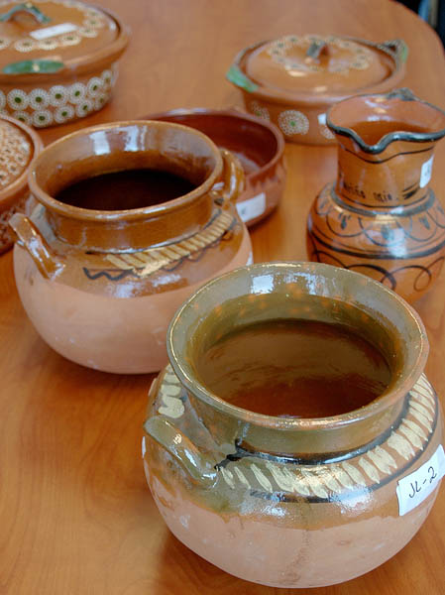
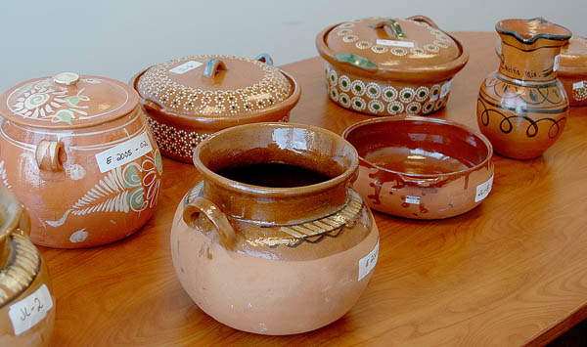
Pottery with Lead
Data from WA DOH (http://www.doh.wa.gov/EHSPHL/Epidemiology/NICE/Lead/pottery.htm)

Slide 30

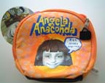
Lead & Lunchboxes
The Center for Environmental Health (CEH) http://www.cehca.org/lunchboxes.htm

Slide 31
Lead In Ethnic Remedies
Remedy | Use | Lead Content
Azarcon (Mexico) | Digestive problems | 76-86%
Greta (Mexico) | Digestive problems | 4-90%
Surma (India) | Cosmetic to improve eye sight | 23-26%
Tibet | Improve slow development | 1-3%

Slide 32
Lead Contaminated Town
Herculaneum, Missouri
Doe Run – Lead smelter
160,000 tons of lead per year
One of the largest lead smelters in US
Past over 800 tons of lead released into the environment as part of the smelting process.
Reduced to 81 tons in 2001
Target is 34 tons in 2002.
NY Times, Jan 19, 2002

Slide 33
Lead Out of Gasoline
1990 – lead removed from Gasoline
Between 1976 and 1994, the mean blood lead concentration in children dropped from 13.7 mcg/dL to 3.2 mcg/dL
One of the major public health triumphs of the 20th century

Slide 34
Take Home Lead Exposure
California, 1998
Lead poisoning in furniture workers and their families
Father 46 µg/dL
18-month-old child BLL 26 µg/dL
4-month-old daughter BLL 24 µg/dL
two refinishers BLLs of 29 and 54 µg/dL,
the four carpenters BLLs of 46, 46, 47, and 56 µg/dL.
MMWR - April 06, 2001 / 50(13);246-8

Slide 35
Lead - Absorption
Orally Consumed Lead Absorbed
In Place of Calcium
CHILDREN – 30-50% OF LEAD
ADULTS – 5-10% OF LEAD
Increased During Pregnancy

Slide 36
Lead - Nutrition
NUTRITIONAL DEFICIENCIES INCREASE
ABSORPTION
(high fat diets, iron, calcium)
VITAMIN D (from sun) INCREASES

Slide 37
Half-life Of Lead
• 25 DAYS -- BLOOD
• 40 DAYS -- SOFT TISSUE
• 20 YEARS -- BONE

Slide 38
Children Vulnerability
CHILDREN are more vulnerable exposure than ADULTS
Size
Consume More Food
Inhale More Air
Developing Nervous System
Increased need for Calcium

Slide 39
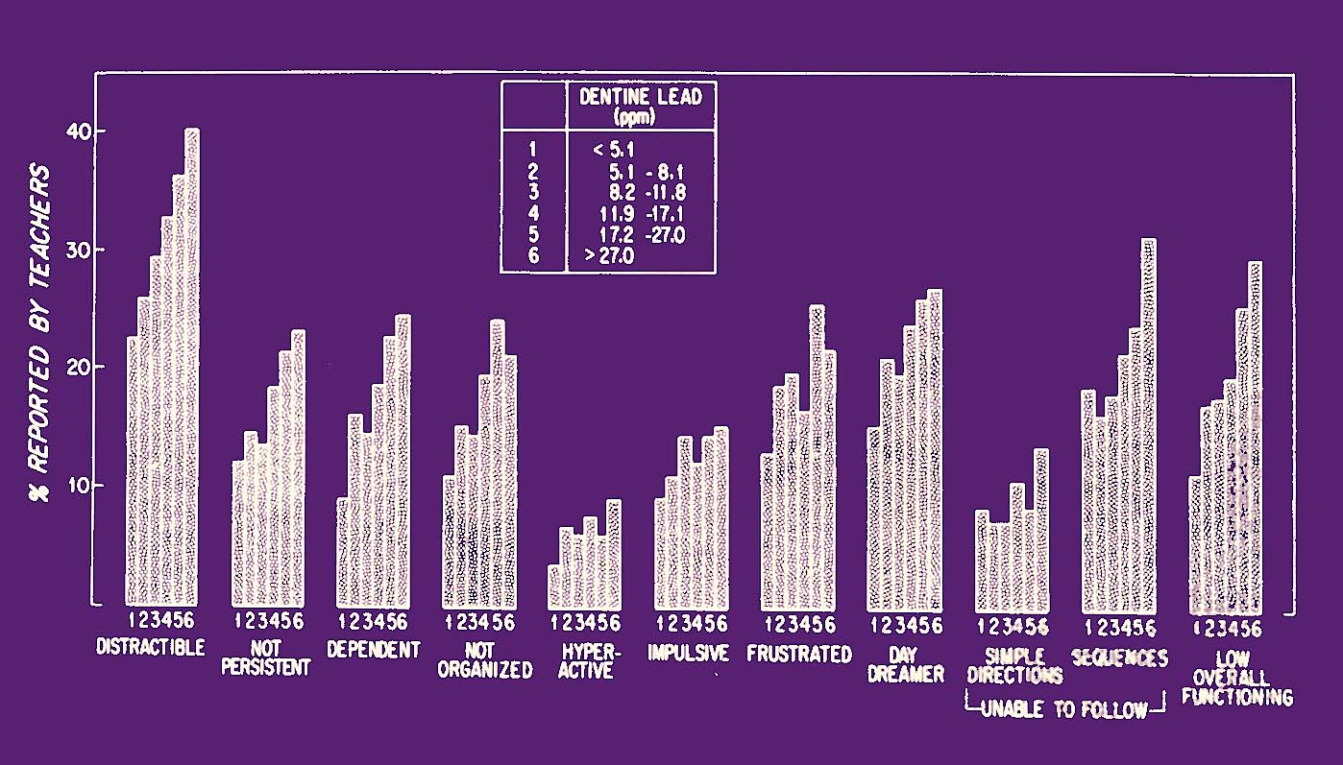
Needleman, NEJM, 1979

Slide 40
Lead-associated Reading Deficits in U.S. Children
Reading Score
Blood lead levels (μg/dl)
Lanphear BP, et al. Public Health Reports 2000;115:521-529. (BL’s slide)

Slide 41
IQ and Blood Lead
Life time overall
Increase in 1 mcg/dl = 0.87 IQ drop
Covariates - 1 mcg/dl = 0.46 IQ drop
1 to 10 mcg/dl (bigger drop)
Increase in 1 mcg/dl = 1.37 IQ drop
Non-linear - 1 mcg/dl = 7.4 IQ drop
Canfield R, et al. NEJM 2003;348:1517-1526

Slide 42
Strengths of study
Lead values mean of 6 samples (SD 0.03 mcg/dl)
Examiners blind
Covariates
Canfield R, et al. NEJM 2003;348:1517-1526

Slide 43
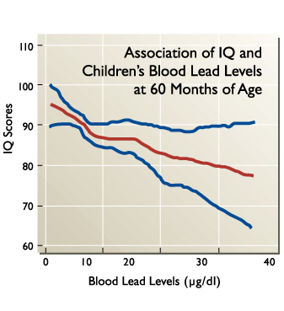
IQ and Blood Lead
Canfield R, et al. NEJM 2003;348:1517-1526. (slide from BL)

Slide 44
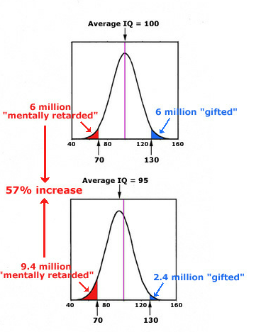
A 5-Point (5%) Shift in IQ Scores in a Population of 100 Million

Slide 45
CHILDREN ADULTS
Blood Lead
(ug Pb/dl)
150
Death
100
Encephalopathy
Encephalopathy
Nephropathy
Frank Anemia
Frank Anemia
Decreased Longevity
Colic
50
Hemoglobin Synthesis
Peripheral Neuropathies
Hemoglobin Synthesis
40
Infertility (MEN)
Nephropathy
Systolic Blood Pressure (MEN)
Vitamin D Metabolism
30
Hearing Acuity
Nerve Conduction Velocity
20
Erythrocyte Protoporphyrin
Erythrocyte Protoporphyrin
Vitamin D Metabolism(?)
(Women)
DEVELOPMENTAL TOXICITY
IQ
10
Hypertension (?)
HEARING
Transplacental Transfer
GROWTH
- Low birth weight
- Miscarriages, Stillbirth
- Premature birth

Slide 46
Reproductive Effects Of Lead
WOMEN
  lead crosses the placenta
  low infant birth weight
  retarded mental development
  miscarriages
  premature birth
  stillbirth
MEN
  decreased sex drive
  impotence
  sterility
  altered sperm-birth defects

Slide 47
Childhood Lead Exposure
-- LONG TERM PROBLEMS --
• LOW GRADES •
• ABSENTEEISM •
• READING DISABILITY •
• HIGH SCHOOL DROP OUT •

Slide 48
Academic & Social Costs Of Lead Exposure
Increased risk of not graduating from high school (rr 4.8)
Poorer reading scores
Increased evidence of depression
Higher rate of hard drug use
Increased risk for attention deficit disorder
Increased risk for antisocial behavior

Slide 49
Children Affected
16% of all American children
Children with blood leads above 15 UG/DL
7% of economically favored white children
55% of African American children in poverty
source: The nature and extent of
lead poisoning in children in the
US: a report to Congress - ATSDR

Slide 50
Mechanisms Of Lead Toxicity
Lead-Calcium Interactions
Lead-Protein Interactions
Lead-Dopamine Systems Interactions
Lead-Opioid Systems Interactions

Slide 51
Lead Chelating
EDTA, Bal, Succimer
EDTA In Use For 48 Years
Little Knowledge Of Benefits Or Hazards Of These Drugs
The Treatment Is Removing The Source Of Lead

Slide 52
Why Screen For Lead Exposure
Test siblings
Find the source
Reduce risky behaviors
Education about the hazards
Education about nutrition

Slide 53
Cost of Childhood Lead
Assumptions in calculating costs
All lead is harmful and from environment
Blood lead of children age 5 – 2.7 ug/dl (CDC)
5-year old boys (1,960,200) and girls (1,869,800)
1 ug/dl of lead = 0.25 IQ point reduction
Cost – boys $27.8 and girls $15.6 Billion
Total Costs $43.4 Billion
Environmental Pollutants and Disease in American Children: Estimates of Morbidity, and Costs for Lead Poisoning, Asthma, Cancer, and Developmental Disabilities, by Landrigan, P. et al. EHP, 110, July 2002, 721-728.

Slide 54
Estimated Costs - Washington
Diseases and disabilities (asthma, cancer, lead exposure, birth defects, and neurobehavioral effects) attributable to environmental contaminants.
Disease/Disability (2004 $ million)
 | Best Estimate | Direct Costs | Indirect Costs | Range
Childhood | $1,875 | $310.6 | $1,565 | $1,600-$2,200
Adult & child | $2,734 | $782.1 | $1,953 | $2,800-$3,500
Kate Davies Economic costs of diseases and disabilities attributable to environmental contaminants in Washington State. Antioch University Seattle 2005. http://washington.chenw.org/pdfs/EnvironmentalCosts.pdf

Slide 55
Agency Blood Lead Levels

Slide 56
Recycling Lead

Slide 57
Precautionary Principle
“When an activity raises threats of harm to human health or the environment, precautionary measures should be take even if some cause and effect relationships are not fully established scientifically.”
Wingspread Conference, 1998.

Slide 58
Central components
Setting goals (Health indicators)
Taking preventive action in the face of uncertainty
Shifting the burden of responsibility to the proponents of an activity (Who benefits?)
Exploring a wide range of alternatives to possibly harmful actions (Is it necessary?)
Increasing public participation in decision making (transparency of information & environmental justice)

Slide 59
Current CDC Policy
Blood lead level µg/dL)^{b} | Actions | Time frame for beginning intervention
10-14 | Provide caregiver lead education. Provide follow-up testing. Refer the child for social services if necessary. | Within 30 days
15-19 | Above actions, plus: If BLLs persist (i.e., 2 venous BLLs in this range at least 3 months apart) or increase, proceed according to actions for BLLs 20-44. | Within 2 weeks
20-44 | Above actions, plus: Provide coordination of care (case management). Provide clinical evaluation and care.^{c} Provide environmental investigation and control current lead hazards. | Within 1 week
45-70 | Above actions. | Within 48 hours
70 or higher | Above actions, plus hospitalize child for chelation therapy immediately. | Within 24 hours

Slide 60
Children with >10 mcg/dL
In 1999 and 2000, 2.2% of children 1-5 year age had lead levels that were above 10 mcg/dL.
Approximately 20 million children under age 5, thus about 440,000 children in the US have blood lead levels above 10 mcg/dL.
From CDC

Slide 61
Proposed CDC Policy
Blood lead level (µg/dL) | Actions | Time frame for beginning intervention
<2 | No action
2-5 | Provide caregiver lead education. Provide follow-up testing. Refer the child for social services to investigate possible sources of lead exposure. | Within 30 days
5-10 | Above actions, plus:If BLLs persist (i.e., 2 venous BLLs in this range at least 3 months apart) or increase, proceed according to actions for BLLs 10-20. | Within 2 weeks
10-20 | Above actions, plus: Provide coordination of care (case management). Provide clinical evaluation and care. Provide environmental investigation and control current lead hazards. | Within 1 week
20-70 | Above actions. | Within 24 hours
70 or higher | Above actions, plus hospitalize child for chelation therapy immediately. | Within 24 hours

Slide 62
Children in WA State
Blood Lead No. %
(mcg/dL)
0-1 9,569 55.3
2-4 6,431 37.2
5-9 1,103 6.4
10-19 167 1.0
20+ 26 0.15
Children 0-6 tested in 2002-2004
WA State DOH

Slide 63
Policy Implications
Drinking water in Seattle Schools

Slide 64
Agency Blood Lead Levels

Slide 65

Runs Better Unleaded

Slide 66
Lead 10 to 2
Rationale for Lowering the Blood Lead Action Level From 10 to 2 µg/dL
Steven G. Gilbert and Bernard Weiss
Neurotoxicology Vol 27/5, September 2006, pp 693-701. http://dx.doi.org/10.1016/j.neuro.2006.06.008

Slide 67
Lead - References
EPA – Lead site – the best
http://www.epa.gov/opptintr/lead/index.html
CDC Childhood Lead Poisoning Prevention Program http://www.cdc.gov/nceh/lead/lead.htm
A Small Dose of Toxicology
www.asmalldoseof.org

Slide 68
A Small Dose of ™ Lead

Slide 69
Authorship Information
This presentation is supplement to
“A Small Dose of Toxicology”
For Additional Information Contact
Steven G. Gilbert, PhD, DABT
E-mail: smdose@asmalldoseof.org
Web: www.asmalldoseof.org

Slide 70
Lead Based Paint
1887 - US medical authorities diagnose childhood lead poisoning
1904 - Child lead poisoning linked to lead-based paints
1909 - France, Belgium and Austria ban white-lead interior paint
1914- Pediatric lead-paint poisoning death from eating crib paint is described
1921 - National Lead Company admits lead is a poison
1922 - League of Nations bans white-lead interior paint; US declines to adopt
1943- Report concludes eating lead paint chips causes physical and neurological disorders, behavior, learning and intelligence problems in children
1971- Lead-Based Paint Poisoning Prevention Act passed

