Slide 1
A Small Dose of Mercury
An Introduction To The Health Effects of
Mercury
Chapter 13 – 3rd Edition
Steven G. Gilbert, PhD, DABT
www.asmalldoseoftoxicology.org

Slide 2
Mercury the Metal

Slide 3
Key Words
Dose / Response
Risk =
Hazard X Exposure
Individual Sensitivity

Slide 4
What Is This?
Hg
CH₃

Slide 5
Methyl Mercury (MeHg)
Hg
CH₃

Slide 6
Hg - Inorganic & Organic
Hg
Inorganic – Quick Silver
Hg
CH₃
Organic – Methyl Mercury

Slide 7
Hg Facts & Uses
Quicksilver
13.6 times the weight of water
Evaporates at room temperature
Bacteria change to Methylmercury
Amalgam
Many Industrial uses (thermometers, chemical reactions, gold mining)

Slide 8
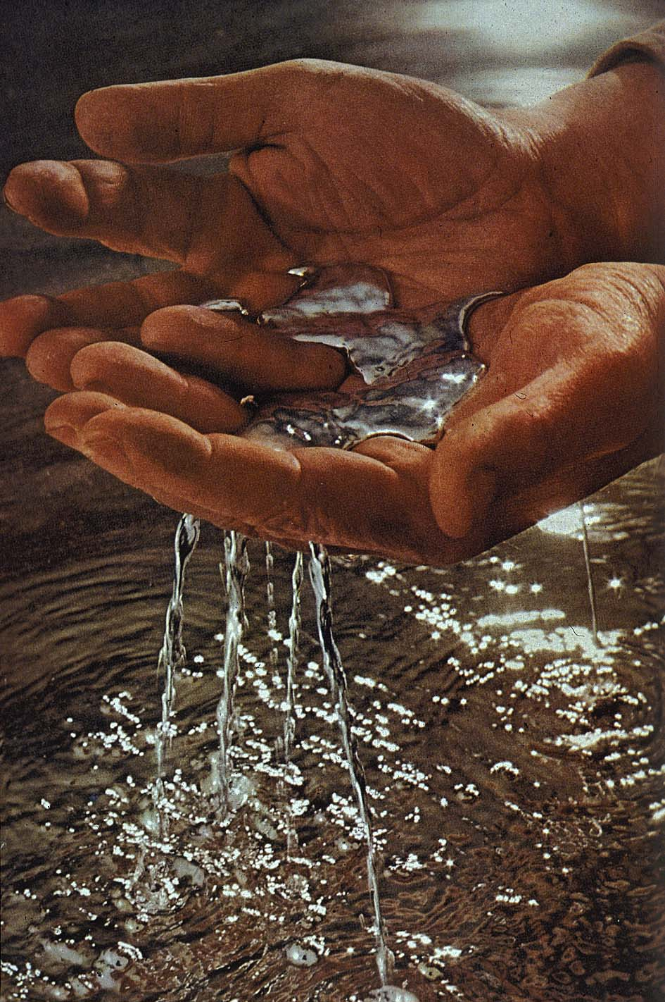
Hg – Like Water

Slide 9
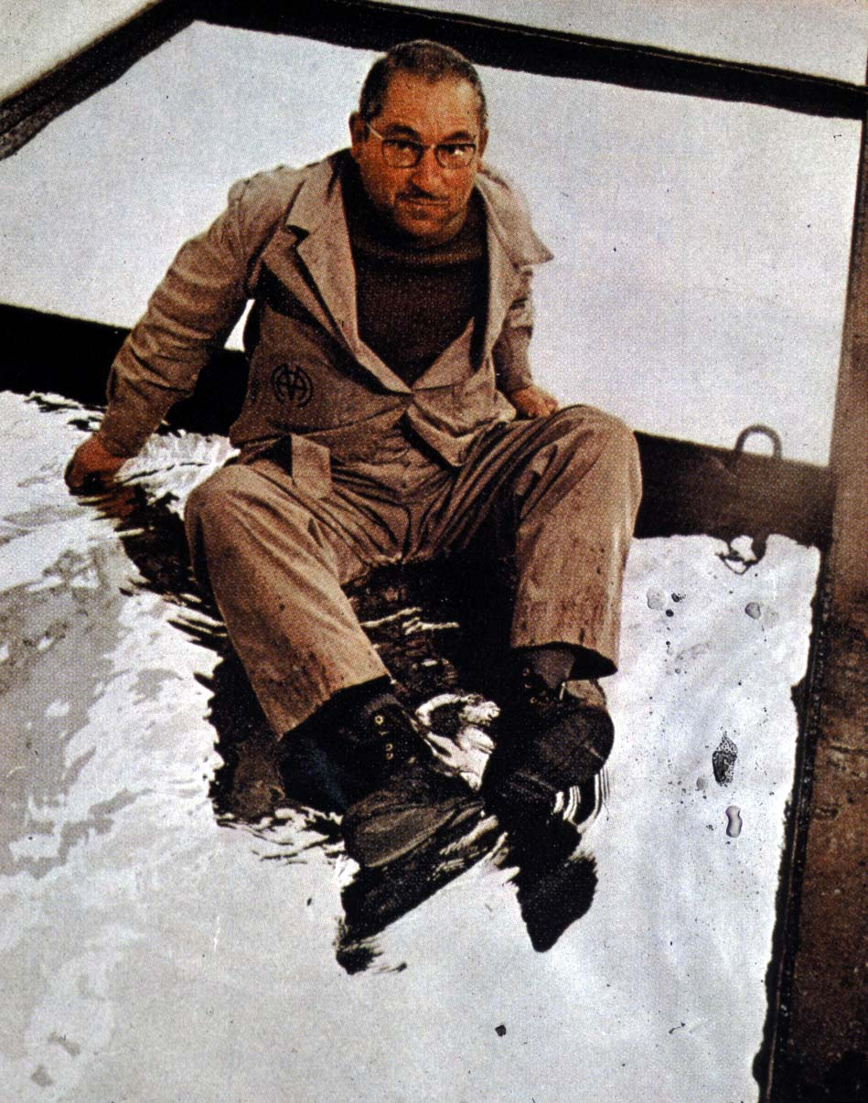
Hg – Solid Enough to Sit On

Slide 10
Ancient Awareness
Alchemy
Medicine - cure syphilis?
Egyptian tomb -1500 BC

Slide 11
Greek God Mercury
“For then she bare a son, of many shifts, blandly cunning, a robber, a cattle driver, a bringer of dreams, a watcher by night, a thief at the gates, one who was soon to show forth wonderful deeds among the deathless gods...”
Description of the birth of the
Greek God Mercury

Slide 12
Historical Events
Occupational Exposure
Gold mining.
Hatters in the felt industry.

Slide 13
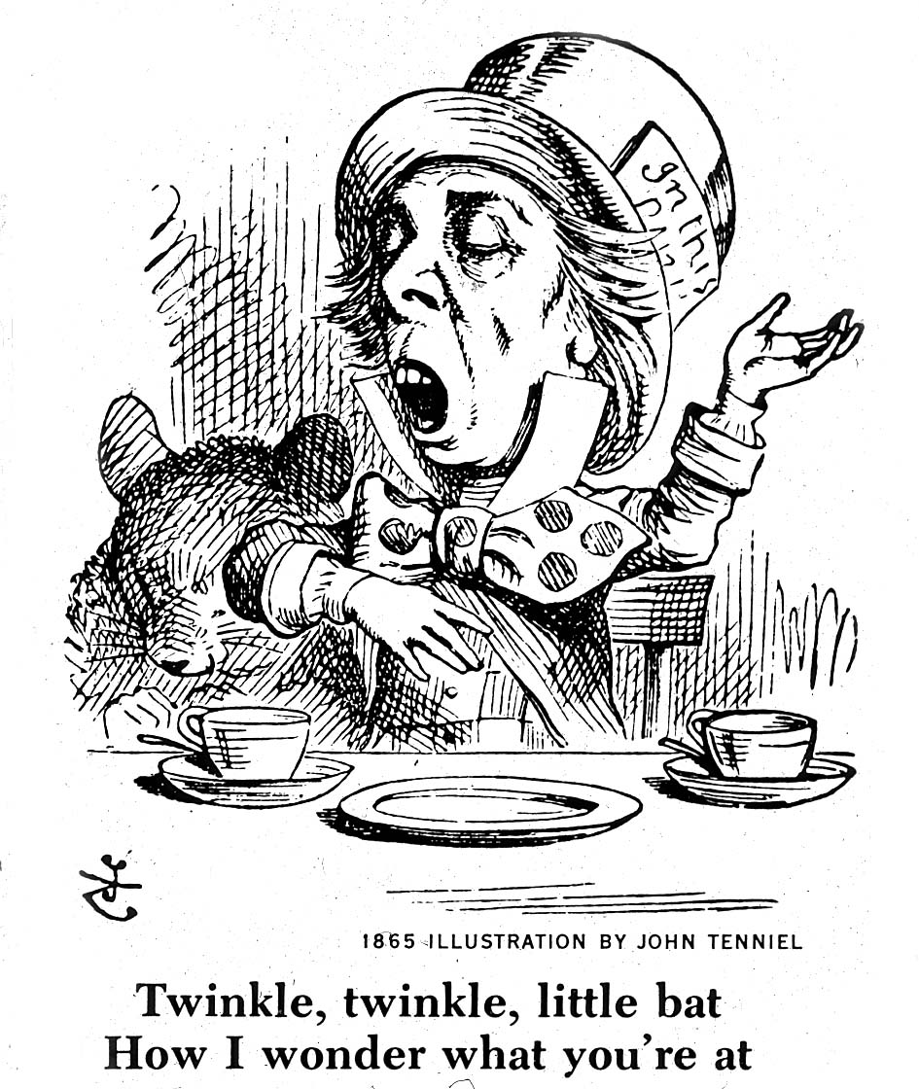
Historical Awareness

Slide 14
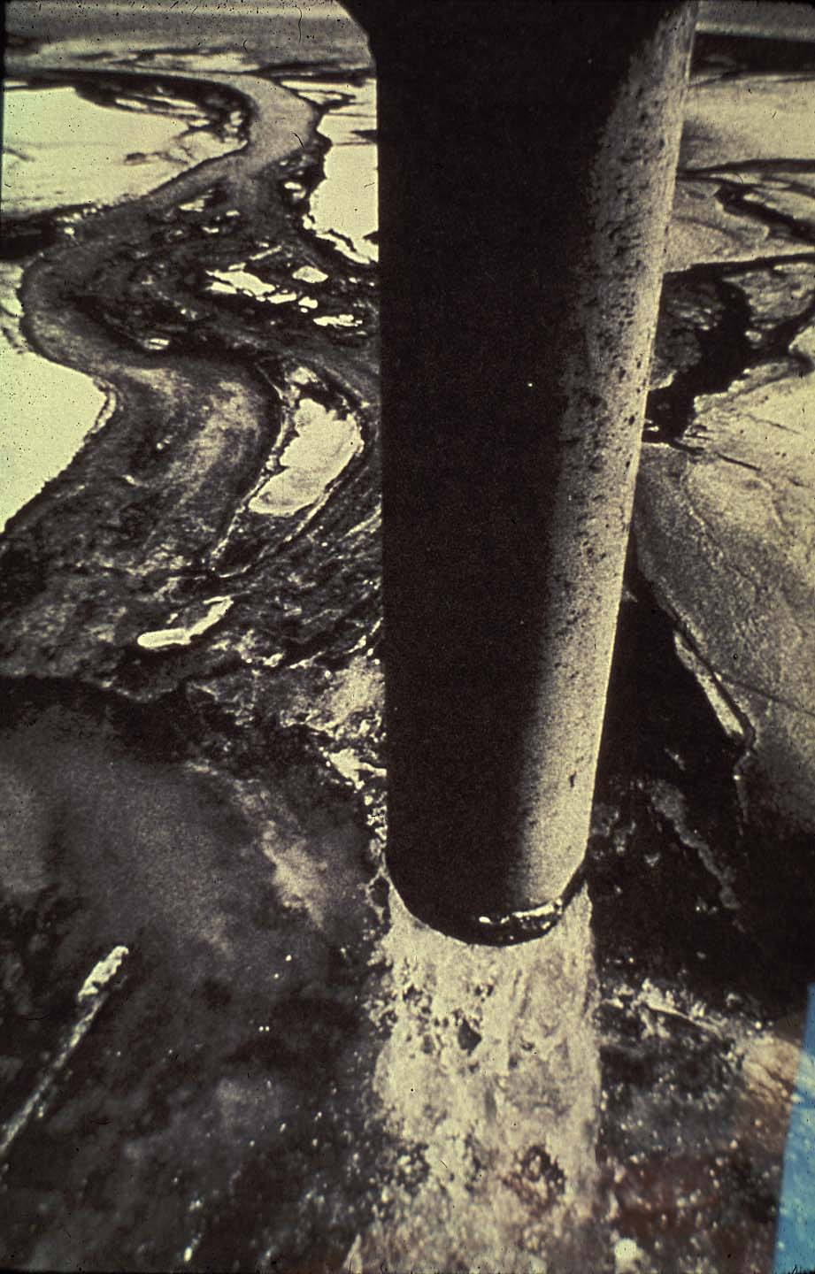
Polluting with HG
Discharge in Minamata Bay

Slide 15
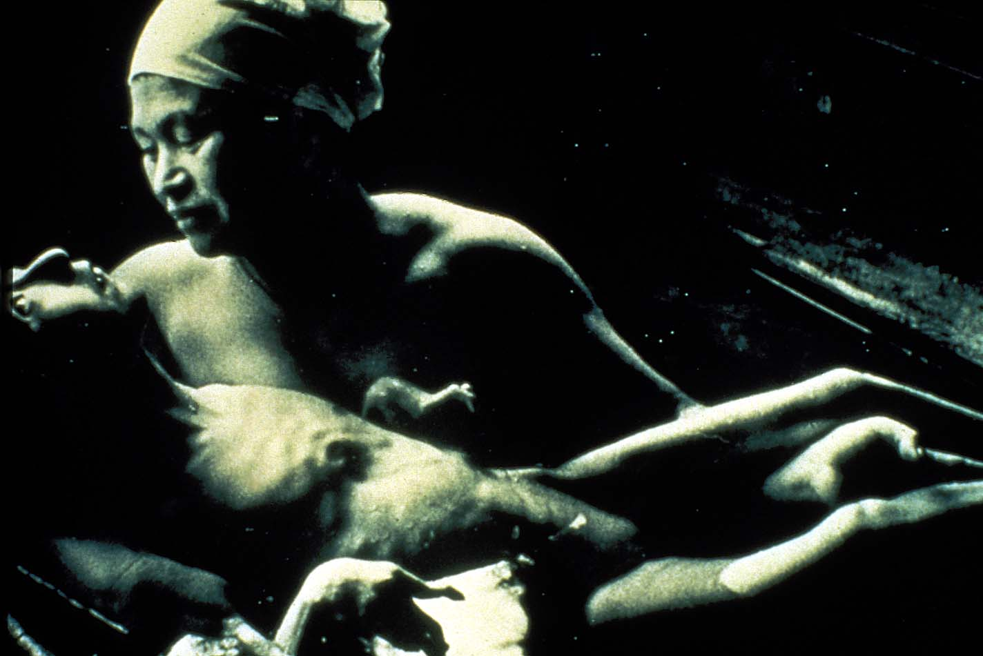
Fetal Effects of MeHg

Slide 16
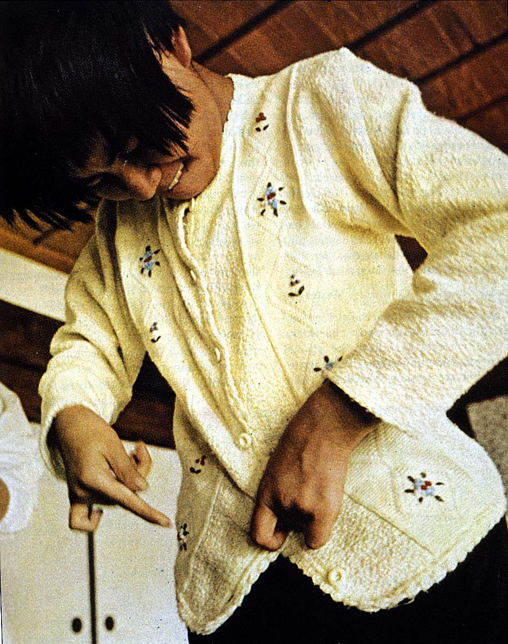
Life-Long Effects of MeHg

Slide 17
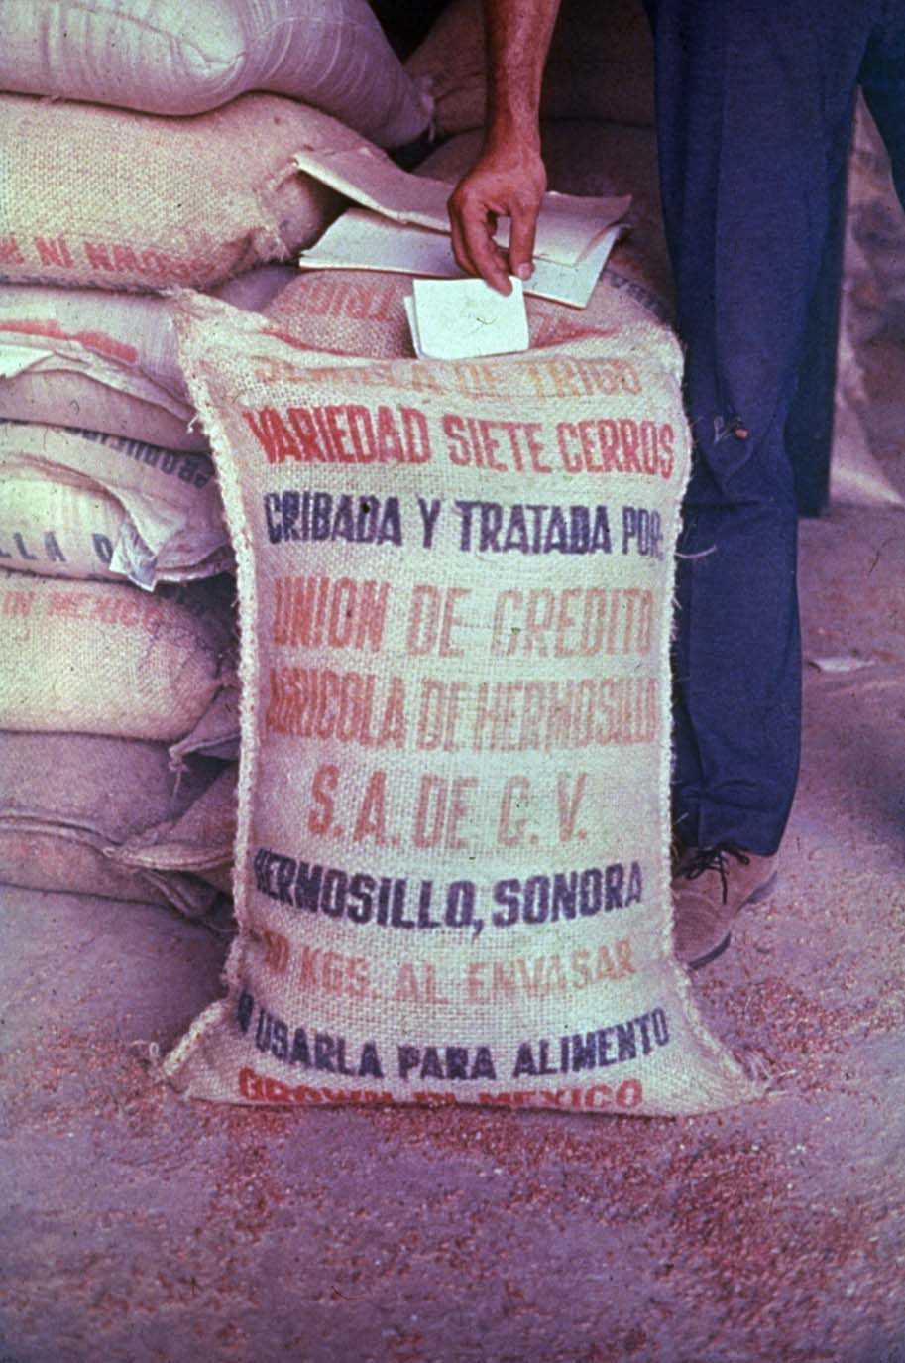
Planting Seed with Mercury

Slide 18
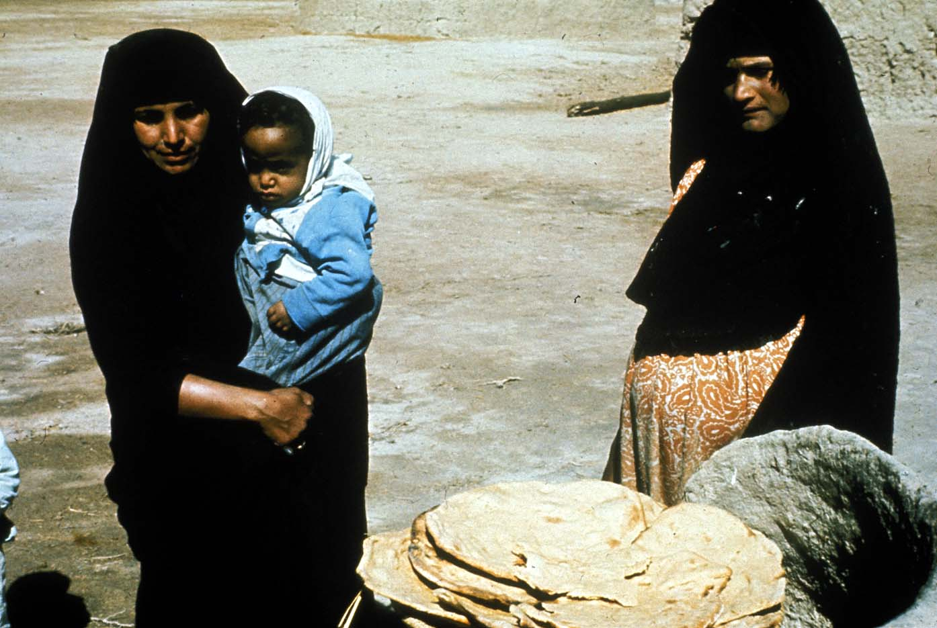
Iraq Mothers with Bread

Slide 19
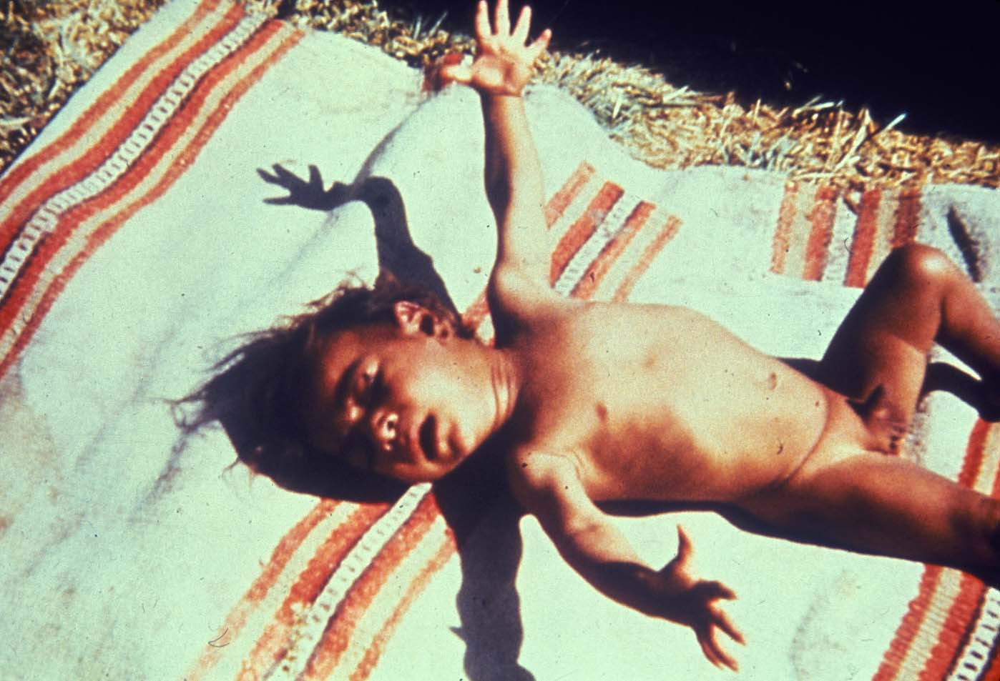
Iraq Infant - Effects of Mercury

Slide 20
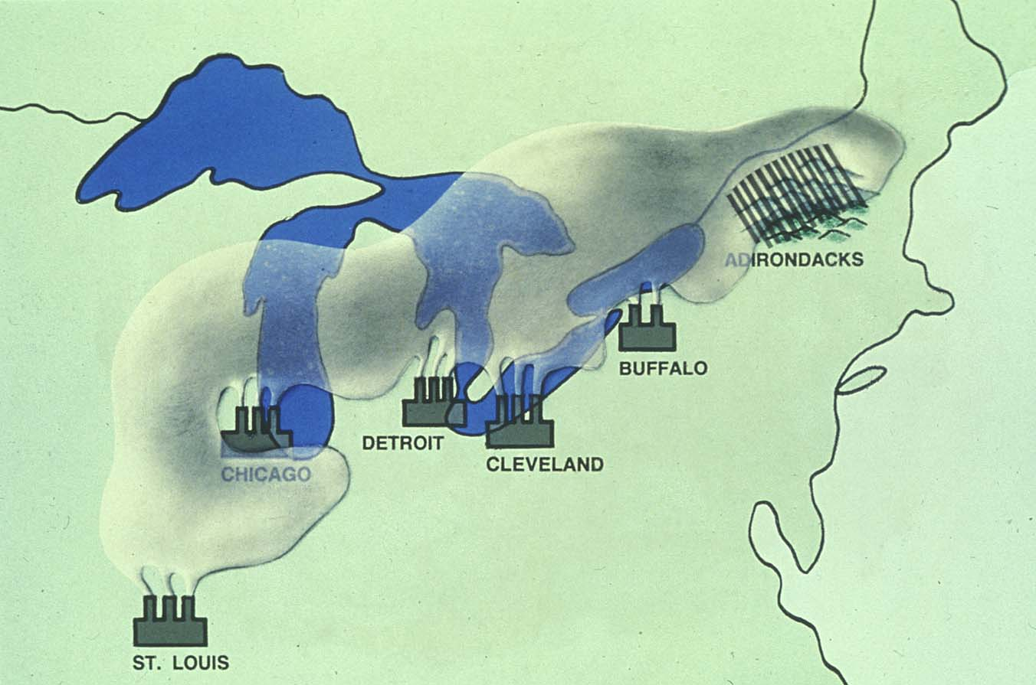
Coal Fired Plants – Hg Emissions

Slide 21
Outbreaks of MeHg Poisoning
Place | Year | Cases
Minamata | 1953-60 | 1000
Nigata | 1964-65 | 646
Guatemala | 1963-65 | 45
Ghana | 1967 | 144
Pakistan | 1969 | 100
Iraq | 1956 | 100
Iraq | 1960 | 1,002
Iraq | 1971 | 40,000
On-going | 2001 | ???

Slide 22
Mercury to Methyl Mercury
Inorganic - elemental mercury vapor Hg⁰
Biotransformation
Organic - Methylmercury - CH₃Hg⁺
Bioaccumulation

Slide 23
Mercury Release
50-75% mercury of released in the environment related to human activities

Slide 24
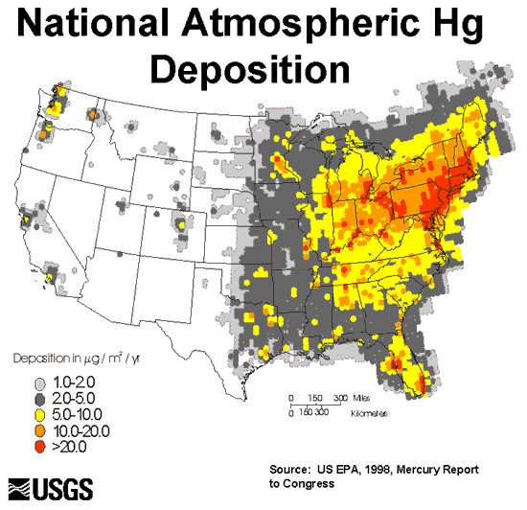
Atmospheric Hg

Slide 25
Biotransformation of Mercury
Inorganic
Mercury
Discharge
Ambient Water
Sediments
Biomethylation
Methyl-Mercury
Bioaccumulation
Edible Fish
Methyl-Mercury
In Humans
Exposure

Slide 26
Environmental Sources of Mercury
Natural Degassing of the earth
Combustion of fossil fuel
Industrial Discharges and Wastes
Incineration & Crematories
Dental amalgams
Hg⁰
Hg²⁺
CH₃Hg⁺

Slide 27
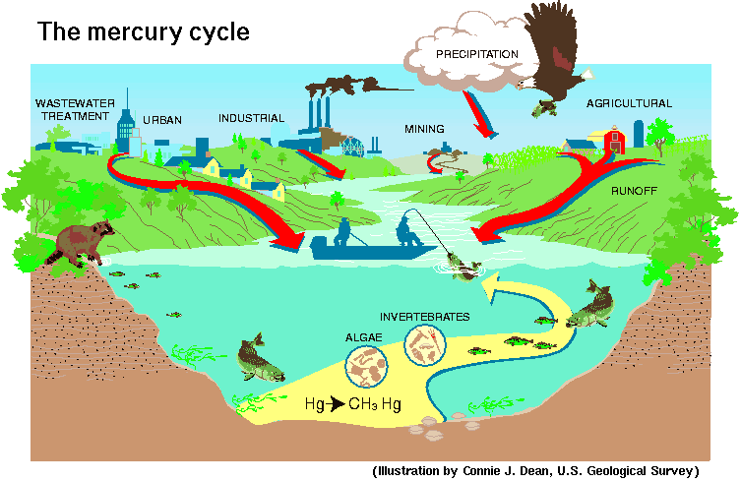
The Mercury Cycle

Slide 28
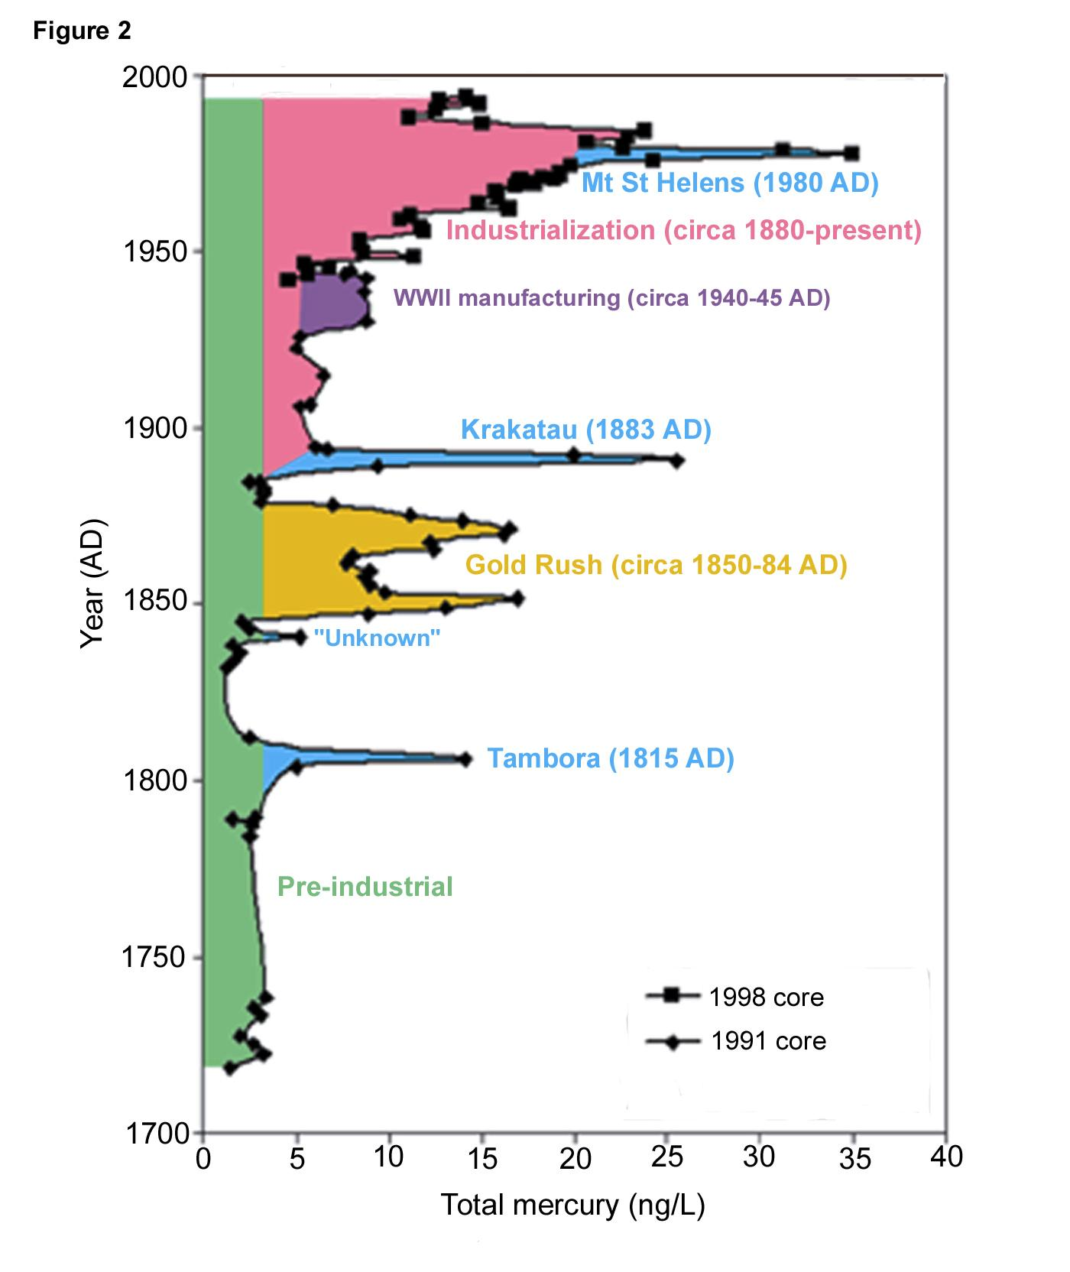

A 270-year record
Major atmospheric releases
  Natural
    Background (42%)
    Volcanic (6%)
  Anthropogenic (52%)
    Gold rush
    WWII
    Industrialization
Significantly
The last 100 years
anthropogenic: 70%
The last 10 years
an apparent decline

Slide 29
Neurobehavioral Effects
Blindness - Deafness
Cerebral Palsy - Seizures
Abnormal reflexes & muscle tone
Retarded motor development
Visual and Auditory Deficits
Delayed motor development
Altered DRH performance

Slide 30
MeHg in Humans
95% of MeHg is absorbed
10% into brain – most stays
half-life in blood is 50–70 days in adults but can vary significantly
the half-life is longer in neonates
crosses the placenta
levels in umbilical cord blood are about 1.7 times as high as the mother’s blood levels

Slide 31
MeHg – Fetal effects
EPA reference level of 5.8 μg/L, the mother’s blood level should thus not exceed 3.5 μg/L
cognitive deficits
motor skill effects
attention deficits,
language skill deficiencies
decreased learning capacity and memory

Slide 32
MeHg – Adult effects
Lower level exposures
Sleep disturbance
Headache
Fatigue
Difficulty concentrating
Depression
Memory loss
Diminished fine motor coordination
Muscle and joint pain
Gastrointestinal upset
Hair thinning
Heart rate disturbance
Hypertension
Tremor
Numbness or tingling around the mouth
Table 2: Signs and symptoms of MeHg poisoning. Silbernagal et al.

Slide 33
MeHg – case studies
A 64-year-old anthropologist who ate fish nine times a week, often choosing tuna, swordfish, sea bass, and halibut, suffered from chronic fatigue, headaches, memory loss and, hair loss. Her blood mercury level at diagnosis was 21 μg/L.
A 10-year-old boy who had always been an “A” student began having problems concentrating and completing assignments in school. He lost his ability to catch a ball and developed hand tremors. He had eaten a can of tuna every day for a year. His blood mercury level was above 60 μg/L.
Silbernagal et al.

Slide 34
MeHg – Adult effects
Higher level exposures
Numbness or tingling in hands and feet
Clumsy gait, difficulty walking (ataxia)
Slurred speech
Tunnel vision
Diminished visual acuity

Slide 35
Effects On The Brain
Decrease in Brain Size
Cell loss
Disorganization of cells
Cell migration failures

Slide 36
Animal - Risk Assessment
MONKEY - 25 µg/kg - LOAEL
RAT - 10 µg/kg - LOAEL
RAT - 50 µg/kg - replicated

Slide 37
Animal - Risk Assessment
2.5 µg/kg - NOAEL (animals)
0.25 µg/kg - Human
0.025 µg/kg - Sensitive populations
(the rule of dividing by 10)

Slide 38
Human - Risk Assessment
• 10-20 ppm hair - LOAEL •
• 40-80 ppb blood - LOAEL •
• 0.645 µg/kg •
• 0.06 µg/kg - RfD •

Slide 39
Mercury Fishing Advisories
49 States have over 2000 fish consumption advisories
An increase from 27 in 1993
Pregnant women, nursing mothers, women who intend to have children, and children under 15

Slide 40
Recommendations
Reduce environmental release
Restrict global production and sale
Advise women of child bearing age
Research mechanisms of action
Assess neurodegenerative effects

Slide 41
MeHg Consumption Limits
1969 - FDA 0.5 ppm action level for total Hg in fish
1979 - FDA 1.0 ppm raised the action level for total Hg
1984 - FDA 1.0 ppm switched to MeHg in fish
1999 - US ATSDR – 0.3 µg/kg-day MRL
2001 - EPA 0.1 ug/kg oral RfD for MeHg
Later - EPA 0.3 ppm advised MeHg fish tissue level for human health based upon water quality standards
2001? - Maine 0.2 ppm action level MeHg (RfD 0.1 ug/kg)
Florida - 0.5 ppm Hg for retail fish and seafood
Canada and EU - 0.5 ppm Hg for retail fish and seafood

Slide 42
MeHg Consumption Limits
US EPA – 0.1 µg/kg-day RfD
US FDA – 1 ppm (mg/kg) in fish
US ATSDR – 0.3 µg/kg-day MRL
Canada - 0.5 ppm Hg for retail fish and seafood
EPA reference level of 5.8 μg/L, the mother’s blood level should thus not exceed 3.5 μg/L

Slide 43
FDA Fish Consumption Advise
Do not eat – as they contain high levels of mercury
    Shark
    Swordfish
    King Mackerel
    Tilefish
Eat up to 12 ounces (2 average meals) a week of a variety of fish and shellfish that are lower in mercury.
Check local advisories about the safety of fish caught by family and friends in your local lakes, rivers, and coastal areas.
(ref - http://www.fda.gov/Food/ResourcesForYou/Consumers/ucm110591.htm)

Slide 44
Mercury A Global Issue
Mercury distribution and exposure is a global problem

Slide 45
Concluding Questions
Is the FDA action level of 1.0 ppm mercury in fish consistency with our scientific understanding of the health effects of mercury and protective of human health?
Should the FDA lower the mercury action level to 0.3 ppm?
Are specific adult consumption advisories needed?
Should Point of Purchase warnings be expanded?
Is better consumer advice needed?

Slide 46
Alice’s Adventures
“Everything’s got a moral, if you can only find it”
Lewis Carroll in Alice’s Adventures in Wonderland

Slide 47
A Small Dose of Mercury

Slide 48
Additional Information
Web Sites
        Toxipedia – Mercury - http://www.toxipedia.org/display/toxipedia/Mercury
        United Nations Environment Program's Global Mercury Assessment. http://www.chem.unep.ch/mercury/
        US EPA - Main site on Mercury. http://www.epa.gov/mercury/
        The Mercury Policy Project (MPP). - works to raise awareness about the threat of mercury contamination - http://www.mercurypolicy.org/
        ATSDR – Mercury - http://www.atsdr.cdc.gov/substances/toxsubstance.asp?toxid=24

Slide 49
Additional Information
Articles
        Recognizing and Preventing Overexposure to Methylmercury Fish and Seafood Consumption: Information for Physicians – Silbernagel et al. 2011

Slide 50
Authorship Information
This presentation is supplement to
“A Small Dose of Toxicology”
For Additional Information Contact
Steven G. Gilbert, PhD, DABT
E-mail: smdose@asmalldoseof.org
Web: www.asmalldoseof.org

Slide 51
State - Risk Assessment
26 States - Fish Advisories
Pregnant women, nursing mothers, women who intend to have children, and children under 15

Slide 52
State - Risk Assessment
• 34 States - Fish Advisories •
• 26 of 34 - Women and kids •
• >0.16 ppm limit consumption •

