Slide 1
An Introduction To The Health Effects of Arsenic (As)
A Small Dose of Arsenic
Chapter 9 – 3rd Edition
Steven G. Gilbert, PhD, DABT
www.asmalldoseoftoxicology.org

Slide 2
Ancient Awareness
A Therapeutic Agent and A Poison
2400 Years Ago
In Greece and Rome

Slide 3
Quote / History
(Henry Adams)….he found himself invariably taking for granted, as a political instinct, with out waiting further experiment,—as he took for granted that arsenic poisoned,—the rule that a friend in power is a friend lost.
Henry Adams (1838–1918).
The Education of Henry Adams. 1918

Slide 4
Quote / History
They put arsenic in his meat
And stared aghast to watch him eat;
They poured strychnine in his cup
And shook to see him drink it up
A.E. (Alfred Edward) Housman (1859–1936)

Slide 5
Historical Awareness
For many years used to treat syphilis and amebic dysentery
But caused skin cancer in patients treated with arsenicals

Slide 6
Production
By product of smelting for cooper, lead, zinc
Last smelter in Tacoma Washington closed in 1985 – still dealing with pollution issues
Annual use 20,000 tons imported

Slide 7
Current Use
Use is dropping because of toxicity
90% used as wood preservative (although this too is being phased out)
Silicon based computer chips
Feed additive (poultry and swine)
Cotton fields
Chemotherapeutic

Slide 8
Human Exposure
Average 20 µg/day from food and water
Background air is less than 0.1 µg/m³
Drinking water usually less that 5 µg/L
Food is usually less that 10 µg/day
(assume 2000 mL/day average water consumption at 5 µg/L arsenic)

Slide 9
Inorganic Arsenic
Trivalent (As³⁺)
arsenic trioxide, sodium arsenite
arsenic trichloride
Pentavalent (As⁵⁺)
arsenic pentoxide, arsenic acid,
arsenates (lead arsenate)

Slide 10
Organic Arsenic
Less toxic that inorganic As
Produced by Biomethylation
Organisms in soil and water
Humans (detoxify organic As)
High in shrimp

Slide 11
Absorption
Inorganic arsenic (arsenic trioxide) 80-90% absorbed from intestine
Organic arsenic (seafood) poorly absorbed from intestine
Lung
Skin

Slide 12
Distribution
Bound to red blood cells
Distributes to liver
Binds to sulfhydryl containing proteins - concentrates in the hair and fingernails (Mees’ Lines)

Slide 13
Metabolism
As⁵⁺ (Arsenate)
As³⁺ (Arsenite)
Methylarsenite (in liver)
Dimethylarsenite
(readily eliminated – urine)

Slide 14
HALF-LIFE
3-5 days
Excreted
Urine (majority
Skin cells
Sweat

Slide 15
Acute - Toxicity
Inorganic arsenic (arsenic trioxide) 70 to 180 mg can be fatal
Constriction of the throat with difficulty in swallowing
Sever intestinal pain
Vomiting, diarrhea
Muscle cramps
Severe thirst
Coma and death

Slide 16
Chronic - Toxicity
Chronic exposure (drinking water)
Skin cancer (recognized 100 years ago)
Garlic odor on breath
Excessive perspiration
Muscle tenderness and weakness
Changes in skin pigmentation
Paresthesia in hands and feet
Peripheral vascular disease
Gangrene of feet – Blackfoot disease

Slide 17
Exposure
Drinking water
Burning arsenic treated wood
Handling treated wood

Slide 18
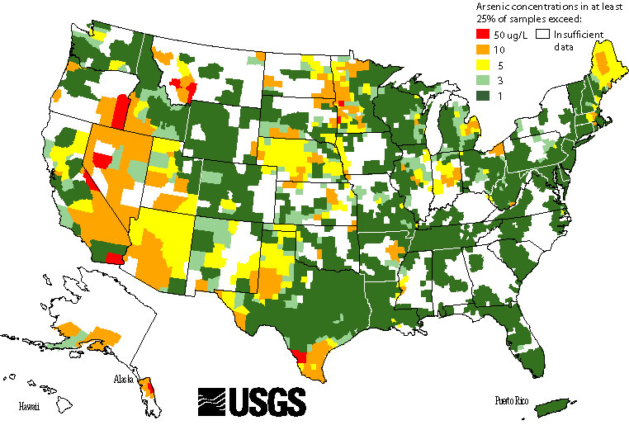
US Arsenic Map
Notes:
Reference -
USGS – US Geological Services
Map of US – arsenic in water - http://co.water.usgs.gov/trace/arsenic/

Slide 19
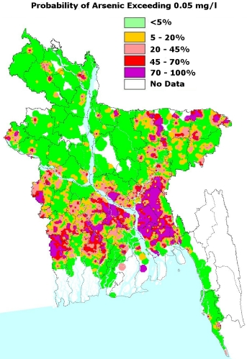
Bangladesh Arsenic Map
Notes:
Reference –
Arsenic in West Bengal & Bangladesh – Arsenic Crisis Information Center
Access: http://bicn.com/acic/

Slide 20
Susceptibility & Variability
Children – small size, higher water consumption for size

Slide 21
Reducing Exposure
Avoid (do not use treated lumber)
Test drinking water
Stop smoking
Wash hands

Slide 22
Summary
Arsenic in drinking water is a worldwide human health hazard
Avoid the use of arsenic treated wood
Reduce or avoid arsenic exposure

Slide 23
Regulatory Status
EPA - Drinking water 50 µg/L (50 ppb) (under review to 10 µg/L)
EPA – RfD - .3 µg/kg-day
ATSDR – MRL – 0.3 µg/kg/day (chronic exposure)
OSHA - Workplace air - 0.5 mg/m³

Slide 24
A Small Dose of Arsenic

Slide 25
Authorship Information
This presentation is supplement to
“A Small Dose of Toxicology”
For Additional Information Contact
Steven G. Gilbert, PhD, DABT
E-mail: sgilbert@innd.org
www.asmalldoseoftoxicology.org

