Slide 1
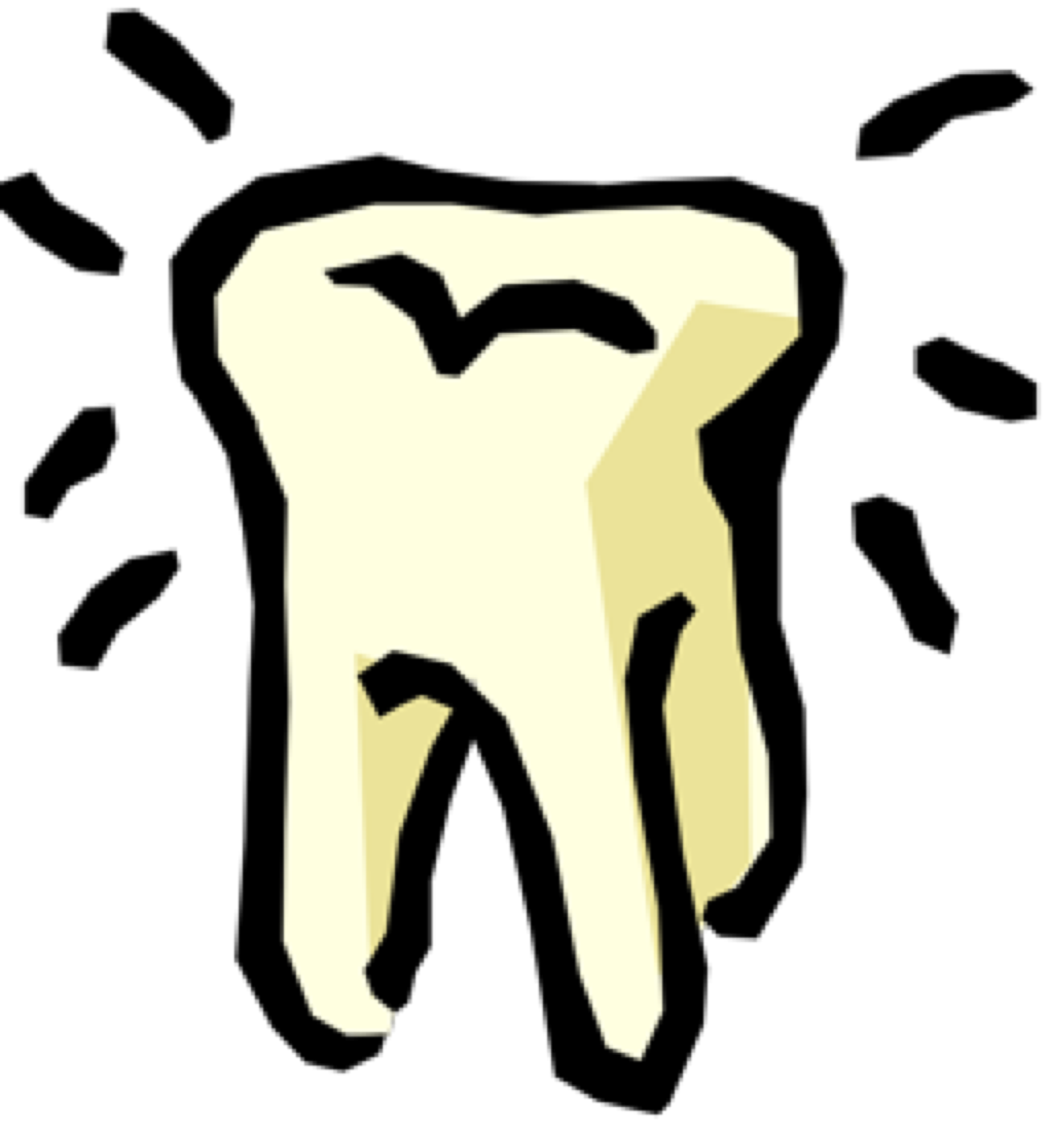
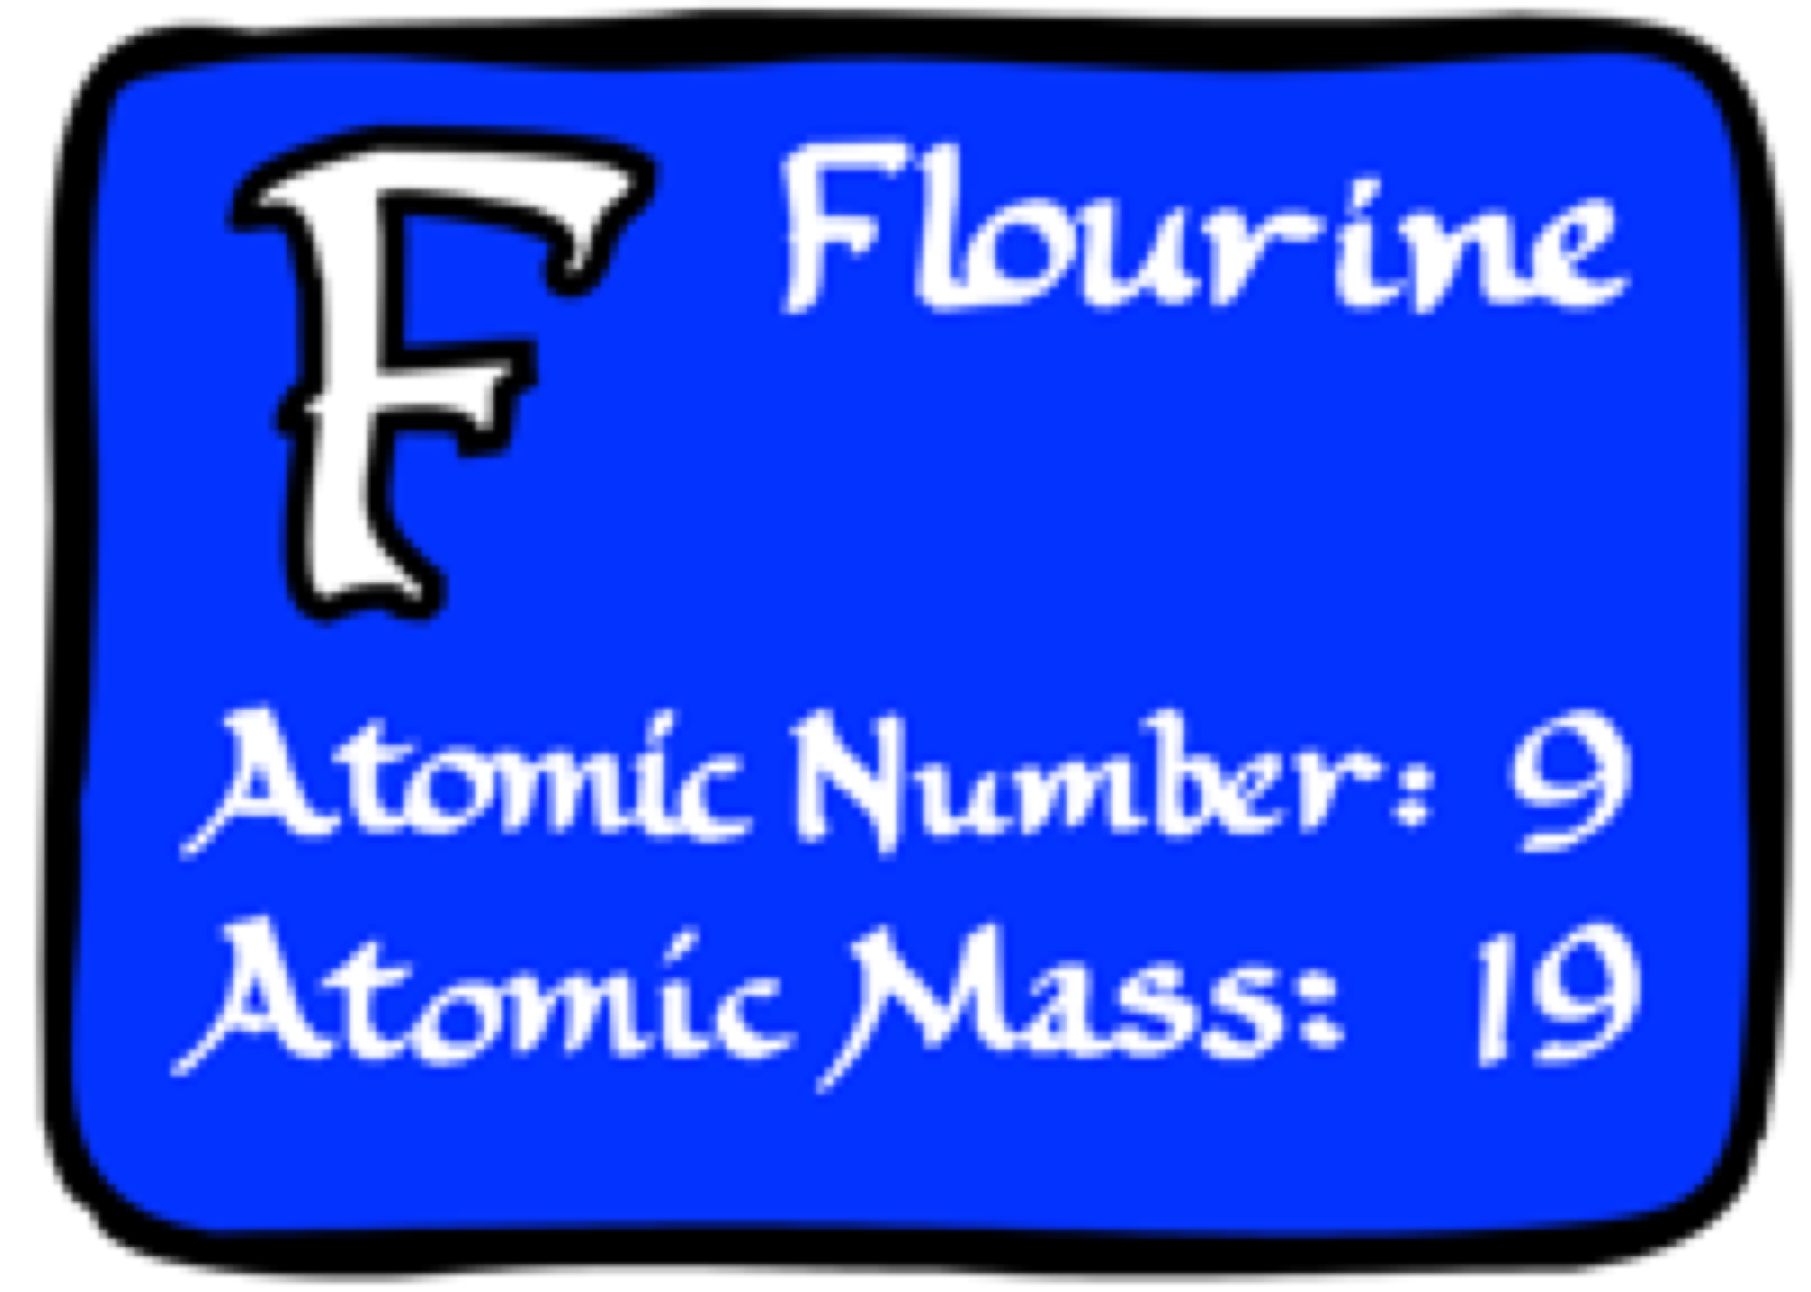
An Introduction To Risks and Benefits of Fluoride
A Small Dose of Fluoride

Slide 2
Fluorine is Reactive
Combines with almost anything
Sodium fluoride, NaF
Calcium fluoride, CaF2
Carbon tetrafluoride, CF4
Oxygen difluoride, OF2
sodium fluoroacetate – rat poison
Uranium hexafluoride

Slide 3
Fluorine (F)
Standard state: gas at 298 K
Colour: pale yellow
Classification: Non-metallic
Group name: Halogen
Highly reactive, corrosive gas, reacts with most organic and inorganic substances
No use and not produced until WW II – used to separate isotopes of uranium

Slide 4
Fluorine (F) - Uses
Producing isotopically fractionated uranium
Fluorochemicals used in high-temperature plastics
Fluoride is used in some pesticides (e.g. sulfuryl fluoride and trifluralin)
Hydrofluoric acid used for etching the glass of light bulbs, etc.
Fluorochloro hydrocarbons are in air conditioning and refrigeration
Fluorides in water sources prevent tooth decay. A constituent of toothpaste.

Slide 5
Fluorine (F) - Toxicity
Elemental fluorine and the fluoride ion (in quantity) are highly toxic.
Lethal - 71 mg/kg of sodium fluoride
Chronic doses as low as 1 mg/kg
Readily absorbed – Short half-life
Excreted in urine
Incorporated in bone / teeth (99% stored in bone)

Slide 6
Reducing Dental Caries
1951, Joseph C. Muhler and Harry G. Day of Indiana University reported that stannous fluoride as a tooth decay preventive and the university first sold the technology to Procter & Gamble to use in Crest toothpaste.
See: http://en.wikipedia.org/wiki/Fluoride

Slide 7
Its all in the acid
“Fluoride ions replace hydroxide ions in calcium hydroxyapatite, Ca5[(PO4)3OH], in teeth, forming calcium fluoroapatite, Ca5[(PO4)3F], which is more chemically stable and dissolves at a pH of 4.5, compared to 5.5 pH for calcium hydroxyapatite.”
See: http://en.wikipedia.org/wiki/Fluoride

Slide 8
Fluoride in Toothpaste
Sodium fluoride (NaF)
Stannous(II) fluoride (SnF2)
sodium monofluorophosphate (Na2PO3F)
Fluorine compounds added to toothpaste

Slide 9
CDC on Mechanism
“...fluoride prevents dental caries predominately after eruption of the tooth into the mouth, and its actions primarily are topical for both adults and children…”
CDC (1999). Achievements in Public Health, 1900-1999: Fluoridation of
Drinking Water to Prevent Dental Caries. MMWR, 48(41); 933-940, October 22.

Slide 10
Health Effects
cancer in young males; osteoporosis; reduced I.Q.; and hip fractures in the elderly
Teeth - mottled enamel
Age-specific fluoride exposure in drinking water and osteosarcoma (United States). Elise B. Bassin, David Wypij, Roger B. Davis, Murray A. Mittleman

Slide 11
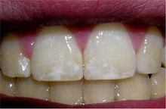
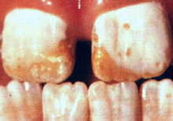
Dental fluorosis
Mild fluorosis
Severe fluorosis
See: http://en.wikipedia.org/wiki/Dental_fluorosis

Slide 12
Dental fluorosis
Fluorosis – excess exposure to fluoride during ages of 6 months to 5 years
Low calcium increase fluorosis
High calcium protective
Drinking water target is 1 ppm (0.7 to 1.3)
See: http://en.wikipedia.org/wiki/Dental_fluorosis

Slide 13
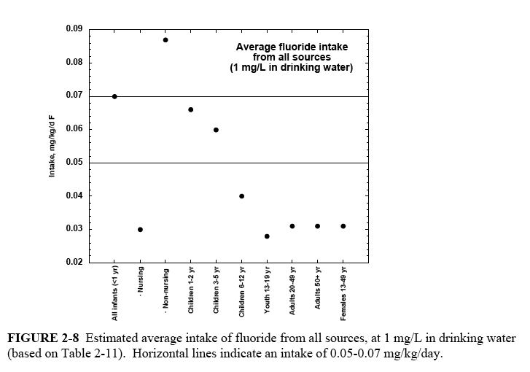
Average Total Fluoride Intake
Risk period for dental fluorosis
Target “theraputic” zone

Slide 14
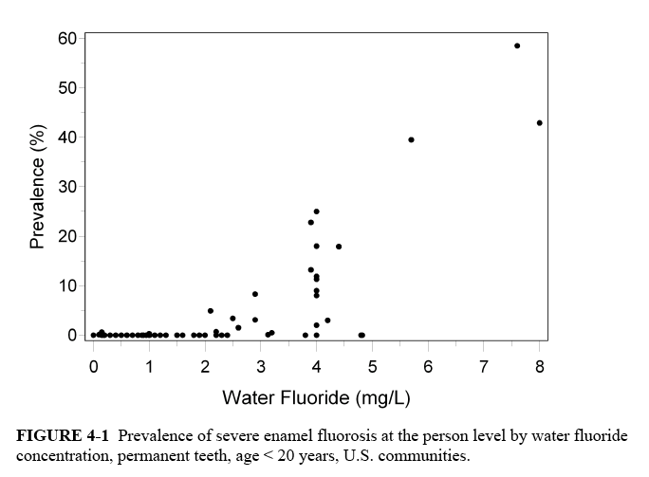
Prevalence of Severe Fluorosis

Slide 15
Dental Fluorosis with “Optimal” Flouride
In largest US Survey 29.9% of US children living in fluoridated communities have dental fluorosis on at least two teeth (Heller et al, 1997).
CDC (2005) dental fluorosis impacts one in three American kids - up 9% since 1986-87.

Slide 16
Symptoms of Skeletal Fluorosis
Moderate (stage II) Crippling (stage III)
Sporadic pain
Stiffness of joints
Osteosclerosis of pelvis and spine
Chronic joint pain
Arthritic symptoms
Calcification of ligaments
Osteosclerosis of cancellous (porous) bones
Limiting of mobility
Bone fluoride concentrations from lifetime exposure at 2 ppm (the SMCL) fall within or exceed levels associated with stage II or stage III skeletal fluorosis. (NRC 2006)

Slide 17
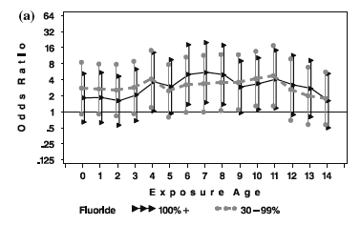
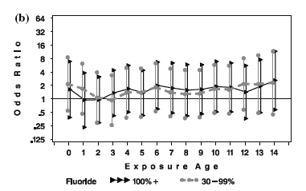
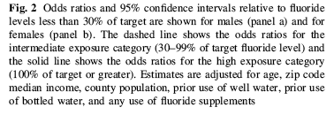
Odds ratio for osteosarcoma (Bassin et al. 2006)
males
females

Slide 18
Effective versus Toxic Conc.
Severe Dental Fluorosis
LOAEL=20mg/day (crippling skeletal fluorosis)
Intake = 2L/day
Safety factor=2.5X
4
MCL=4ppm
2.5-4ppm IQ deficits in Chinese studies
?
2.5ppm=“threshold” for severe dental fluorosis
2
SCL=2ppm: 4-15% mod. dental fluorosis
ppm in drinking water
?
1
1ppm=target level of water fluoridation
0
Prevalence (%)

Slide 19
Effective versus Toxic Dose
0.20
4ppm (1L/d, 20 kg child)
0.15
1ppm child 10kg 1L/d
4ppm (2L/d, 70kg adult)
Average dietary intake
Age 0-2 yrs
Fluoride 0.7-1.1 ppm
0.10
Crippling Skel. Flsis at 40 yr (NRC 77)
1ppm child 20 kg 1L/d
Dose (mg/kg/day)
EPA RfD
“Optimal” theraputic dose range
0.05
1ppm adult 2L/d
1ppm adult 1L/d
0
STANDARDS THERAPUTIC/DIETARY RANGE TOTAL INTAKES

Slide 20
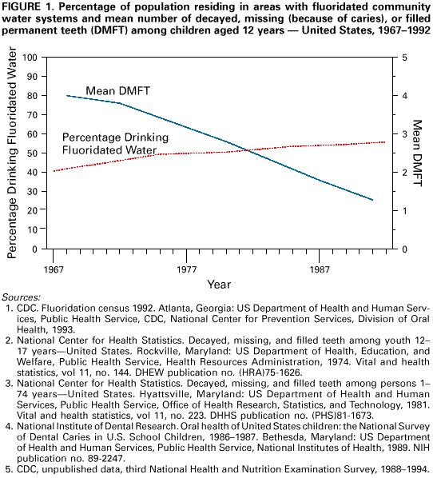
Has Fluoridation Reduced Tooth Decay?
CDC MMWR, October 22, 1999

Slide 21
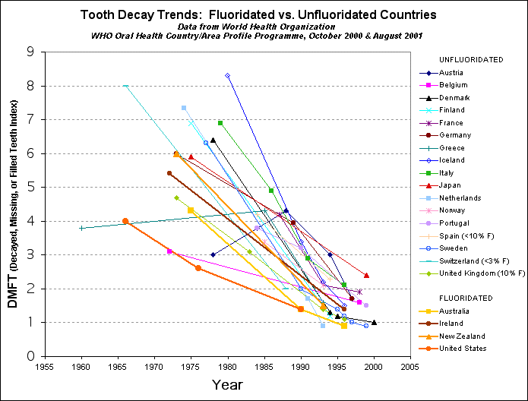
Fluoridated vs. Unfluoridated
Figure 2: Tooth Decay Trends for 12 Year Olds: Fluoridated Vs. Unfluoridated Countries. Data from World Health Organization. (Graph by Chris Neurath).

Slide 22
Selected Findings from NRC
The MCL should be lowered (EPA directed to do a new risk assessment).
Bone fluoride concs from lifetime exposure at 2 ppm (SMCL) fall within or exceed levels associated with stage II (mod.) or stage III (sev.) skeletal fluorosis
The SCML (2ppm) does not completely protect against moderate enamel fluorosis.(Moderate enamel fluorosis might have phychological or social effects.)

Slide 23
More Findings from NRC
The possibility has been raised by the studies conducted in China that fluoride can lower intellectual abilities. (2.5-4 ppm)
Fluoride affects normal endocrine function or response; fluoride is an endocrine disruptor in the broad sense of altering normal endocrine function or response.

Slide 24
Principal Conclusions (P+S)
Drinking water not most effective treatment method
Small to vanishing margin of safety does not protect highly exposed people
Water fluoridation is only part (~1/2-2/3 of total fluoride exposure)
Lifetime exposure to fluoridated water may lead to severe skeletal fluorosis, increased risk of hip and other bone fractures)
Fluoride at 1 ppm appears to increase risk of bone cancer in boys around age 7.
Much that we don’t know about many health effects (endocrine effects, bone cancer, etc.)
Most dentists have not looked at the data, only the ADA and CDC positions.

Slide 25
A Small Dose of Fluoride

Slide 26
Additional Information
Web Sites
Wikipedia - http://en.wikipedia.org/wiki/Fluoride
The Controversy - -http://en.wikipedia.org/wiki/Water_fluoridation_controversy
Anti fluoridation groups -- Fluoride Action Network - http://www.fluoridealert.org/
www.fluorideACTION.net
Pro fluoridation -- CDC on Water Fluoridation American Dental Association

Slide 27
Authorship Information
This presentation is supplement to
“A Small Dose of Toxicology”
For Additional Information Contact
Steven G. Gilbert, PhD, DABT
Web: www.asmalldoseoftoxicology.org

