Slide 1
An Introduction To The Health Effects of Solvents
A Small Dose of Solvent

Slide 2
Carbon tetrachloride (CCl₄)
Cl
Cl
C
Cl
Cl
Liver necrosis – fat accumulation

Slide 3
Methanol
H
H
C
OH
H
Methyl Alcohol

Slide 4
Ethanol
H
H
H
C
C
OH
H
H
Ethyl Alcohol

Slide 5
n-Hexane
H
H
H
H
H
H
H
C
C
C
C
C
C
H
H
H
H
H
H
H

Slide 6
Ethyl Ether
H
H
H
H
H
C
C
O
C
C
H
H
H
H
H

Slide 7
Carbon Disulfide (CS₂)
S
C
S

Slide 8
Chloroform (CHCl₃)
Cl
H
C
Cl
Cl
An early anesthetic agent.
Caused liver damage.

Slide 9
Quote / History
Have you every inhaled too much of a solvent?

Slide 10
Historical Events - Anesthetics
1275 - Ether discovered by Spanish chemist Raymundus Lullius and called “sweet vitriol”
1500s - Paracelsus experimented (enjoyed?) with the effects of ether
1842 – First used in surgery by Crawford Williamson Long, MD, of Jefferson, Georgia, U.S.
1846 - Dr. William T.G. Morton a dentist, anaesthetized a patient for surgery at the Massachusetts General Hospital
1929 – discovery of cyclopropane
1956 – discovery of halothane in England

Slide 11
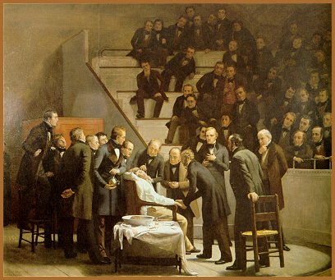
First Operation with Ether
Robert Hinckley's (1880’s)
"The First Operation with Ether"

Slide 12
Historical Awareness
Chloroform – one of the earliest anesthetic agents – discontinued early 1900’s because of liver toxicity

Slide 13
Anesthetic Agents
Cyclopropane
Enflurane
Halothane
Methoxyflurane
Diethy ether
Sevoflurane

Slide 14
Products – Mostly Solvents
Gasoline
Diesel Fuel
Charcoal lighter fluid
Lantern fuel
Grease
Lubricating oils
Degreasing agents
Paint stripers
Paint thinner
Turpentine
Nail polish remover

Slide 15
Products – Partly Solvents
Glues
Adhesives
Oil based paints
Furniture polishes
Floor polishes and waxes
Spot removers
Metal and wood cleaners
White out
Computer disk cleaner
Varnishes and shellacs
Wood and concrete stains

Slide 16
Exposure
Lungs – Quick to brain
Skin – Slow, irritant
Oral – e.g. alcohol

Slide 17
Acute Adverse Effects
Obvious (high exposure)
Death, loss of consciousness, paralysis, convulsion, disorientation, euphoria, giddiness, confusion.
Subtle
Impaired performance, depression, apathy, fatigue,

Slide 18
CNS Effects
Motor – fatigue, tremor, incoordination
Sensory – visual, auditory
Cognitive – short and long term memory, intellectual ability
Mood – depression, apathy, irritability, depression

Slide 19
Chronic Adverse Effects
Obvious
Cancer, reproductive effects, liver and kidney damage, developmental effects, visual system damage
Subtle
Impaired performance, impaired memory, depression, reduced intellectual ability

Slide 20
Regulatory Status
TLV – Threshold Limit Value
STEL – Short Term Exposure Limits (15 minute exposure)
TWA – Time Waited Average (acceptable for 8 hr day, 40 hr week)
TLV-C – Threshold Limit Value-C (ceiling not to be exceeded)

Slide 21
A Small Dose of ™ Solvent

Slide 22
Authorship Information
This presentation is supplement to
“A Small Dose of Toxicology”
For Additional Information Contact
Steven G. Gilbert, PhD, DABT
E-mail: sgilbert@innd.org
Web: www.asmalldoseoftoxicology.org

