Slide 1
An Introduction To The Health Effects of Persistent Chemical Pollutants
A Small Dose of Pollutant
Chapter 19 – 3rd Edition
Steven G. Gilbert, PhD, DABT
www.asmalldoseoftoxicology.org

Slide 2
Persistent Defined
Existing for a long or longer than usual time or continuously: as continuing without change in function or structure <persistent gills> or effective in the open for an appreciable time usually through slow volatilizing <mustard gas is persistent> or degraded only slowly by the environment <persistent pesticides>
Merriam-Webster Dictionary

Slide 3
What Persistent Chemical Pollutants?
Toxic to humans and animals
Persist in the environment
Do not break down
Bioaccumulate in animals becoming part of the food chain
Tend to be widespread

Slide 4
Persistent Environmental Contaminants
Various names depending on agency
U.S. EPA Persistent Bioaccumulative and Toxic (PBT)
United Nations Persistent Organic Pollutant (POP)

Slide 5
Persistent Organic Pollutants
“Persistent Organic Pollutants (POPs) are chemical substances that persist in the environment, bioaccumulate through the food web, and pose a risk of causing adverse effects to human health and the environment.”
UN Environment Program http://www.chem.unep.ch/pops/

Slide 6
Quote / History
“These (British Columbia, Canada & Washington, U.S.) killer (Orca) whales can now be considered among the most contaminated marine mammals in the world”
Dr. Peter Ross, Institute of Ocean Studies

Slide 7
ORTHO Lindane – 1953
From Advertisement for ORTHO Lindane – 1953
“Check These ORTHO Lindane Advantages:
High Safety Factor – Authorities have approved Lindane for lice and mange control on dairy cattle. Shows no contamination in milk when properly applied. …. Even used by dermatologists for human itch, lice and scabies. Not cumulative and practically odorless. Any taken in by a warm-blooded animal is eliminated.”

Slide 8
Silent Spring I
“As crude a weapon as a cave man’s club, the chemical barrage has been hurled against the fabric of life.”
Rachel Carson – Silent Spring (1962)

Slide 9
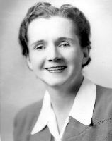
Silent Spring II
“The “control of nature” is a phrase conceived in arrogance, born of the Neanderthal age of biology and the convenience of man.”
Rachel Carson – Silent Spring (1962)

Slide 10
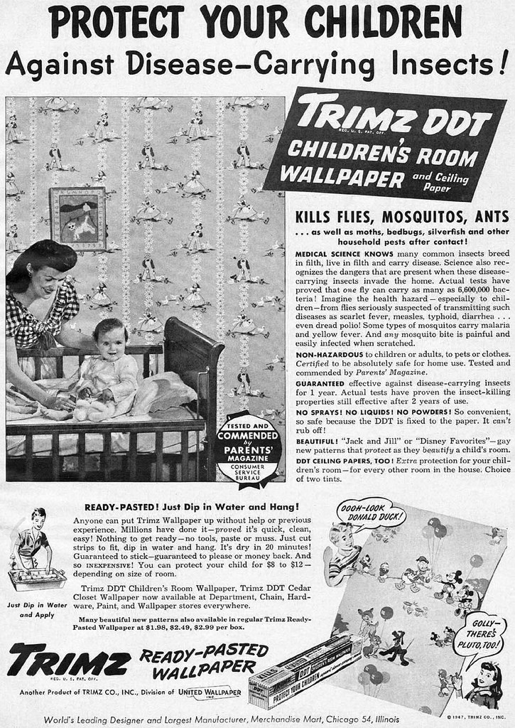
Historical Events
DDT – widely used 1950s and 1960s – now banned
PCBs – low flammable oil - widely distributed in environment – now banned
Rachel Carson – Silent Spring (1962)

Slide 11
Persistent Chemicals I
Aldrin/Dieldrin
Benzo(a)pyrene
Cadmium
Chlordane
DDT, DDD, DDE
Dicofol
Dioxins (TCDD) & Furans
Endrin
Endosulfan
Hexachlorobenzene

Slide 12
Persistent Chemicals II
Heptachlor
alkyl-lead
Lindane
Mercury
Methoxychlor
Mirex
Octachlorostyrene
Polychlorinated biophenyl’s (PCBs)

Slide 13
Persistent Chemicals III
Pendimethalin
Pentabromo diphenyl ether
Pentachloronitrobenzene
Polybrominated Hydrocarbons
Polycyclic aromatic hydrocarbons (PAHs)
Tin (organotins)
Toxaphene
Trifluralin
1,2,4,5-tetrachlorobenzene

Slide 14
Chemical Toxicity I
Aldrin/Dieldrin
Pesticide – Organochlorine – Bioaccumulates – Used to control mosquitoes and termites Importation and manufacture prohibited in the U.S. in 1987.
Chlordane
Pesticide – Organochlorine – Bioaccumulates – Used to control mosquitoes and termites

Slide 15
Chemical Toxicity II
DDT, DDD, DDE
Pesticide – Organochlorine – Bioaccumulates – Used to control mosquitoes – Importation and manufacture prohibited in the U.S. in 1972. Affects wildlife – found in breast milk and fat
Dioxins (TCDD) & Furans
By product of combustion – Bioaccumulates – municipal and medical waste incinerators – human carcinogen

Slide 16
Chemical Toxicity III
Lead
Metal – Widely distributed in environment when used as a gasoline additive and in paint. Now banned from use in gasoline and paint. Potent child neurotoxicant
Mercury
Metal – Persistent – Bioaccumulates – Contaminates many species of fish. Widely used in industrial processes. Cause developmental neurotoxicity – children most susceptible

Slide 17
Chemical Toxicity IV
Mirex
Pesticide – Organochlorine – Bioaccumulates – Extensively used in U.S. from 1962-1978 to control fire ants. All use canceled in U.S. in 1978
Pentabromo diphenyl ether (PBDEs)
Widely used as flame retardant in fabric and plastics – highly persistent – recently found in women’s breast milk

Slide 18
Chemical Toxicity V
Polychlorinated biophenyl’s (PCBs)
Heat and fire resistant – extensively used from 1929 and 1977 in electrical transformers – all manufacture banned – extensively regulated – very widespread global contaminate
Polycyclic aromatic hydrocarbons (PAHs)
Combustion by products – class of 100 chemicals – combustion by products from oil to tobacco. Some of the first known carcinogens.

Slide 19
Chemical Toxicity VI
Tin (organotins)
Organotins are used in a number of consumer products including paint as a pesticide. Bioaccumulates and persistent, effects nervous system
Toxaphene
Pesticide – Organochlorine – Bioaccumulates – Extensively used on U.S. cotton crops from 1947 to 1980. Manufacture and use prohibited in the U.S.

Slide 20
Integrated Pest Management
"Integrated Pest Management (IPM) is a sustainable approach to managing pests by combining biological, cultural, physical and chemical tools in a way that minimizes economic, health and environmental risks.”
See www.IPMopedia.org

Slide 21
A Small Dose of Pollutant

Slide 22
Authorship Information
This presentation is supplement to
“A Small Dose of Toxicology”
For Additional Information Contact
Steven G. Gilbert, PhD, DABT
E-mail: sgilbert@innd.org
Web: www.asmalldoseoftoxicology.org

