Slide 1
A Small Dose of Toxicology
Principles of Toxicology
(an introduction to toxicology)
Chapter 2 – 3rd Edition
Steven G. Gilbert, PhD, DABT
www.asmalldoseoftoxicology.org

Slide 2
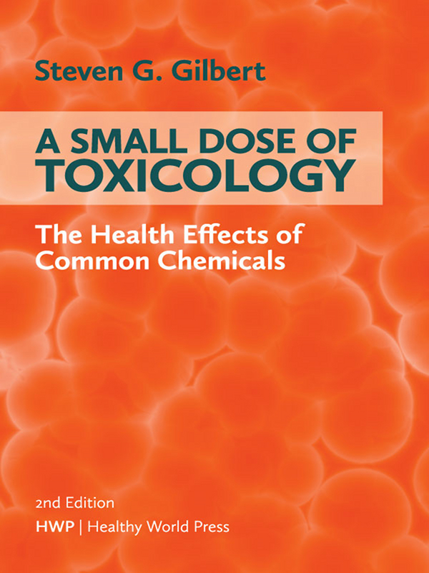
A Small Dose of Toxicology 3rd Edition
Free e-book
Healthy World Press
PDF and Power- power slides for each of
29 Chapters
See: www.asmalldoseoftoxicology.org

Slide 3

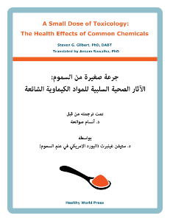
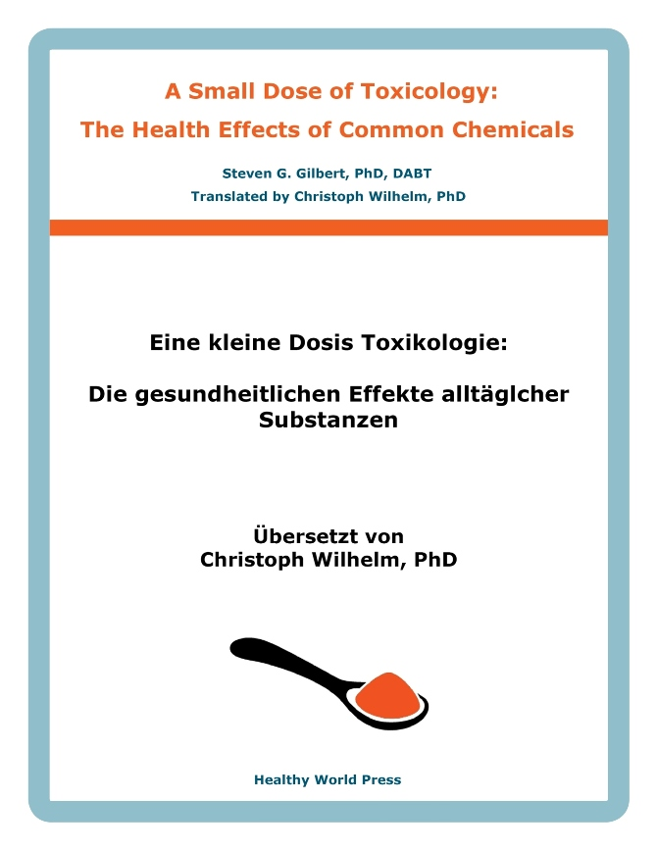
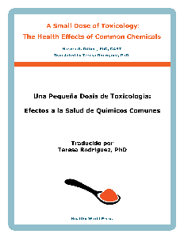
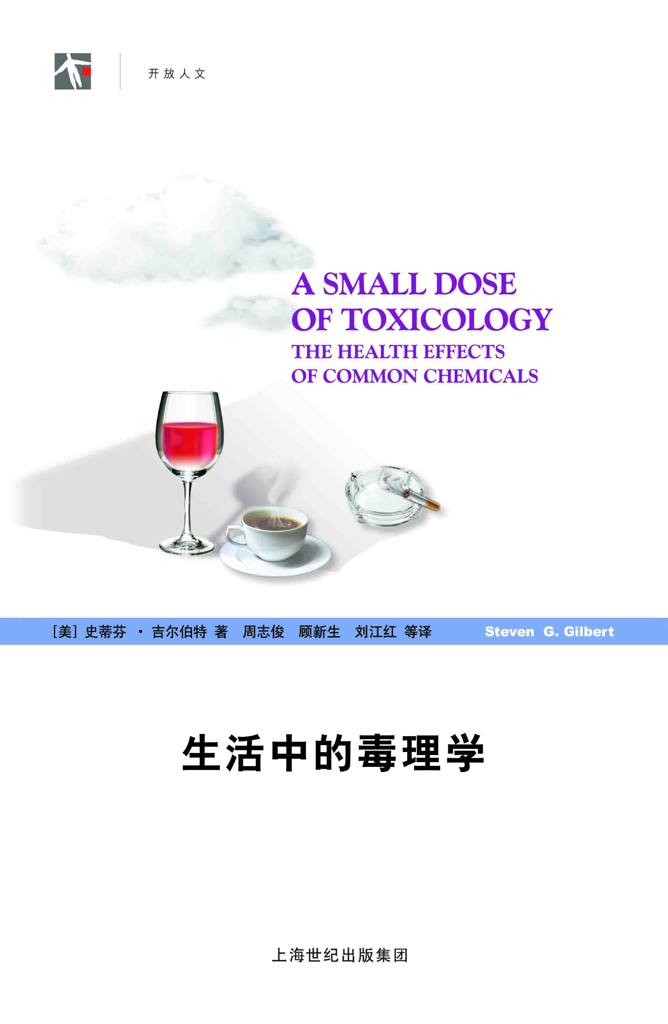
Small Dose of Toxicology
FREE
www.asmalldoseoftoxicology.org
English, Spanish, Arabic, German, Chinese

Slide 4
Environmental Health
“Conditions that ensure that all living things have the best opportunity to reach and maintain their full genetic potential.”
Steven G. Gilbert, 1999

Slide 5
What do these have in common?
Hong Kong
Princess Diana
Ambassador to Mexico
Coeur d’Alene, Silver Valley, ID
$276 Billion
$65 Billion
Solar Radiation (UV)
Food, noise, dust
Too much caffeine
12,000 children
Notes:
Hong Kong --

Slide 6
Power To Discover The Truth
“It is not the truth that makes you free. It is your possession of the power to discover the truth. Our dilemma is that we do not know how to provide that power.”
Richard Lewontin
(New York Review of Books, Jan 7, 1997)

Slide 7
What Is This?
O
CH₃
CH₃
N
N
7
1
3
O
N
N
CH₃
Notes:
Caffeine – 1,3,7-trimethylxanthine

Slide 8
Key Words
Dose / Response
Risk =
Hazard X Exposure
Individual Sensitivity

Slide 9
Paracelsus
“All substances are poisons;
there is none which is not a poison.
The right dose differentiates a poison from a remedy.”
Paracelsus (1493-1541)

Slide 10
An Individual View
“The sensitivity of the individual differentiates a poison from a remedy. The fundamental principle of toxicology is the individual’s response to a dose.”
S. G. Gilbert (1997)

Slide 11
Examples
Thalidomide
Prenatal Alcohol Exposure
Childhood lead exposure
Mercury in gold mining

Slide 12
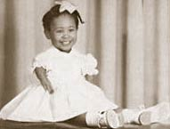
Thalidomide
Introduced in 1956 as sedative (sleeping pill) and to reduce nausea and vomiting during pregnancy
Withdrawn in 1961
Discovered to be a human teratogen causing absence of limbs or limb malformations in newborns
5000 to 7000 infants effected
Resulted in new drug testing rules

Slide 13
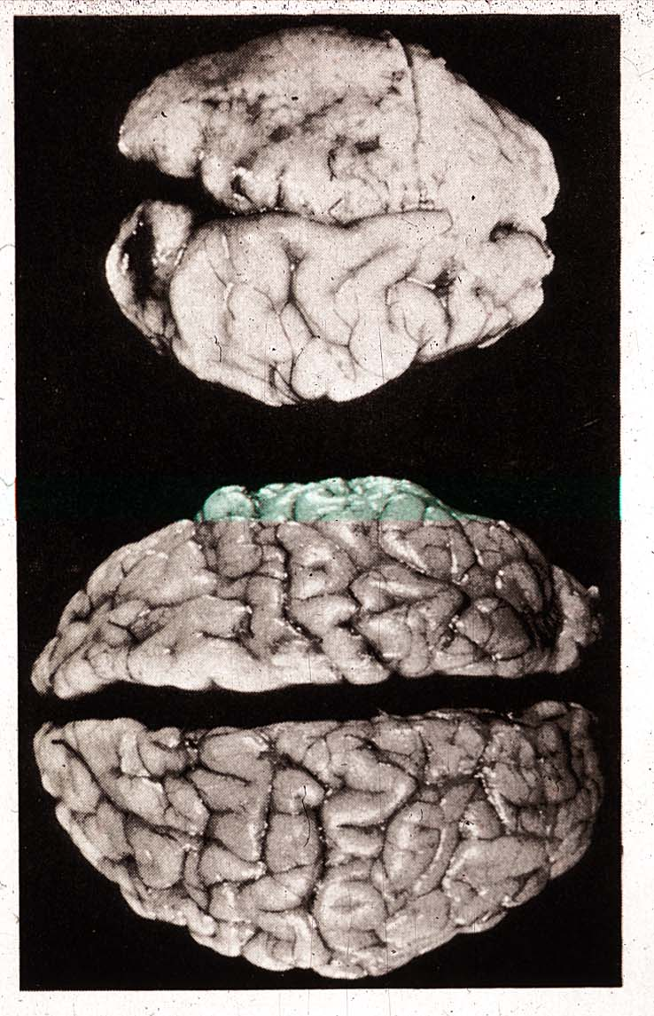
Effects of Prenatal Alcohol

Slide 14
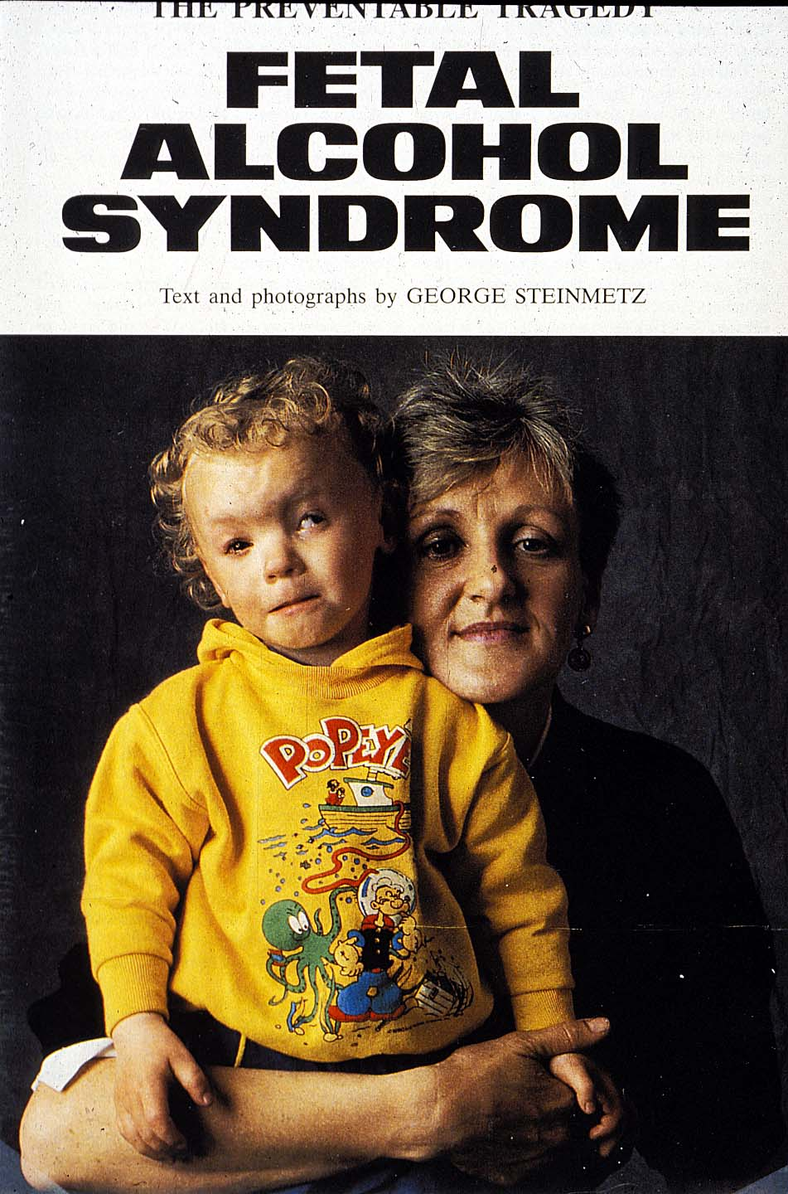
FAS Child

Slide 15
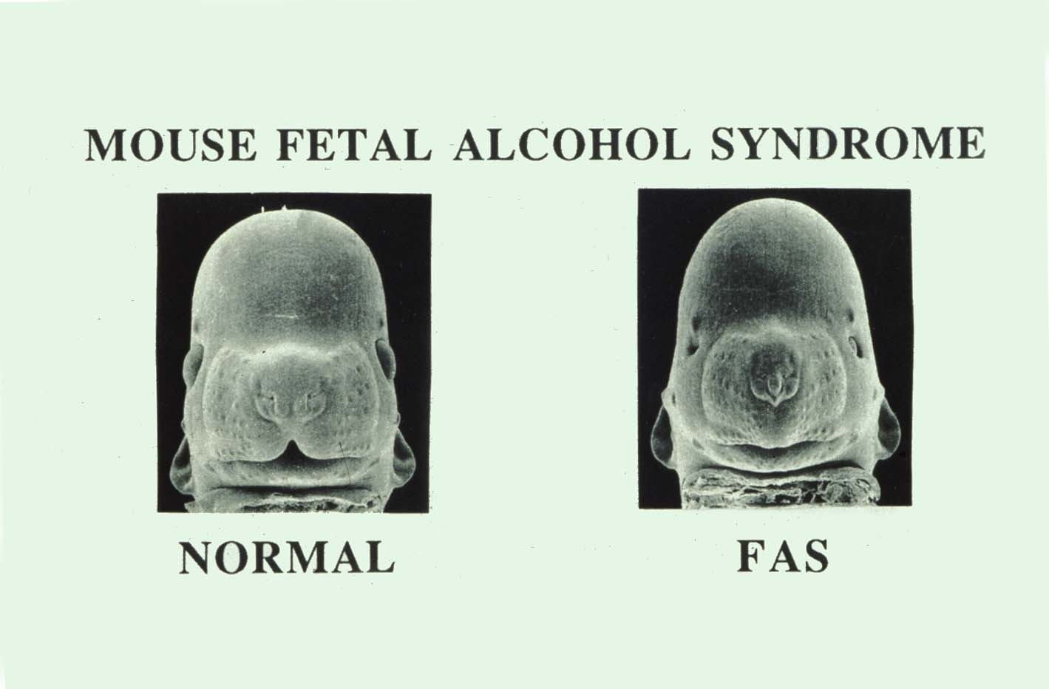
Mouse – Scanning EM

Slide 16
A Small Dose of Lead

Slide 17
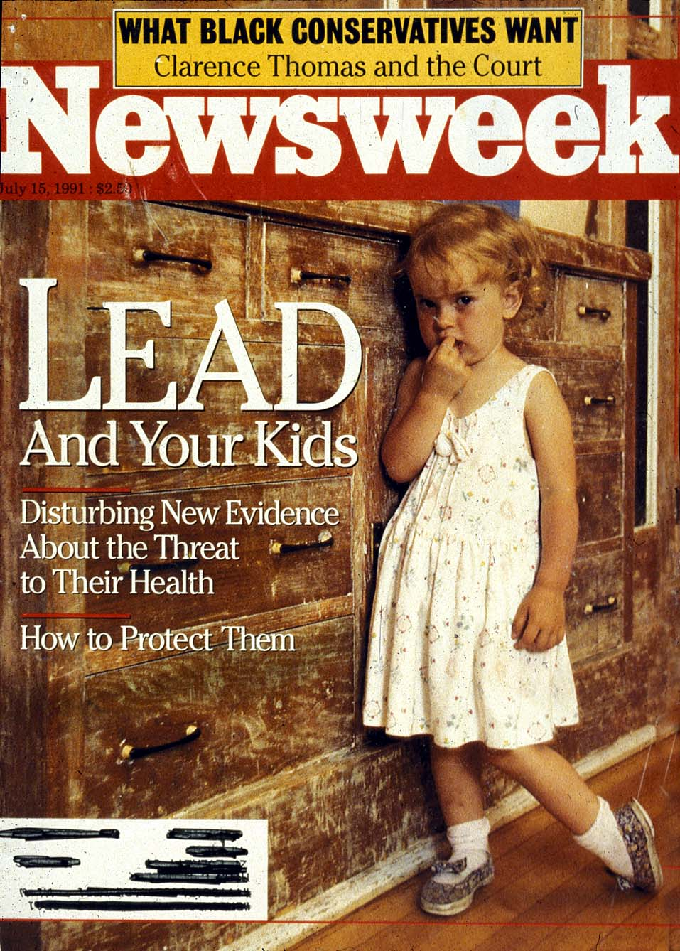
Lead In Homes

Slide 18
Lead History
Lead Makes the Mind Give Way
Greek 2nd BC

Slide 19
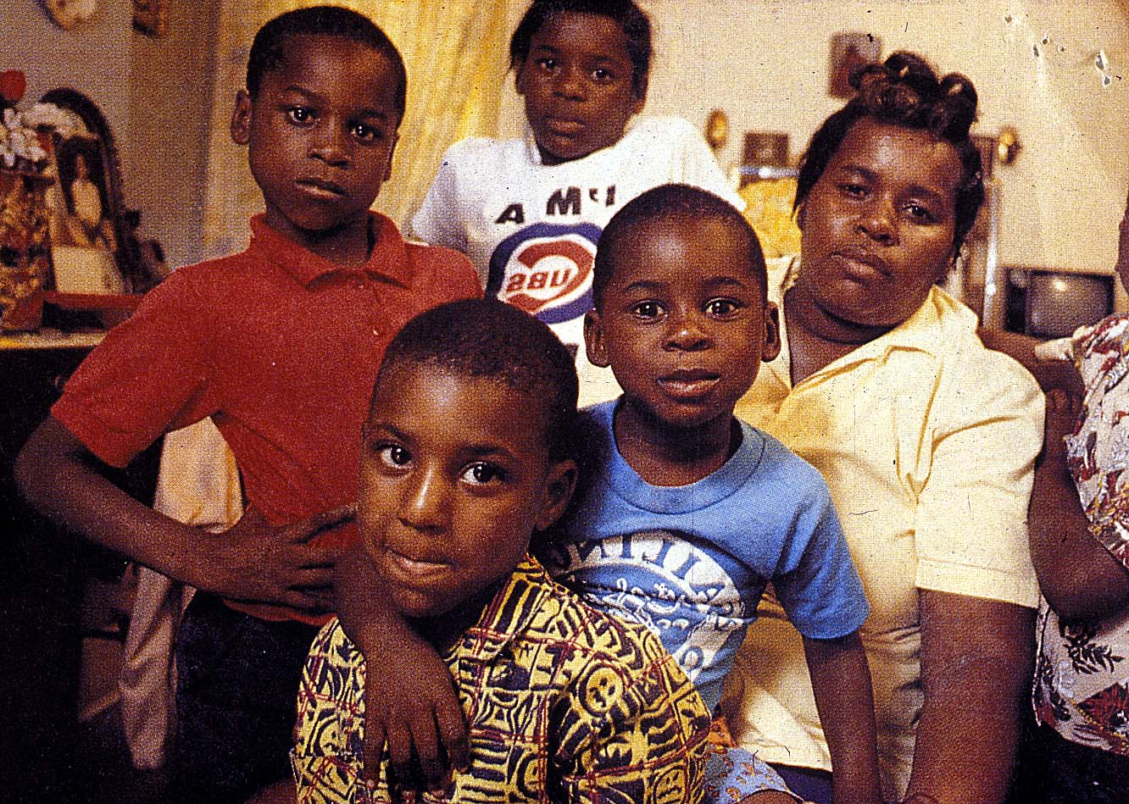
Lead in Families

Slide 20
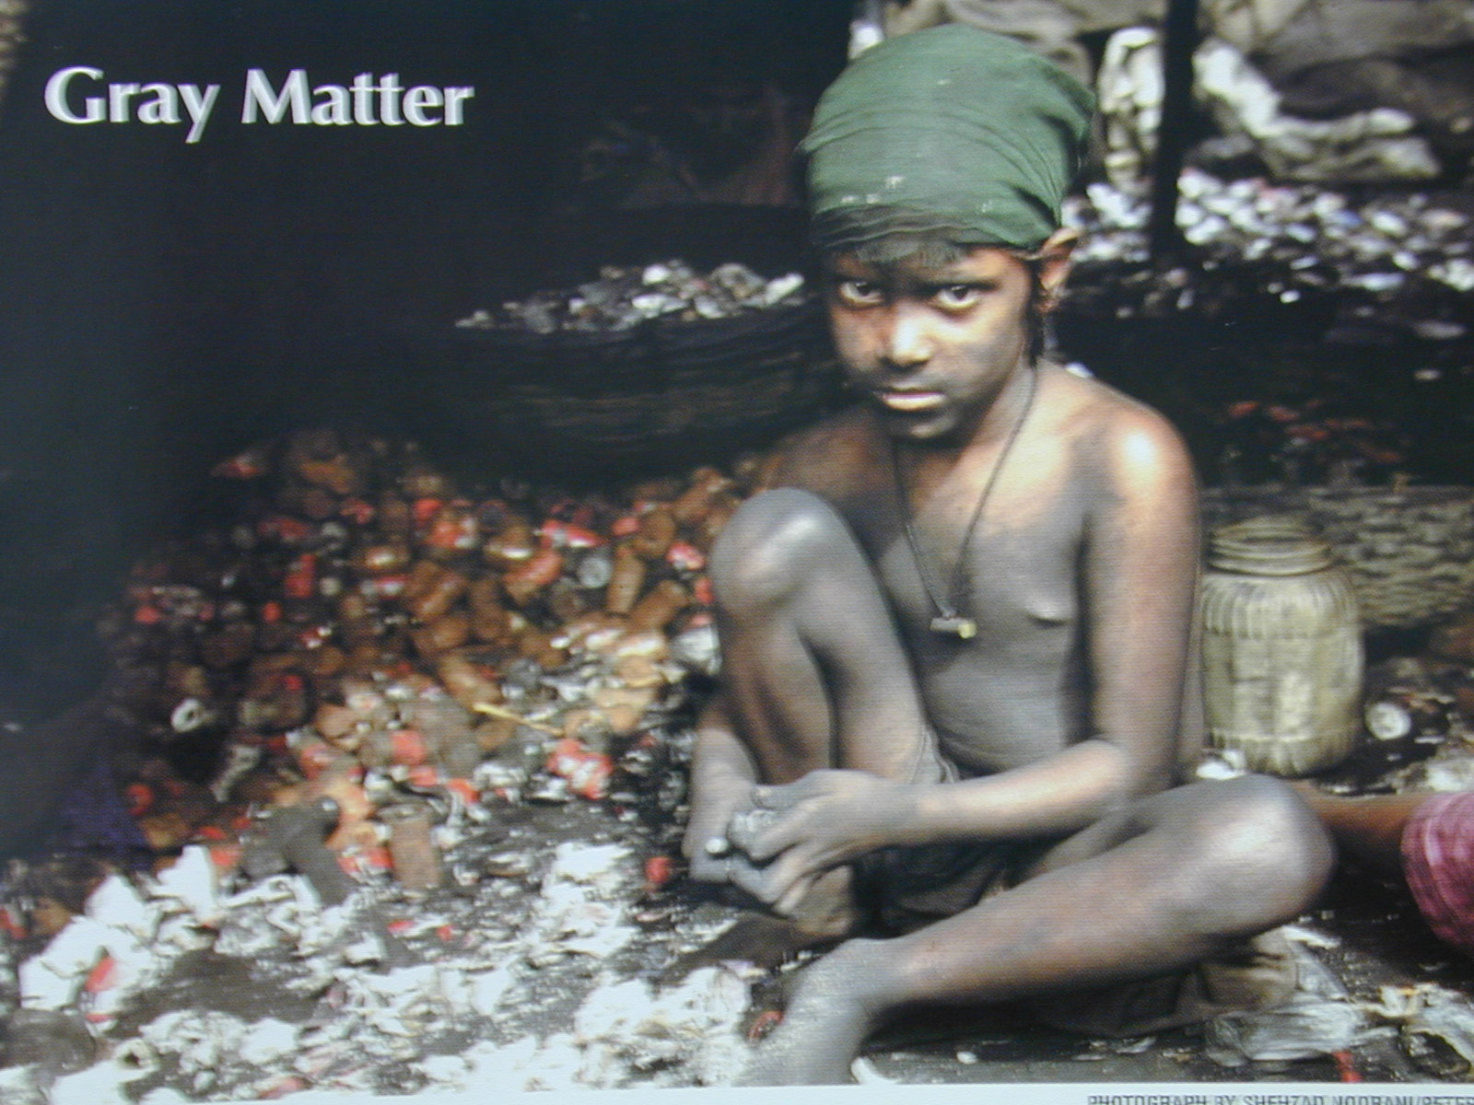
Recycling Lead

Slide 21
CDC Blood Lead Levels

Slide 22
A Small Dose of Mercury

Slide 23
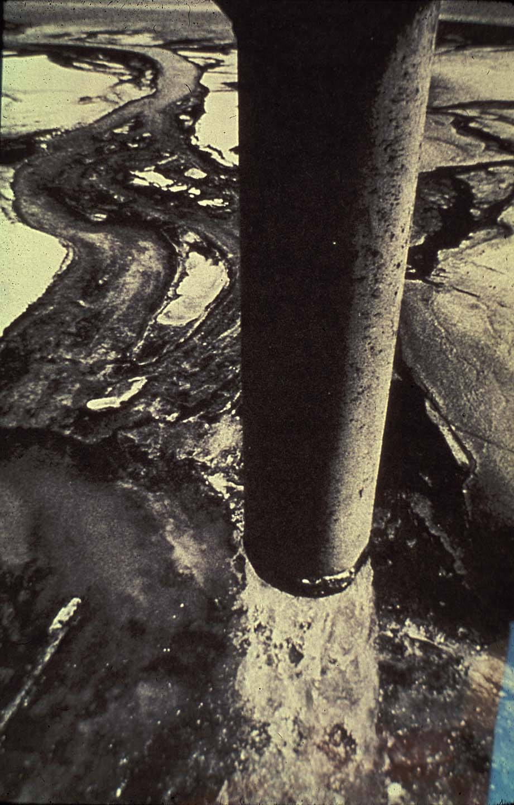
Polluting with HG
Discharge in Minamata Bay

Slide 24
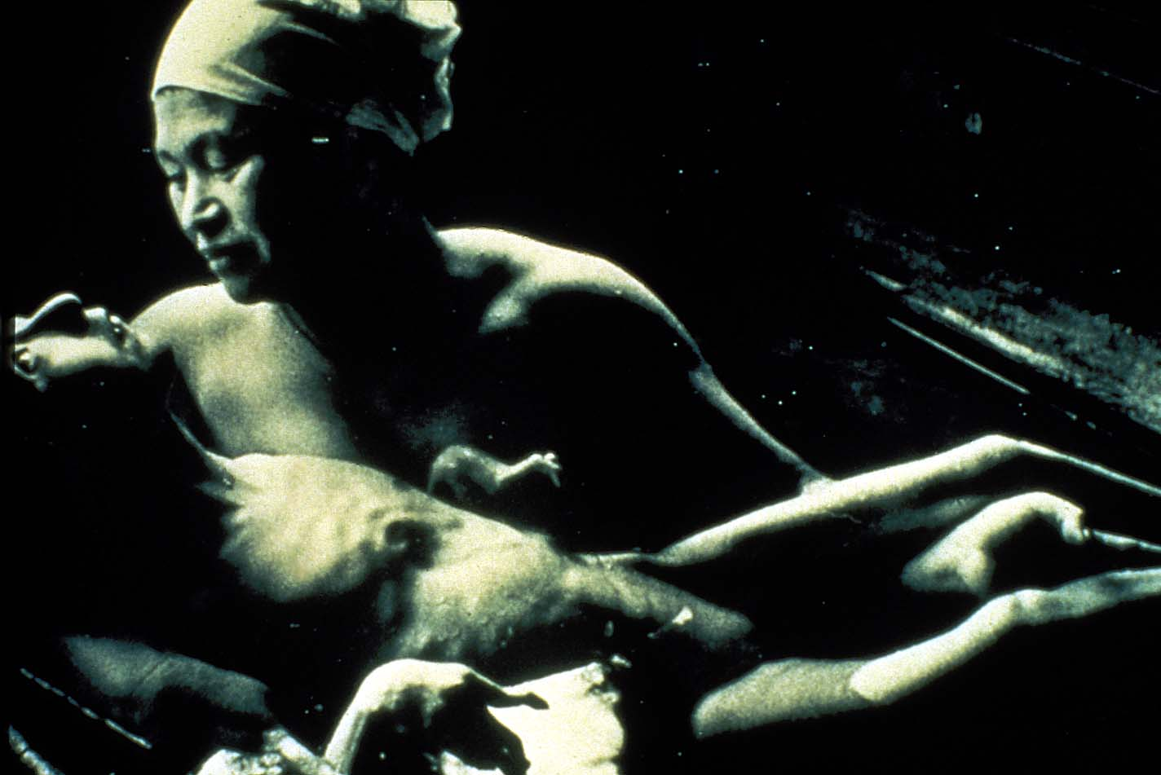
Fetal Effects of MeHg

Slide 25
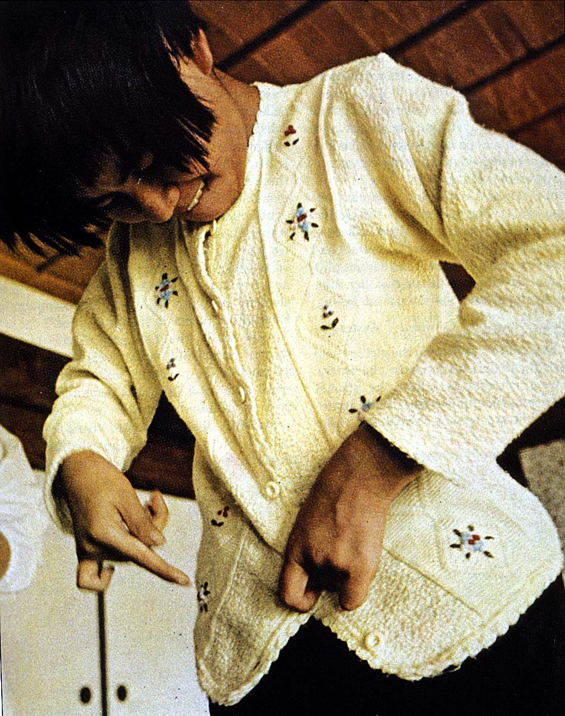
Life-Long Effects of MeHg

Slide 26
Effects of Amount on Response

Slide 27
Effects of Size on Response

Slide 28
Glasses of Wine - Dose Response
All Effected
100
75
% Difficulty Walking
50
Amount half
are effected
25
NO Effect
0
0
1
2
3
4
5
6
7
8
Glasses of Wine

Slide 29
Dose Response Function
All Effected
100
75
% Response
50
Half Effected
25
NO Effect
0
0
10
20
30
40
50
60
70
80
90
100
Dose (mg/kg body weight)
Increasing dose

Slide 30
Agent LD-50 (mg/kg)
Ethyl alcohol 10,000
Salt (sodium chloride) 4,000
Iron (Ferrous sulfate) 1,500
Morphine 900
Mothballs 500
(paradichlorobenzene)
Aspirin 250
DDT 250
Cyanide 10
Nicotine 1
Tetrodotoxin (from fish) 0.01
Dioxin (TCDD) 0.001
Botulinum Toxin 0.00001
Bee Venom ??

Slide 31
Exposure & Absorption
Route of exposure
1) Skin (dermal)
2) Lung (inhalation)
3) Oral (gut)

Slide 32
Frequency Of Exposure
Number of Times
Time Between
4 Beers in an hour or
4 Beers in 4 Days

Slide 33
Duration Of Exposure
Acute Exposure
Sub-chronic Exposure
Chronic Exposure

Slide 34
Distribution
Where It Goes
(body water, fat, bone)
Where It Accumulates

Slide 35
Metabolism
How The Body Breaks It Down
What It Turns Into
How Fast It Does It

Slide 36
Caffeine - 1,3,7 Trimethylxanthine
O
CH₃
CH₃
N
N
7
1
3
N
O
N
CH₃

Slide 37
Half-life
How Long It Takes To Go
14
12
10
8
Concentration (µg/ml)
6
4
2
0
0
1
2
3
4
5
6
7
8
9
10
11
Time (hrs)

Slide 38
Susceptibility & Variability
Young or Old
Male or Female
Individual Variability
Genetics Differences
Species Differences

Slide 39
Risk Assessment
Process of estimating association between an exposure and the incidence of some adverse outcome

Slide 40
What Is This?
CH₃
N
N

Slide 41
Nicotine
CH₃
N
N

Slide 42
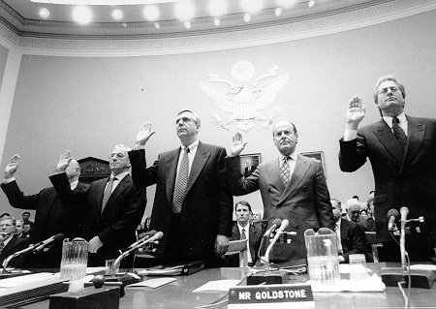
Tobacco CEOs

Slide 43

NW Public Health
Public Health and the Precautionary Principle
By Steven G. Gilbert
See: http://healthlinks.washington.edu/nwcphp/nph/
nwph

Slide 44
Precautionary Principle
“When an activity raises threats of harm to human health or the environment, precautionary measures should be take even if some cause and effect relationships are not fully established scientifically.”
Wingspread Conference, 1998.

Slide 45
Central components
Setting goals (Health indicators)
Taking preventive action in the face of uncertainty
Shifting the burden of responsibility to the proponents of an activity (Who benefits?)
Exploring a wide range of alternatives to possibly harmful actions (Is it necessary?)
Increasing public participation in decision making (transparency of information & environmental justice)

Slide 46
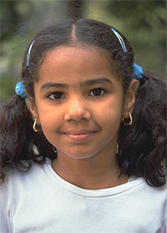
Child Health

Slide 47
A Small Dose of Toxicology

Slide 48
Additional Information
Web Sites
        Society of Toxicology - www.toxicology.org
        US Environmental Protection Agency (EPA) – www.epa.gov
        A Small Dose of Toxicology – www.asmalldoseof.org

Slide 49
Authorship Information
This presentation is supplement to
“A Small Dose of Toxicology”
For Additional Information Contact
Steven G. Gilbert, PhD, DABT
E-mail: sgilbert@innd.org
Web: www.asmalldoseoftoxicology.org

Slide 50
Normal Receptor-Ligand Interaction
1
Ligand
Receptor
Outside Cell
2
Cell Membrane
Inside Cell
Ligand binds to receptor
3
Signal Protein
Positive Response

Slide 51
Inactivation of Receptor by Toxicant
1
Toxicant
2
Toxicant
inactivates
receptor
3
No Response

Slide 52
Competition For Receptor
Ligand
1
Toxicant
2
Toxicant
out competes
normal ligand
3
Ligand cannot bind
receptor
No Response

