Slide 1
An Introduction To The Health Effects of Endocrine Disrupting Chemicals (EDCs)
A Small Dose of EDC
Chapter 20 – 3rd Edition
Steven G. Gilbert, PhD, DABT
www.asmalldoseoftoxicology.org

Slide 2
EDCs Defined
Endocrine Disrupting Chemicals
A broad range of chemicals that interact with endocrine system of humans and animals and produce a range of adverse effects

Slide 3
Case Study - Hormonal Contraceptives
Oral contraceptives - ultimate endocrine disruptor
May 9, 1960, the Food and Drug Administration approved “the Pill”
Combination of an estrogen and a progesterone, to inhibit female fertility
Patient reports of blood clots and pulmonary embolism

Slide 4
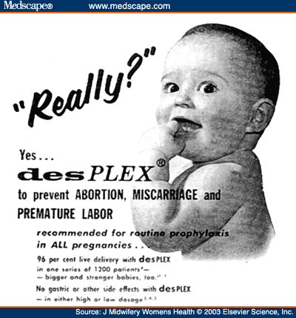
Case Study - DES
1938 - synthetic estrogen diethylstilbestrol (DES)
1941 the FDA approved its use for menopausal symptoms and 1947 to prevent miscarriages
1953 the first study indicating that DES was not effective in preventing miscarriages
1971 first study was published link DES to vaginal cancer in female offspring

Slide 5
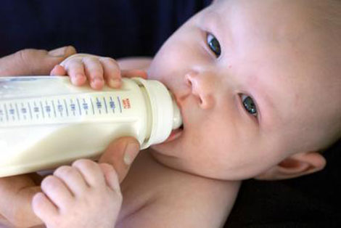
Case Study - BPA
1891 - Bisphenol-A (BPA), created by Aleksandr Dianin
1940s and 1950s, the chemical industry discovered that BPA was an excellent hardener for epoxy resins and plastic polycarbonate
estimated use per year of 6 billion pounds – used in consumer products
effects on the endocrine system occur at very low doses

Slide 6
Case Study - Atrazine
herbicides like Atrazine, used to kill broadleaf and grassy weeds
banned in the European Union as a persistent ground water contaminant
most widely used herbicides in the US
Atrazine feminizes male frogs by disrupting the endocrine system

Slide 7
Introduction - EDC
1991 - endocrine disruptor first used at a conference at the Wingspread Conference Center in Racine, Wisconsin. This conference was chaired by Theo Colburn,
The term was introduced into the scientific literature in 1993. Colborn T, vom Saal FS, Soto AM (EHP, 101(5) October 1993).

Slide 8
Health Effects - EDCs
reproductive issues
reduced fertility
male and female reproductive tract abnormalities
skewed male/female sex ratios changes in hormone levels
early puberty
brain and behavior problems
impaired immune functions
various cancers

Slide 9
Chemicals - EDCs
Hormones (natural & synthetic)
Plant constituents
Pesticides
compounds used in the plastics industry and in consumer products
other industrial by-products and pollutants

Slide 10
Chemicals - EDCs
DDT
Bisphenol A
Polychlorinated biphenyls
Polybrominated diphenyl ethers
Phthalates

Slide 11
Endocrine System
The endocrine system is the body’s chemical communication system, using the blood vessels to move chemicals throughout the body to communicate with different cells of the body. The endocrine system regulates metabolism, growth, development and puberty, and organ function.

Slide 12
Glands that excrete Hormones
Pineal gland
Pituitary gland
Thyroid gland
Adrenal gland
Pancreas
Ovary
Testes

Slide 13
Hormones and Function – I
Gland (location) | Example hormone | Function
Pineal gland (brain) | Melatonin | Sleep
Pituitary gland (brain) | Growth hormone | Growth, cell reproduction
 | Prolactin | Milk production, sexual gratification
 | Thyroid-stimulating hormone | stimulates thyroid gland to secrete T3 and T4
 | Luteinizing hormone | Female: ovulation Male: regulates testosterone
Thyroid gland (neck) | Thyroxine (T4) | Metabolism
 | Triiodothyronine (T3) | Metabolism

Slide 14
Hormones and Function – II
Gland (location) | Example hormone | Function
Adrenal gland (kidney) | Glucocorticoids | Effects glucose uptake
 | Adrenaline | Fight-or-flight response (range of effects)
Pancreas (kidney) | Insulin | Regulates glucose
Ovary (female) | Progesterone | Pregnancy, muscle relaxation, range of effects
 | Estrogens | Growth, sexual characteristics
Testes (male) | Testosterone (androgen) | Muscle mass, bone density, sexual maturation

Slide 15
Silent Spring I
“As crude a weapon as a cave man’s club, the chemical barrage has been hurled against the fabric of life.”
Rachel Carson – Silent Spring (1962)

Slide 16
Silent Spring II
“The “control of nature” is a phrase conceived in arrogance, born of the Neanderthal age of biology and the convenience of man.”
Rachel Carson – Silent Spring (1962)

Slide 17
A Small Dose of ED

Slide 18
Authorship Information
This presentation is supplement to
“A Small Dose of Toxicology”
For Additional Information Contact
Steven G. Gilbert, PhD, DABT
E-mail: sgilbert@innd.org
Web: www.asmalldoseoftoxicology.org

