Slide 1
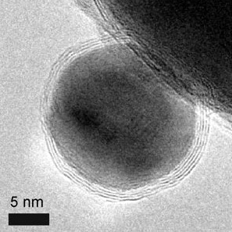
An Introduction to the Effects of Nanomaterials –
The Next Unregulated Revolution?
A Small (nano) Dose of Nanotoxicology
Chapter 21 – 3rd Edition
Steven G. Gilbert, PhD, DABT
www.asmalldoseoftoxicology.org
A Cobalt nanoparticle coated with layers of graphene

Slide 2
Nanomaterials
Very Small
Very disruptive (electricity, telephone, birth control …)
Huge benefits
Potential for huge harm

Slide 3
Nanotechnology
Latin from Greek nanos ‘dwarf’
“Nanotechnology is the understanding and control of matter at dimensions between approximately 1 and 100 nanometers, where unique phenomena enable novel applications.” http://www.nano.gov/
Multiple disciplines, including science, engineering, technology, toxicology, biomedical, government, materials science (manufacture / characterization)

Slide 4
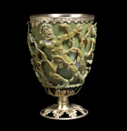
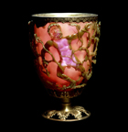
Nano in History
4th C: The Lycurgus Cup (Rome) - dichroic glass; colloidal gold and silver in the glass allow it to look opaque green when lit from outside but translucent red when light shines through the inside.’
http://www.nano.gov/timeline

Slide 5
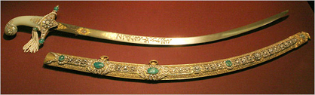
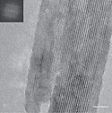
Nano in History
13th-18th C: “Damascus” saber blades contained carbon nanotubes and cementite nanowires—an ultrahigh-carbon steel formulation that gave them strength, resilience, the ability to hold a keen edge
http://www.nano.gov/timeline

Slide 6
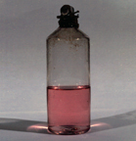
Nano in History
1857: Michael Faraday discovered colloidal “ruby” gold, demonstrating that nanostructured gold under certain lighting conditions produces different-colored solutions.
http://www.nano.gov/timeline

Slide 7
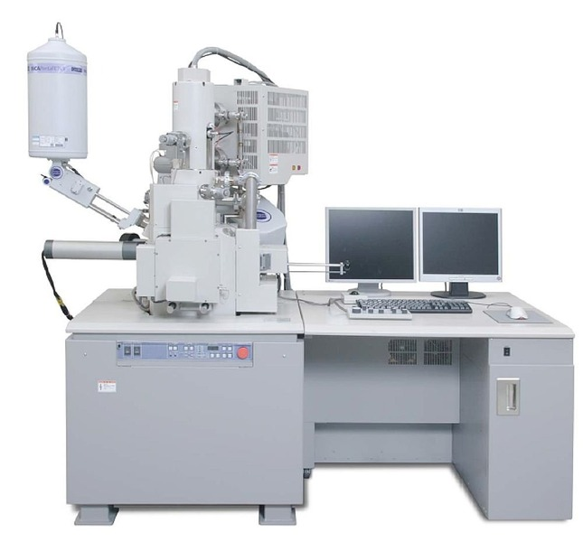
Nano in History
1936: Erwin Müller, working at Siemens Research Laboratory, invented the field emission microscope, allowing near-atomic-resolution images of materials.
http://www.nano.gov/timeline

Slide 8
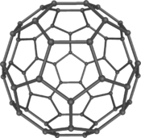
Nano in History
1981: Russia’s Alexei Ekimov discovered nanocrystalline, semiconducting quantum dots in a glass matrix and conducted pioneering studies of their electronic and optical properties.
1985: Rice University researchers Harold Kroto, Sean O’Brien, Robert Curl, and Richard Smalley discovered the Buckminsterfullerene (C60), more commonly known as the buckyball, which is a molecule resembling a soccerball in shape and composed entirely of carbon, as are graphite and diamond.
http://www.nano.gov/timeline

Slide 9
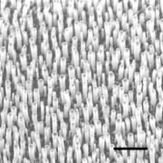
Nano in History
1991: Sumio Iijima of NEC is credited with discovering the carbon nanotube (CNT). Iijima shared the Kavli Prize in Nanoscience in 2008 for this advance and other advances in the field.
http://www.nano.gov/timeline

Slide 10

Nano in History
1999–early 2000’s: Consumer products making use of nanotechnology began appearing in the marketplace
http://www.nano.gov/timeline

Slide 11
Nano in History
2004: Britain’s Royal Society and the Royal Academy of Engineering published Nanoscience and Nanotechnologies: Opportunities and Uncertainties advocating the need to address potential health, environmental, social, ethical, and regulatory issues associated with nanotechnology.
http://www.nano.gov/timeline

Slide 12
Nano in History
2008: The first official National Nanotechnology Initiative (NNI) Strategy for Nanotechnology-Related Environmental, Health, and Safety (EHS) Research was published, based on a two-year process of NNI-sponsored investigations and public dialogs.
2011: The NSET Subcommittee updated both the NNI Strategic Plan and the NNI Environmental, Health, and Safety Research Strategy, drawing on extensive input from public workshops and online dialog with stakeholders from Government, academia, NGOs, and the public, and others.
http://www.nano.gov/timeline

Slide 13
Promises of Nanotechnology
Clean Energy
Clean, secure affordable energy
Solar panels more efficient.
Fuel cell development
Clean Water
Nanomaterials - detection of impurities (pollutants, microbes, etc), as well as removal of them, catalysts reduce waste water

Slide 14
How big is a nanometer (nm)?
Sheet of paper is about 100,000 nm thick.
A strand of human DNA is 2.5 nanometers in diameter
A human hair is approximately 80,000- 100,000 nanometers wide
There are 25,400,000 nm in an inch.
A single gold atom is about a third of a nanometer in diameter
A nanometer is a millionth of a millimeter (10-9)

Slide 15
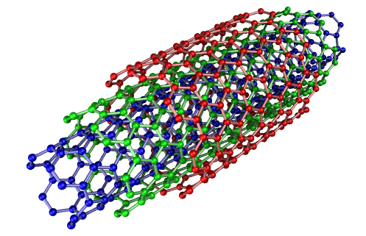
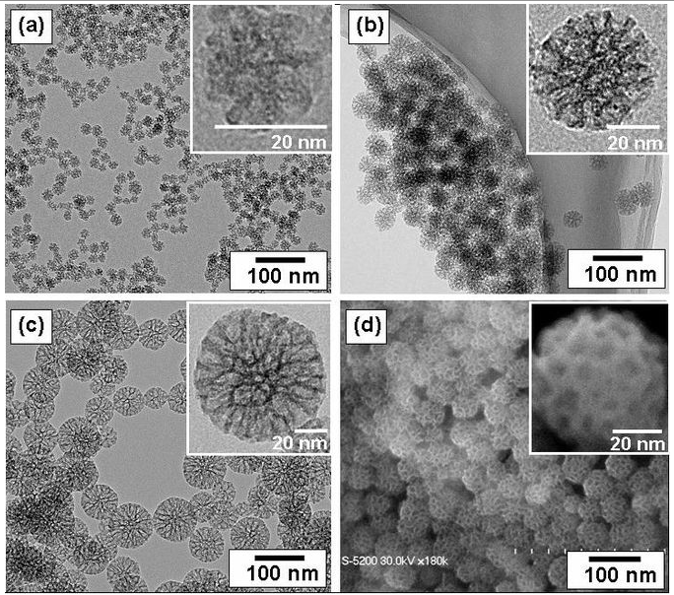
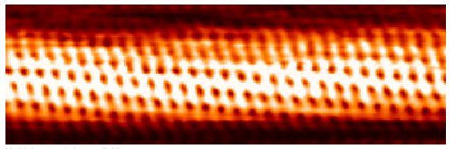
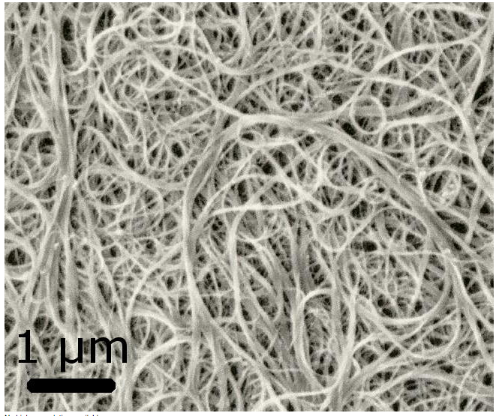
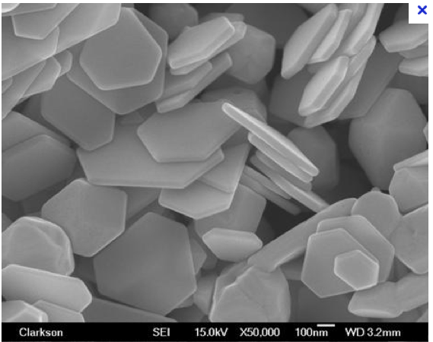
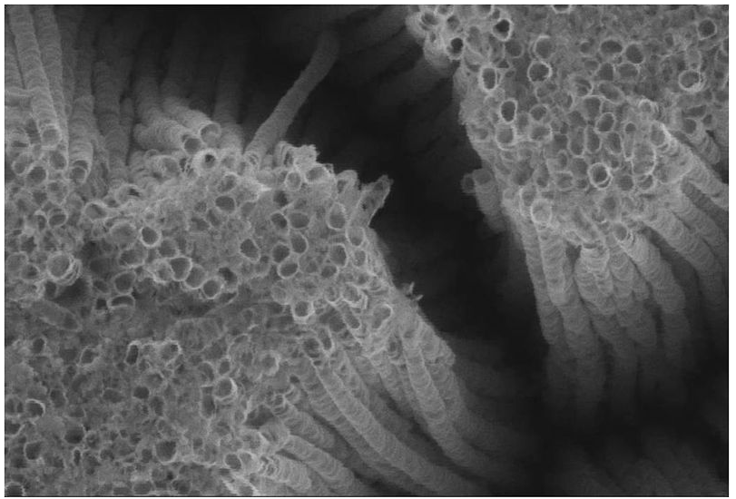
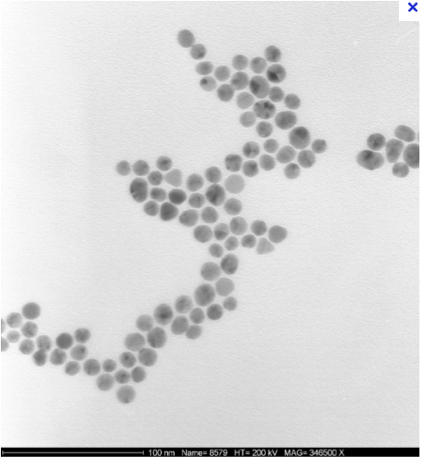
Common engineered nanomaterials
Amorphous silica
Carbon nanotubes
Nanosilver
TiO2 (nanotubes)
Nanogold

Slide 16
Nano New Chemical Entity?
Nanomaterials can exhibit different fundamental physical, biological, and chemical properties than their larger counterparts.
Consequences?

Slide 17
Classes of nanomaterials
Engineered nanomaterials: Manufactured materials with engineered structure between 1 - 100 nm.
Incidental nanomaterials: Materials with a structure between 1 - 100 nm produced as a by-product of a process. Examples: welding fume and diesel emission particulates.
Natural nanomaterials: Materials with a structure between 1 - 100 nm that are a result of natural processes. Example: volcanic emissions, sea spray, and atmospheric gas-to-particle conversion.
Mimic of natural nanomaterials - create engineered nanomaterials. Example: Metallic Organic Frameworks (MOFs) similar structure and characteristics of volcanic ash

Slide 18
Nanomaterial New Properties?
Unusual physical, chemical, and biological characteristics at nano-scale
Individual nanoparticles have different properties than bulk solutions
Greater surface area/volume-potentially more reactive
Ability to manipulate individual particles
Surface chemicals
Consequences?

Slide 19
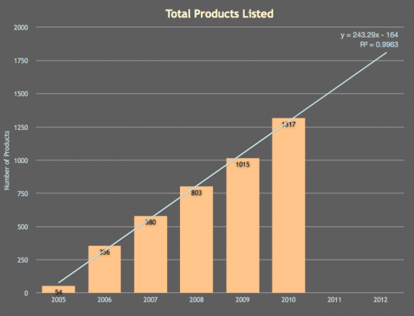
Nano Products Growing
March 2011, consumer products inventory contains 1317 products or product lines
http://www.nanotechproject.org/inventories/consumer/analysis_draft/

Slide 20
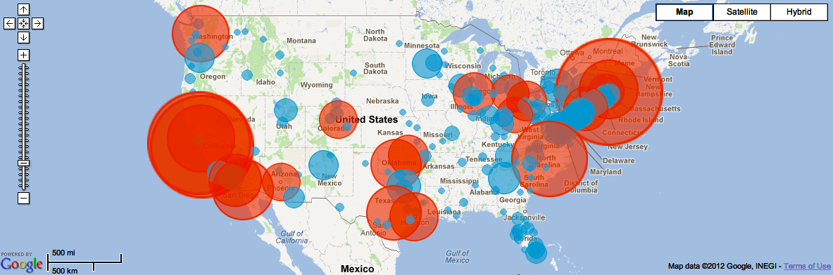
US NanoMetro Map
goods based on nanotechnology is predicted to grow from $147 billion in 2007 to $3.1 trillion in 2015
US Nano
http://www.nanotechproject.org/inventories/map/

Slide 21
Seattle NanoMetro Map
WA 35 companies / universities working with nano
http://www.nanotechproject.org/inventories/map/

Slide 22
Seattle NanoMetro Map
Examples
Hummingbird Scientific
  Analytical instruments
  http://www.hummingbirdscientific.com/home/
  Lacey, WA 98516
Nordstrom
  3LAB 'Super h' Age-Defying Serum
  An advanced treatment serum that contains Nano-Claire GY™—the world’s first cosmetic grade synthetic growth hormone $320
  http://shop.nordstrom.com/sr?keyword=nanotechnology&origin=keywordsearch
APEX NANOTECH, LLC
  Gasoline additive (secret technology)
  http://www.apexnanotech.com/
http://www.nanotechproject.org/inventories/map/

Slide 23
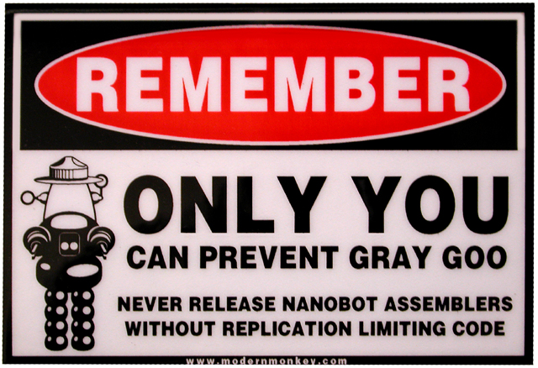
Take Precautions
Prey -- novel by Michael Crichton

Slide 24

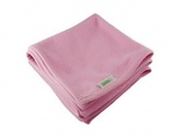
Known Nano Products
Baby Bear - With the additive of Silver Nanoparticles, our product has been clinically proven to fight against harmful bacteria, molds and mites.
Baby Blanket - The fabric is made using so-called ‘nano technology’ and allows the naturally occurring metal silver to be incorporated into the material.
http://www.nanotechproject.org/inventories/consumer/browse/categories/goods_for_children/

Slide 25
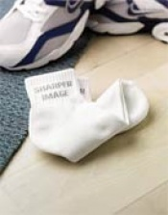
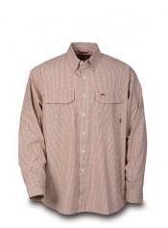
Known Nano Products
Antibacterial Silver Athletic and Lounging Socks: Sharper Image®PRODUCT “Cushioned, fitted, quarter-length sports socks knitted with a cotton material containing millions of invisible silver nanoparticles. Innovative socks are naturally antibacterial and antifungal.”
3XDRY® ESSEX SHIRT: Simms Fishing Products -- “UPF 30 offers all day sun protection Fabric features a special silver-based nanotechnology -
http://www.nanotechproject.org/inventories/consumer/browse/categories/health_fitness/clothing/

Slide 26
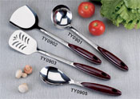

Known Nano Products
Antibacterial Kitchenware: Nano Care Technology, Ltd. -- Our Antibacterial tableware with nano silver coating could kill the attached bacteria and microbial in ten minutes and the effect can last for a long time even permanently and keep the surface always clean.
Nano-in Natural Environmental Cleaning Agent: Nano-Infinity Nanotech Co., Ltd. -- “this Nano micelle product containing natural glycerin can completely remove any pesticide residues on fruits/vegetable, and all the oil/dirt on cutlery. Its efficient and safe cleaning power is a must for your healthy life.”
http://www.nanotechproject.org/inventories/consumer/browse/categories/food_beverage/cooking/

Slide 27
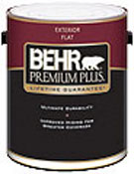

Known Nano Products
Behr® PREMIUM PLUS® Exterior Paint: Behr® Process Corporation -- “…Nanophase’s proprietary nanoparticles are now being used in Behr’s Premium Plus Ultra paint. Nanophase’s nanoparticles not only lend the paint improved adhesion and anti-mildew properties.”
Samsonite® Silhouette® 11 Collection: Samsonite – “Tricore Nylon with DuPont Nano Technology fabric protection
http://www.nanotechproject.org/inventories/consumer/browse/categories/food_beverage/cooking/

Slide 28
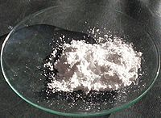
Case Study – Titanium dioxide (TiO2)
white pigment
Many uses - paints, coatings, plastics, papers, inks, foods, medicines, toothpastes
cosmetic and skin care products
  strong UV light absorbing capabilities
  coated with silica or alumina
NANO – clear instead of white

Slide 29
Case Study – Titanium dioxide (TiO2)
titanium dioxide (TiO2) and zinc oxide (ZnO) rub on clear instead of white.
“The U.S. Food and Drug Administration’s newly released sunscreen rules fail to meaningfully consider the risks posed by nanoscale ingredients, according to public interest groups including Friends of the Earth, The International Center for Technology Assessment and Consumers Union.” June 23, 2011
  (http://www.foe.org/news/archives/2011-06-new-fda-sunscreen-rules-called-blind-to-nanotechnolo)

Slide 30
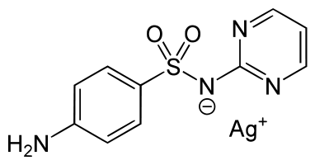
Case Study – Silver Nanoparticles
History –
Hippocrates, noted beneficial healing and antidisease properties
Silver coins in milk (1900s)
regulatory approval as an antimicrobial agent
Use declined in 1940s with antibiotics
Silver sulfadiazine – antibacterial – wound treatment – burns, external infections
colloidal silver as an alternative medicine treatment – no data, claims unsupported

Slide 31
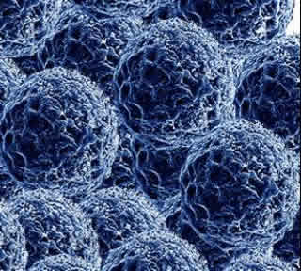
Case Study – Silver Nanoparticles
Silver nanoparticles of between 1-100 nm in size
Uses - catalysis, optics, electronics, medical, water treatment, textiles, consumer products
Silver nanoparticles are now replacing silver sulfadiazine – wound dressing
US EPA State of the Science Literature Review: Everything Nanosilver and More – August 2010 - http://www.epa.gov/nanoscience/files/NanoPaper1.pdf

Slide 32
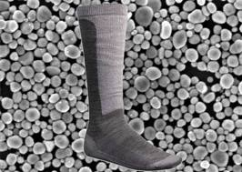
Case Study – Silver Nanoparticles
More than 200 products -- including odor-resistant socks, baby bottles and clothes-washing machines -- are laced with specks of nanosilver
Harms aquatic organisms
Regulate the chemical as a pesticide
Harms bacteria in wastewater treatment plants
Health – allergic reaction, accumulation in liver, brain?, Argyria and staining

Slide 33
Case Study - Quantum Dots
Semiconductor Nanocrystals
Ranging in size from approximately 2 - 150 nm
Metalloid crystalline core
  Zinc (Zn)
  Cadmium (Cd)
Cap or shell covering core
  Selenium (Se)
  Tellurium (Te)
Coating
  Biocompatible coating
  Functional groups
Green Dots (no heavy metals)
  Nanoco Group PLC - http://www.nanocotechnologies.com/
  Functional groups
Market size $7.5 billion - 2022
  Nanoco http://betanews.com/newswire/2012/05/18/marketsandmarkets-global-quantum-dots-qd-market-worth-of-7480-25-million-by-2022//

Slide 34
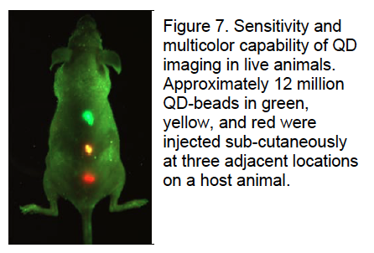
Case Study - Quantum Dots
Quantum Dots and You
Medical imaging
  Cancer
  Diagnostics
  Therapeutics
Biological imaging agent
  “Tag” proteins
  Monitor cellular uptake

Slide 35
Key Words
Dose / Response
Hazard X Exposure = Risk
Individual Sensitivity

Slide 36
Nanotoxicology Issues
Occupational Health
  Workers
Human Health
  Consumers
  Vulnerable – kids / elderly
Environmental Health
  Eco-system --- Aquatic life, Terrestrial life, Plant, Wildlife

Slide 37
Nanotoxicology Practical Issues
How to properly take field (environment / work place) samples, detect, characterize, quantify
Standard testing procedures, protocols
Incorporating into laws, regulations
Air quality and sediments standards as examples?

Slide 38
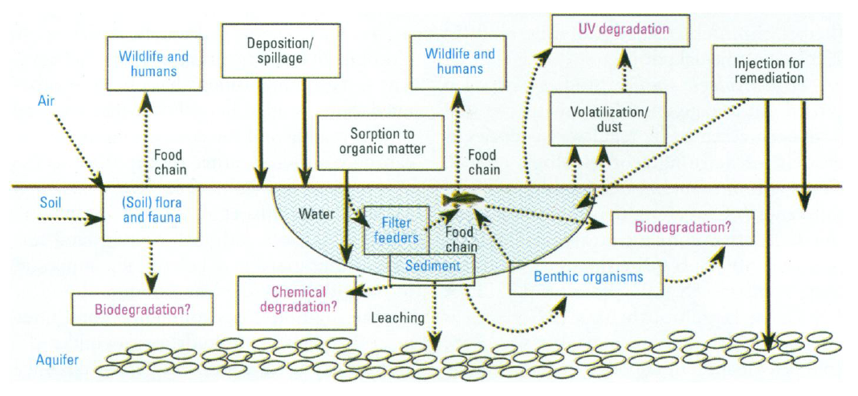
Nanotoxicologoy Issues

Slide 39
Environmental, Health, and Safety research
Who is responsible?
National Institute for Standards and Technology (NIST)
  - Instrumentation, metrology, and analytical methods
National Institutes of Health (NIH)
- Nanomaterials and human health
Environmental Protection Agency (EPA)
- Nanomaterials and the environment
National Institutes of Occupational Safety and Health (NIOSH)
- Human and environmental exposure assessment
Food and Drug Administration (FDA)
- Risk management (also EPA)
Consumer Product Safety Commission (CPSC)
- xx?

Slide 40
Consumer Product Safety Commission
Evaluation of Consumer Products
The potential safety and health risks of nanomaterials, as with other compounds that are incorporated into consumer products, can be assessed under existing CPSC statutes, regulations and guidelines. Neither the Consumer Product Safety Act (CPSA) nor the Federal Hazardous Substances Act (FHSA) requires the pre-market registration or approval of products. Thus, it is usually not until a product has been distributed in commerce that the CPSC would evaluate a product’s potential risk to the public.
CPSC Nanomaterial Statement - http://www.cpsc.gov/LIBRARY/CPSCNanoStatement.pdf

Slide 41
Occupational Health
“The people that research, develop, manufacture, package, handle, transport, use and dispose of nanomaterials will be those most exposed and therefore most likely to suffer any potential human health harms. As such, worker protection should be paramount within any nanomaterial oversight regime.”
WHO -- http://www.who.int/occupational_health/background_review_1.6.12.pdf

Slide 42
Occupational Health
Is PPE adequate ?
Individual sensitivity / vulnerability
Are MSDS sheets informative ? EU and Canadian MSDS yes, not US
Transparency about use ?
Regulation adequate ?
High concern – inhalation – carbon nano tubes, nano-silver

Slide 43
Human Health
Products
Expanding products
Absorption (sun screens)
How much of what ? Right to know?
Weak regulation – CPSC
Who regulates socks / washing machines ?
Medical
Expanding products
FDA regulating medical uses more of a precautionary approach
Supplements not regulated (silver is natural)

Slide 44
A risk to human and environmental health?
The physical and chemical characteristics of nanomaterials that give promise, also have the potential for peril.
Effects are not well characterized.
Ultrafine particles (UFPs) generally cause more toxicity in lung models
Reactivity of some particles increases as surface area-volume ratio increases
Surface coatings?
Represents a very important need for research.

Slide 45
Environmental Health
Persistence
Bioaccumulation
Release to environment
Water / Air
Coating
Surface area (not weight)

Slide 46
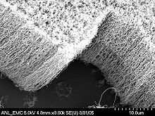
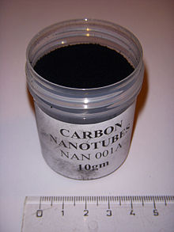
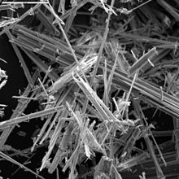
Carbon Nanotubes / Asbestos
Asbestos fibers
Carbon Nanotubes aligned
Carbon Nanotubes powder

Slide 47
Environmental Health
Donaldson, K., Murphy, F., Schinwald, A., Duffin, R., & Poland, C. A. (2011). Identifying the pulmonary hazard of high aspect ratio nanoparticles to enable their safety-by-design. Nanomedicine (Lond), 6(1), 143-156.

Slide 48
Nanomaterial challenges
Nanomaterials synthesis
the control of physical properties
obtaining uniform particle size distribution
identical shape
morphology
chemical composition
crystal structure.

Slide 49
Cradle to Grave challenges
Manufacture – many methods
chemical coatings
Use – consumer to industry
human / environmental exposure
Disposal / Reuse / Recycle

Slide 50
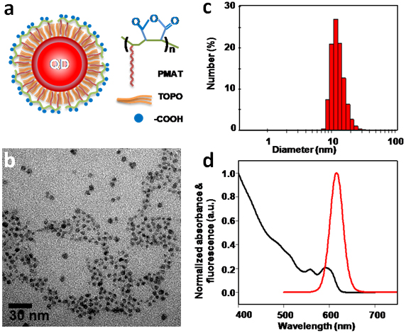
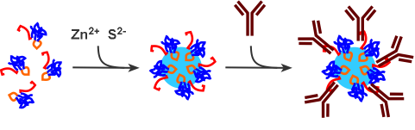
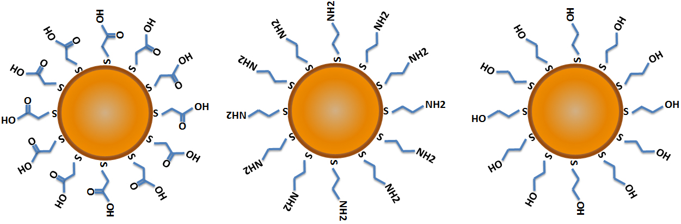
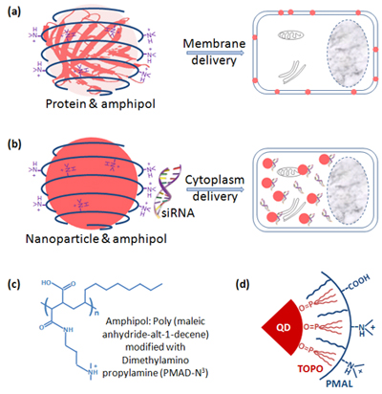
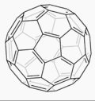
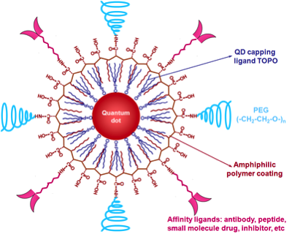
One of The Problems
Thousands of nanoparticle types, each having unique chemical and physical characteristics, and potentially, unique biological reactivity.`

Slide 51
Methodological Needs
developing methods to measure
  nanosilver concentration
  size
  shape
  surface charge
  crystal structure
  surface chemistry
  surface transformations
Range of tools

Slide 52
Solutions
Hummingbird Scientific
http://www.hummingbirdscientific.com/home/
Analytical equipment - Lacey, WA 9851
Center for Nanotechnology at UW
The NanoTech User Facility (NTUF) established in 1998 to provide the nanotechnology community with access to advanced characterization and nanofabrication equipment
  https://depts.washington.edu/ntuf
Pacific Northwest National Laboratory
  Materials sciences -- http://www.pnnl.gov/

Slide 53
Regulation - FDA
June 2011, FDA - Draft Guidance for Industry entitled, "Considering Whether an FDA-Regulated Product Involves the Application of Nanotechnology”
The draft foods guidance
The draft cosmetics guidance
http://www.fda.gov/Food/GuidanceComplianceRegulatoryInformation/GuidanceDocuments/ucm300914.htm?source=govdelivery

Slide 54
Regulation - FDA
The draft foods guidance
Affects the identity of the food substance;
Affects the safety of the use of the food substance;
Affects the regulatory status of the use of the food substance;
Warrants a regulatory submission to FDA.
http://www.fda.gov/Food/GuidanceComplianceRegulatoryInformation/GuidanceDocuments/ucm300914.htm?source=govdelivery

Slide 55
Regulation - FDA
The draft cosmetics guidance
safety assessment of nanomaterials when used in cosmetic products.
Cosmetics are not subject to premarket approval; however, they must be safe for consumers under labeled or customary conditions use, and they must be properly labeled.
Cosmetics manufactured using nanomaterials are subject to the same legal requirements as any other cosmetics. Companies and individuals who market cosmetics are legally responsible for the safety of their products.
In general, the processes currently in use for assessing safety are appropriate for cosmetics containing nanomaterials. However, data needs and testing methods should be evaluated in light of the properties or functions that may be exhibited by nanomaterials used in cosmetic products
http://www.fda.gov/Food/GuidanceComplianceRegulatoryInformation/GuidanceDocuments/ucm300914.htm?source=govdelivery

Slide 56
Regulation - EPA
Nanoscale Materials
Many nanoscale materials are regarded as "chemical substances" under the Toxic Substances Control Act (TSCA). To ensure that nanoscale materials are manufactured and used in a manner that protects against unreasonable risks to human health and the environment, EPA is pursuing a comprehensive regulatory approach under TSCA. This four-pronged approach includes: Premanufacture notifications; a Significant New Use Rule; an information gathering rule; and a test rule.
http://www.epa.gov/oppt/nano/

Slide 57
Regulation - EPA
Nanosilver
“Currently, tracking products that contain nanosilver is getting to be difficult because the products are almost always packaged under numerous brand names, and current labeling regulations do not require that the nanomaterial be listed as an ingredient.”
US EPA State of the Science Literature Review: Everything Nanosilver and More – August 2010 - http://www.epa.gov/nanoscience/files/NanoPaper1.pd

Slide 58
Cradle to Grave - EPA
Assess the cradle to grave cost/risk associated with any given product
Life Cycle Assessment (LCA)
Comprehensive Environmental Assessment (CEA)
Risk assessment paradigm, which includes hazard identification, dose-response assessment, risk characterization and exposure assessment
US EPA State of the Science Literature Review: Everything Nanosilver and More – August 2010 - http://www.epa.gov/nanoscience/files/NanoPaper1.pdf

Slide 59
European Union
European Union is implementing a new Classification, Labeling and Packaging (CLP)Regulation. CLP includes the requirement that if the form or physical state of a substance is changed, an evaluation must be done to determine if the hazard classification should be changed.
http://www.understandingnano.com/nanotechnology-regulation.html

Slide 60
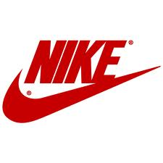
Nike
Nike currently restricts the use of nanomaterials within apparel, footwear, and equipment product lines.
Products to which nanomaterials are applied must:
• Not leach or release chemicals (or particles) in order to be effective or as a result of wear , unless safety data are available and acceptable
• Meet legislative standards (globally)
• Be appropriately registered (e.g., EU Biocide Directive, if used as bacteriostatic agent)
• If registration not required: Manufacturer/supplier has made available an analysis of consumer safety
• Pass a corporate toxicity review (conducted thru the Considered Chemistry team)
• Be proven effective (for our product types)
• Comply with the Nike Corporate RSL (Restricted Substances List)
Nike Restricted Substances List (RSL) and Sustainable Chemistry Guidance (SCG)
http://www.nikeresponsibility.com/rsl

Slide 61
Questions / Recommendations
Are nanomaterials new substances?
YES
Transparency about use in industry and consumer products
Research / Standards for sampling and assessment
Fate and transport – cradle to grave
Human and Environmental health effects

Slide 62
Silent Spring I
“As crude a weapon as a cave man’s club, the chemical barrage has been hurled against the fabric of life.”
Rachel Carson – Silent Spring (1962)

Slide 63
Silent Spring II
“The “control of nature” is a phrase conceived in arrogance, born of the Neanderthal age of biology and the convenience of man.”
Rachel Carson – Silent Spring (1962)

Slide 64
Additional Information
Web Sites
Nanotechnology wikipedia - http://en.wikipedia.org/wiki/Nanotechnology
The National Nanotechnology Initiative (NNI) - http://nano.gov/
The International Council on Nanotechnology (ICON) http://icon.rice.edu/
Toxipedia – Nanotoxicology - http://www.toxipedia.org/display/toxipedia/Nanotechnology

Slide 65
A Small Dose of Nanotoxicology

Slide 66
Authorship Information
This presentation is supplement to
“A Small Dose of Toxicology”
For Additional Information Contact
Steven G. Gilbert, PhD, DABT
E-mail: sgilbert@innd.org
Web: www.asmalldoseoftoxicology.org

Slide 67
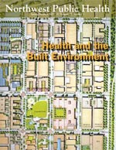
NW Public Health
Public Health and the Precautionary Principle
By Steven G. Gilbert
See: http://healthlinks.washington.edu/nwcphp/nph/
nwph

Slide 68
Precautionary Principle
“When an activity raises threats of harm to human health or the environment, precautionary measures should be take even if some cause and effect relationships are not fully established scientifically.”
Wingspread Conference, 1998.

Slide 69
Central components
Setting goals (Health indicators)
Taking preventive action in the face of uncertainty
Shifting the burden of responsibility to the proponents of an activity (Who benefits?)
Exploring a wide range of alternatives to possibly harmful actions (Is it necessary?)
Increasing public participation in decision making (transparency of information & environmental justice)

