Slide 1
An Introduction To Cancer and Genetic Toxicology
A Small Dose of Cancer & Genetic Tox
Chapter 20 – 3rd Edition
Steven G. Gilbert, PhD, DABT
www.asmalldoseoftoxicology.org

Slide 2
Quote / History
"There is no treatment.“
1600 B.C. Egypt
(comment on breast cancer)

Slide 3
Incidence of Breast Cancer
A Women’s Risk of Breast Cancer (US)
1940’s – 1 in 22
2004 – 1 in 7
WHY?
Breast Cancer is leading cause of death in women ages 34 to 44.

Slide 4
Incidence of Breast Cancer
A Women’s Risk of Breast Cancer (WA)
ACS 148 per 100,000
WA cancer registry – 181 per 100,000
WHY?
This year in WA
4,000 women diagnosed with BC
800 will die of BC
Highest rate in US

Slide 5
Ancient Awareness
80 Million years ago – Dinosaur bones show evidence of cancer
3000 BC - Egyptian mummies – bone cancer
1600 BC – Egypt – 8 cases of breast tumors (or ulcers)
Treated by cauterization – with the “fire drill” - Edwin Smith Papyrus

Slide 6
Ancient Awareness
300 BC – Hippocrates named tumors as carcinos or carcinoma – tumors spread out like legs of a crab
1500 – autopsy start to provide a greater understanding of cancer
1650 – more knowledge with advance in medical science tools like the microscope

Slide 7
Human Cancer Awareness
1700 – Occupational cancer – High incidence of breast cancer among nuns
1775 – Percivall Pott – Occupational – cancer of scrotum in chimney sweeps
1895 – Bladder cancer in workers in aniline dye industry

Slide 8
Animal Cancer Models
1915 – skin tumors in rabbits treated with coal tar on the skin
1930s – isolation of polycyclic aromatic hydrocarbon from coal tar
1932 – benzo(a)pyrene synthesized
1935 – feeding azo dyes to rats can cause liver cancer

Slide 9
Historical Events
Opium War of 1839-42
Great Britain has a monopoly on the sale of opium which it forces on China. Eventually getting control of Hong Kong.
Consider our societies current “wars on drugs”.

Slide 10
Recent Awareness
Year | Cancer type | Cause
1775 | Scrotal Cancer | Soot
1822 | Skin Cancer | Arsenic
1879 | Lung Cancer | Uranium Mining
1895 | Bladder Cancer | Aniline Dye
1902 | Skin Cancer | X-rays
1908 | Leukemia | Filterable Agent
1914 | Experimental Induction of Skin Cancers (rabbit) | Coal Tar
1928 | Experimental Induction of Skin Cancers | UV Light

Slide 11
Recent Awareness
300 million tons of organic chemical manufactured each year
100,000+ compounds

Slide 12
What is Cancer?
Cancer is the uncontrolled multiplication of cells.
Benign – cancerous cells are contained in one place
Malignant – cancerous have spread to other areas

Slide 13
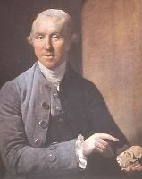
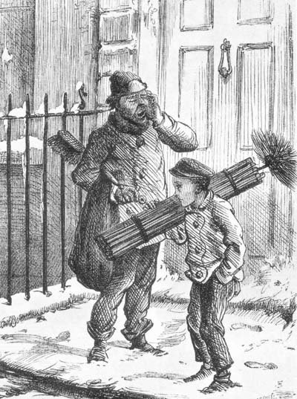
Case Studies - Soot
Born in London (January 6, 1714 - December 22, 1788) Percivall Pott made some groundbreaking discoveries in the fields of cancer research and surgery techniques. He discovered the link between occupational carcinogens and scrotal cancer in chimney sweeps and wrote multiple scientific articles.

Slide 14
Case Studies - Soot
1775 – Percivall Pott – Occupational – cancer of scrotum in chimney sweeps
1892 – scrotal cancer rare on European content but still high in England – attributed to hygiene
1915 – skin tumors in rabbits treated with coal tar on the skin
1930s – isolation of polycyclic aromatic hydrocarbon from coal tar
Now – smoking and organic fuels

Slide 15
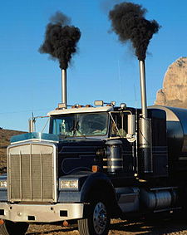
Case Studies - Soot
Soot refers to impure carbon particles resulting from the incomplete combustion of a hydrocarbon. The gas-phase soots contain polycyclic aromatic hydrocarbons (PAHs). The PAHs in soot are known mutagens and probable human carcinogens. They are classified as a "known human carcinogen" by the International Agency for Research on Cancer (IARC).

Slide 16
Case Studies - Benzene
C₆H₆ – Clear, colorless, high flammable, vaporizes at room temp
Known human carcinogen – effect bone marrow causing leukemia
Acute inhalation – CNS effects, dizziness
In US gasoline 2% benzene but up to 5% in other countries
Metabolized by liver to more toxic metabolites
US EPA water standard 0.005 mg/L (5 ppb)
US OSHA – 1 ppm in workplace air over 8 hrs

Slide 17
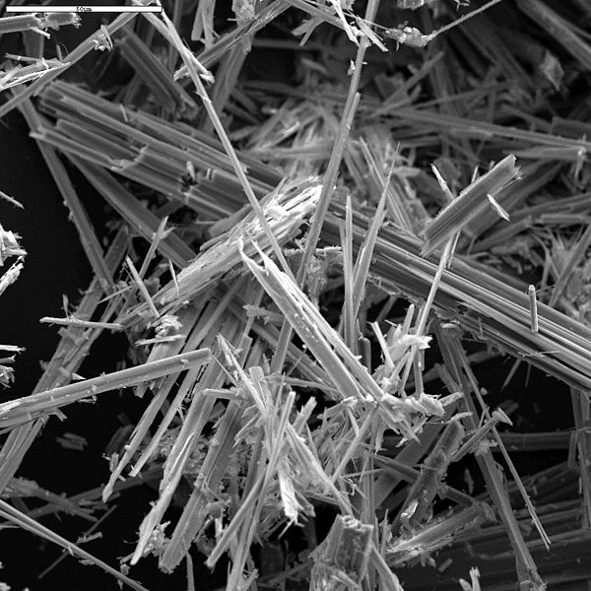
Case Studies - Asbestos
Asbestos Greek "unquenchable" or "inextinguishable")
Cause serious lung disease
Asbestosis – scarring of the lung
Mesothelioma– cancer of lung lining

Slide 18
Case Studies - Asbestos
Known since ancient times – commercial use started in early 1900’s with wide spread use during World War II
Used in 1000s of consumer and industrial products
First heath effects seen in early 1900s
Dose response and latency effects established in 1930s
Regulation and banning started in 1970s
Millions of people exposed

Slide 19
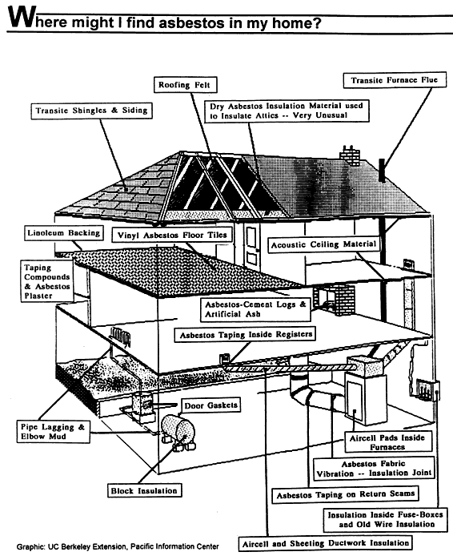
Asbestos – In the Home
From The White Lung Association web site
http://whitelung.org/pubs/aith/wherefind.html

Slide 20
Case Studies - Radon
1400’s lung disease in miners
1879 – lung cancer in European Miners
Colorless, odorless radioactive gas
Decay product – uranium to radium to the gas radon to the solid polonium
Polonium sticks to lung tissue – decays releasing an alpha particle which damages cellular DNA causing cancer
1 in 15 (6%) homes in US elevated Radon
U.S. EPA action level 4 pCi/L

Slide 21
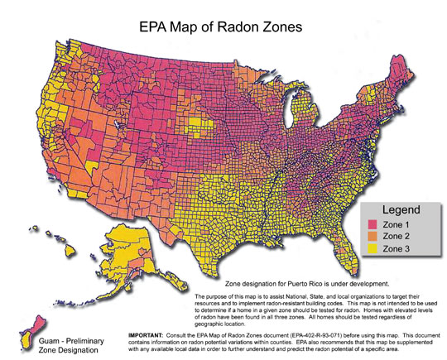
Radon – US Map

Slide 22
Environmental Factors and Cancer Deaths
Diet 35% (10-70%)
Tobacco 30% (25-40%)
Infection 10% (?)
Alcohol 3% (2-4%)
Reproductive and sexual behavior 7% (1-13%)
Occupation 4% (2-8%)
Pollution 2% (<1-5%)
Geophysical factors 3% (2-4%)
Medicines and medical procedures 1% (0.5-3%)
Industrial Products 1% (<1-2%)
Adapted from Doll and Peto, 1981; Casarett and Doull’s Toxicology, 5th Ed.

Slide 23
Cancer Death Rates Male 1930-2003
Rate Per 100,000
Lung & bronchus
Stomach
Prostate
Colon & rectum
Pancreas
Leukemia
Liver
*Age-adjusted to the 2000 US standard population.
Source: US Mortality Public Use Data Tapes 1960-2003, US Mortality Volumes 1930-1959,
National Center for Health Statistics, Centers for Disease Control and Prevention, 2006.

Slide 24
Cancer Death Rates US Female 1930-2003
Rate Per 100,000
Lung & bronchus
Uterus
Breast
Colon & rectum
Stomach
Ovary
Pancreas
*Age-adjusted to the 2000 US standard population.
Source: US Mortality Public Use Data Tapes 1960-2003, US Mortality Volumes 1930-1959,
National Center for Health Statistics, Centers for Disease Control and Prevention, 2006.

Slide 25
Cancer Death Rates*, by Race and Ethnicity US 1999-2003
*Per 100,000, age-adjusted to the 2000 US standard population.
† Persons of Hispanic origin may be of any race.
Source: Surveillance, Epidemiology, and End Results Program, 1975-2003, Division of Cancer Control and
Population Sciences, National Cancer Institute, 2006.

Slide 26
Tobacco Use in the US, 1900-2003
Per capita cigarette consumption
Male lung cancer death rate
Female lung cancer death rate
*Age-adjusted to 2000 US standard population. Source: Death rates: US Mortality Public Use Tapes, 1960-2003, US Mortality Volumes, 1930-1959, National Center for Health Statistics, Centers for Disease Control and Prevention, 2005. Cigarette consumption: US Department of Agriculture, 1900-2003.

Slide 27
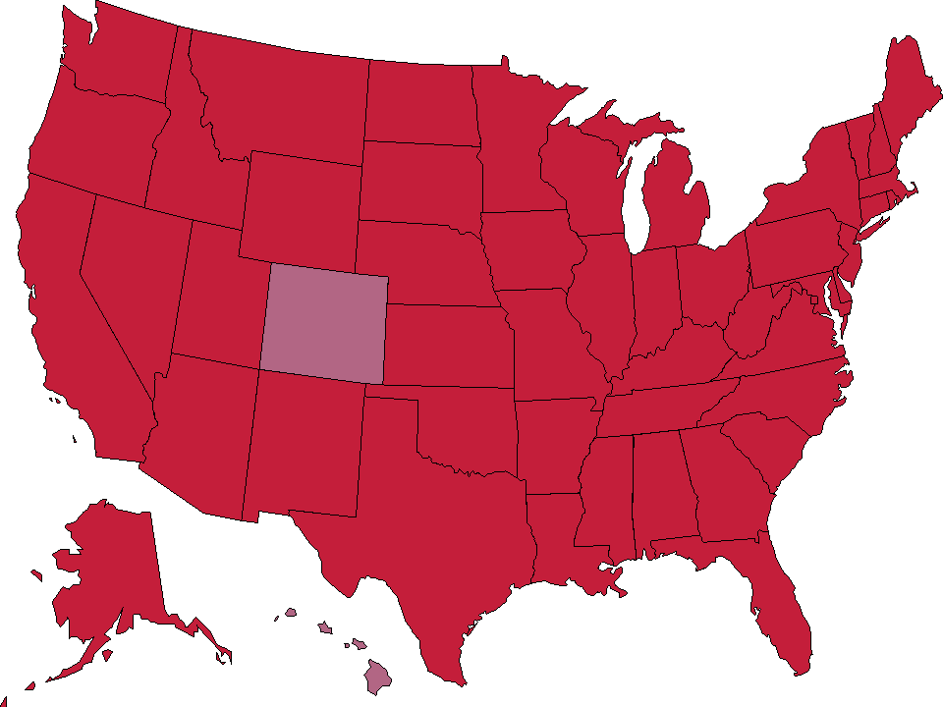
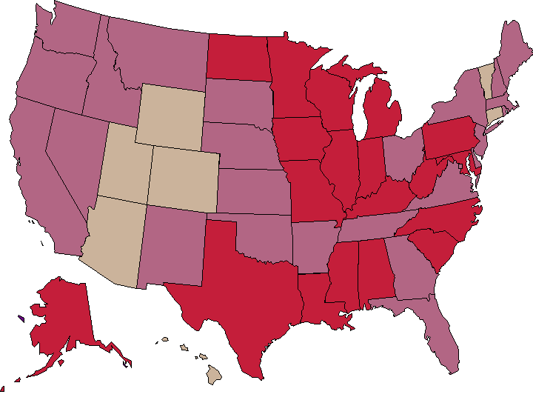
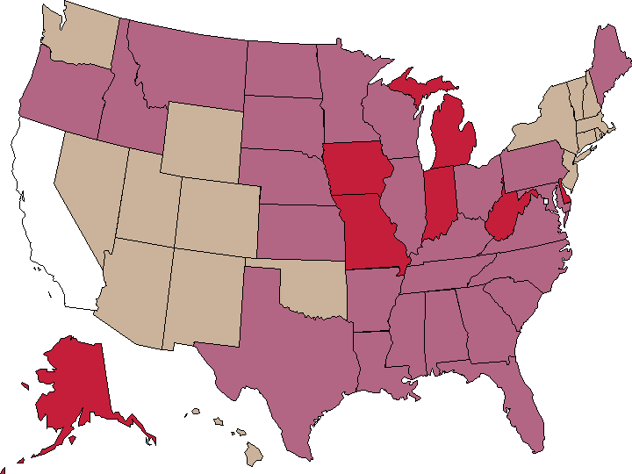
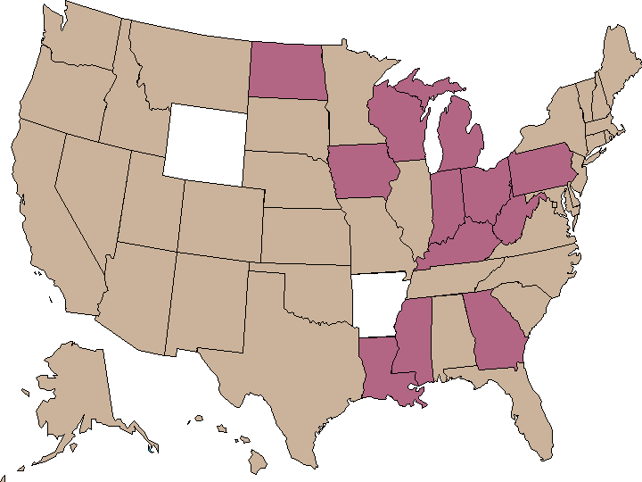
Trends in Overweight* Prevalence (%), Adults 18 and Older, US, 1992-2005
1992
1995
1998
2005
Less than 50%
50 to 55%
More than 55%
State did not participate in survey
*Body mass index of 25.0 kg/m²or greater. Source: Behavioral Risk Factor Surveillance System, CD-ROM (1984-1995, 1998) and Public Use Data Tape (2004, 2005), National Center for Chronic Disease Prevention and Health Promotion, Centers for Disease Control and Prevention, 1997, 2000, 2005, 2006.

Slide 28
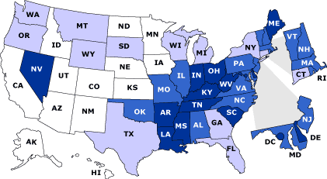
Rates of Death Due to Cancer,* United States, 1999
154.7-193.7
194.5-206.5
207.8-214.0
214.8-236.9
*Deaths per 100,000 people, age adjusted to 2000 total U.S. population. Data are grouped in quartiles and ranked from lowest to highest. Source: National Center for Health Statistics, CDC.

Slide 29
Exposure Issues
Home environment
Current events
Workplace
School
Government Decisions
Global and local environment

Slide 30
Causes of cancer
Organic chemicals (alcohol, tars, dyes, solvents ….)
Inorganic agents (metals – arsenic, nickel …)
Hormones
Nutrition (diet, fat, high calories)
Tobacco products
Chemical mixtures
Genetics

Slide 31
What causes cancer?
Internal factors
hormones
immune conditions
inherited conditions
External factors
lifestyle habits (smoking, diet, alcohol)
viruses, chemicals, radiation

Slide 32
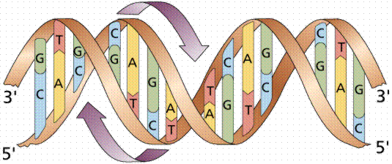
DNA – T-A C-G
Thymine (T) Adenine (A)
Cytosine (C) Guanine (G)
Over 3 billion base pairs, 30,000 genes
Humans are over 99.9% identical

Slide 33
DNA Mutations
Genetic toxicology, start in 1927 when American geneticist Hermann J. Muller (1890 - 1967) demonstrated that X-rays increased the rate of gene mutations and chromosome changes in fruit flies.
Normal strand of DNA --- Mutated Strand
G C A G C A T G C A A C A T
C G T C G T A C G T T G T A
Chemicals that induce mutations in the DNA are called mutagens.

Slide 34
A Small Dose of ™ Cancer & Genetic Tox

Slide 35
Authorship Information
This presentation is a supplement to
“A Small Dose of Toxicology”
For Additional Information Contact
Steven G. Gilbert, PhD, DABT
sgilbert@innd.org
Web: www.asmalldoseoftoxicology.org

