Slide 1
An Introduction To
Pregnancy and Developmental Toxicology
A Small Dose of Developmental Toxicology
Chapter 9 – 3rd Edition
Steven G. Gilbert, PhD, DABT
www.asmalldoseoftoxicology.org

Slide 2
Life – Potential & Harm
All life depends on reproduction and development.
What effects this process and harms a child's potential?

Slide 3
Terms
Monster – abnormal or strange animal or plant. From Latin monstrum omen, from monere to warn (abnormal infants reflect the future).
Teratology – The study of malformations. From the Greek word for monster – teras.

Slide 4
Three Areas
Reproduction – issues associated with the egg and sperm
Pregnancy – the critical environment of early development
Development of the infant.

Slide 5
Ancient Awareness
Many ancient cultures had fertility goddess
Many ancient documentation of malformations
Malformations rich aspect of mythology
6500 BC – Turkey - figurine of conjoined twins
4000-5000 BC – Australia drawings of twins
2000 BC - Tablet of Nineveh – describes 62 malformations and predicts the future

Slide 6
Historical Awareness
15th-16th centuries malformations caused by the devil, mother and child killed
1830’s - Etienne Geoffroy Saint-Hilaire experimented with chicken eggs
1900’s began acceptance of malformations related to genetics
1940’s - Josef Warkany – environmental factors affect rat development

Slide 7
Historical Events
1941 – Human malformations linked to rubella virus
1960’s – Thalidomide (a sedative and anti-nausea drug) found to cause human malformations
1950’s – Methylmercury recognized as developmental toxicant
1970’s – Alcohol related to developmental effects – Fetal Alcohol Syndrome (FAS)

Slide 8
Human Reproductive Facts
50% of pregnancies end in miscarriage or spontaneous abortion often before pregnancy is recognized
15% of couples of reproductive age are infertile

Slide 9
Reproductive Endpoints
Fertility
Menstrual cycle
Sperm count and viability
Sexual behavior

Slide 10
Reproductive Toxicants
Endocrine disruptors
  DDT, Dioxin
Heavy metals
  Lead (decreased sperm)
Organic Solvents
  Toluene, benzene
Drugs
  Alcohol

Slide 11
Pregnancy Effects the Women
Cardiovascular
  Increased - cardiac output heart rate, blood pressure, blood volume expands
Oxygen consumption increases by 15-20%
Urine volume increases
Gut absorption changes
  Increases in iron and calcium (toxic lead substitutes for calcium)
Liver metabolism decreases for some drugs or chemicals (caffeine)

Slide 12
Developmental Endpoints
Teratology (physical malformations)
Birth weight
Growth
Neurobehavioral
  Decreased intelligence
  Decreases learning and memory

Slide 13
Metals
Lead
Methylmercury
Arsenic (in animals)

Slide 14
Chemicals/Radiation
Chlorobiphenyls
Solvents (Toluene)
Endocrine disruptors
  DDT, PCBs
TCDD
X-rays (therapeutic)
Atomic fallout

Slide 15
Infections/Medical Conditions
Rubella virus
Herpes simplex virus
Toxoplasmosis
Syphilis
Diabetes

Slide 16
Plants
Skunk cabbage (Veratrum californicum) – sheep & cattle
Parasites (frogs)

Slide 17
Medical Drugs
Antibiotics (tetracylines)
Anticancer drugs
Anticonvulsants (Valproic Acid)
Lithium
Retinoids (Vitamin A)
Thalidomide
Diethylstilbestrol (DES)
Anticoagulants (Warfarin)

Slide 18
Recreational Drugs
Alcohol (ethanol)
Tobacco
Cocaine
Solvent abuse

Slide 19
Case Studies
Thalidomide
Ethanol (Alcohol)
Methylmercury
Lead

Slide 20
Thalidomide
Introduced in 1956 as sedative (sleeping pill) and to reduce nausea and vomiting during pregnancy
Withdrawn in 1961
Discovered to be a human teratogen causing absence of limbs or limb malformations in newborns
5000 to 7000 infants effected
Resulted in new drug testing rules

Slide 21
Ethanol (Alcohol)
The common preventable cause of adverse fetal development
Fetal Alcohol Syndrome (FAS) first described in 1970’s
Symptoms included facial deformities, growth retardation, sever nervous system effects and reduced intelligence
4,000-12,000 infants per year in US
Fetal Alcohol Effect (FAE) – milder form but still serious nervous system effects

Slide 22
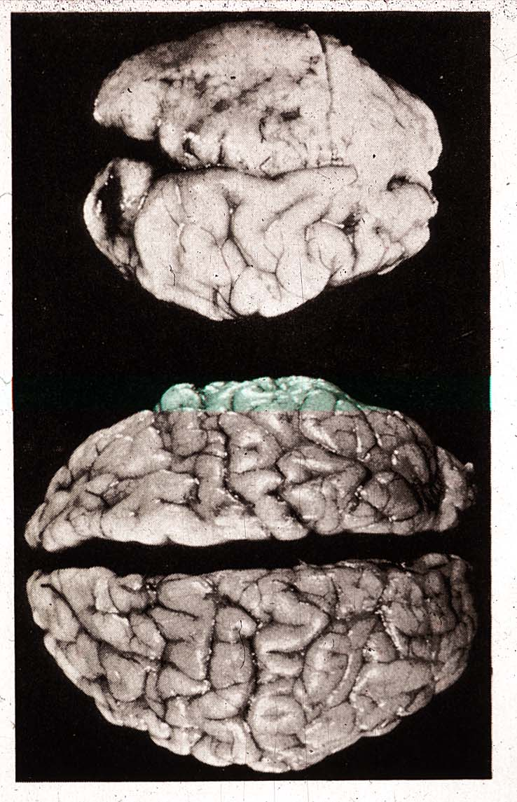
Effects of Prenatal Alcohol

Slide 23
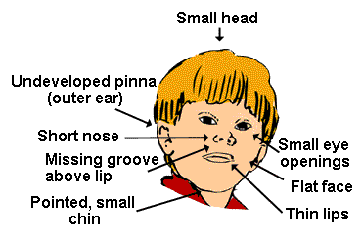
Effects of Prenatal Alcohol

Slide 24
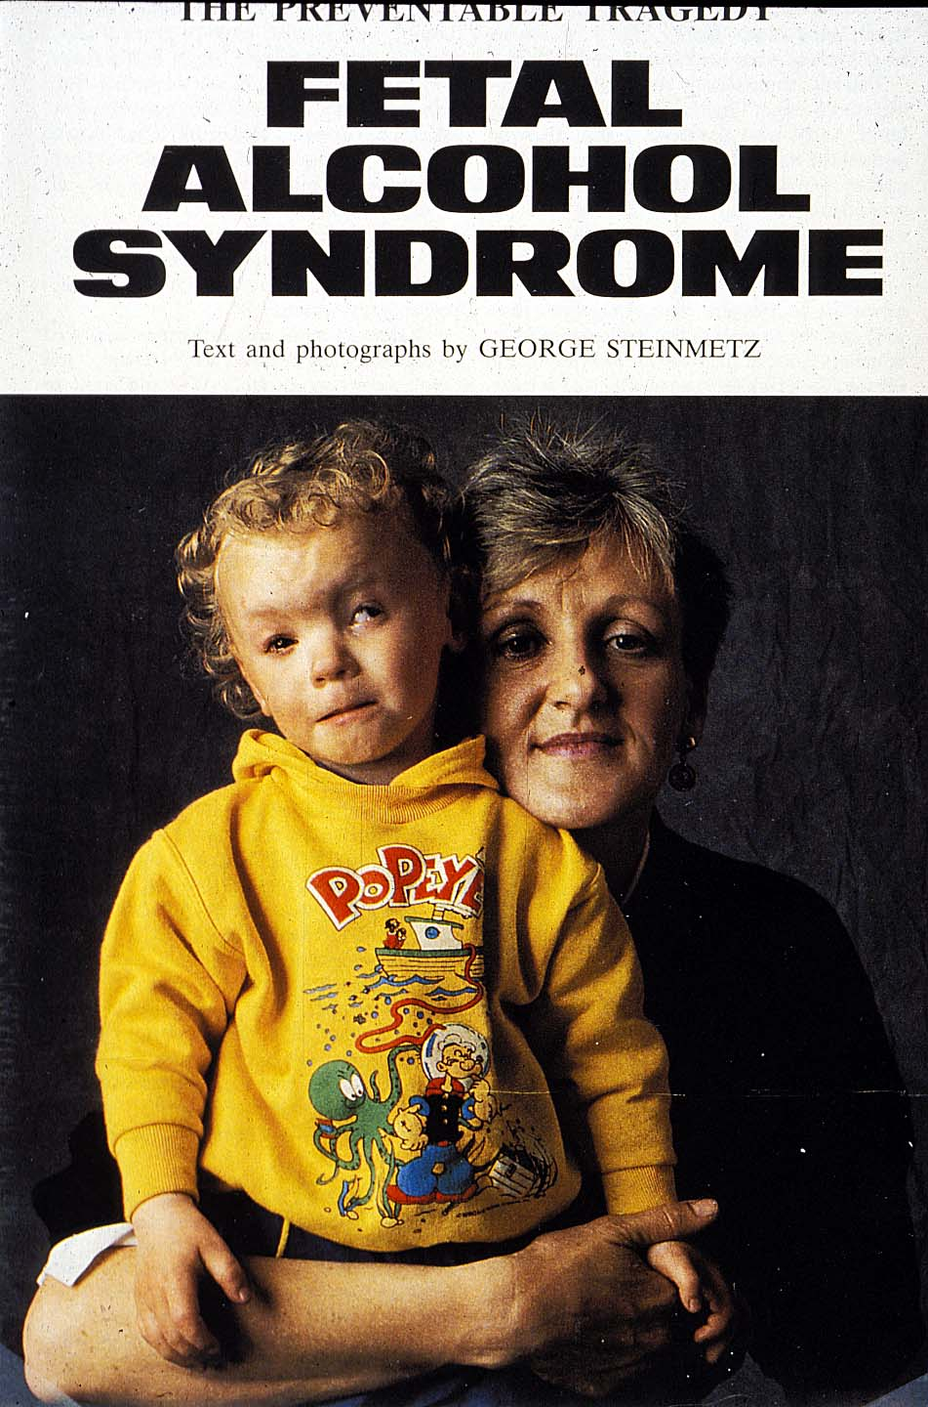
FAS Child

Slide 25
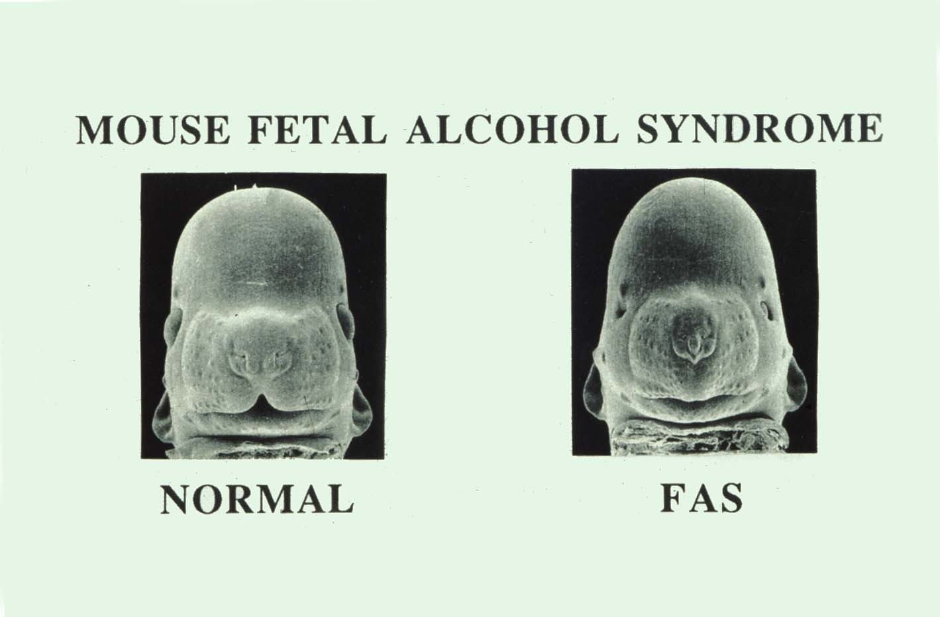
Mouse – Scanning EM

Slide 26
Methylmercury (MeHg)
Mercury (quick silver) is converted to methylmercury by bacteria
Methylmercury accumulates in fish, which are consumed by humans
In 1950’s the developmental effects of MeHg were first recognized in Minamata, Japan
Across the world there a regulatory agencies set limits the amount of mercury in fish that is safe to consume

Slide 27
Hg - Inorganic & Organic
Hg
Inorganic – Quick Silver
Hg
CH₃
Organic – Methyl Mercury

Slide 28

Polluting with HG
Discharge in Minamata Bay

Slide 29
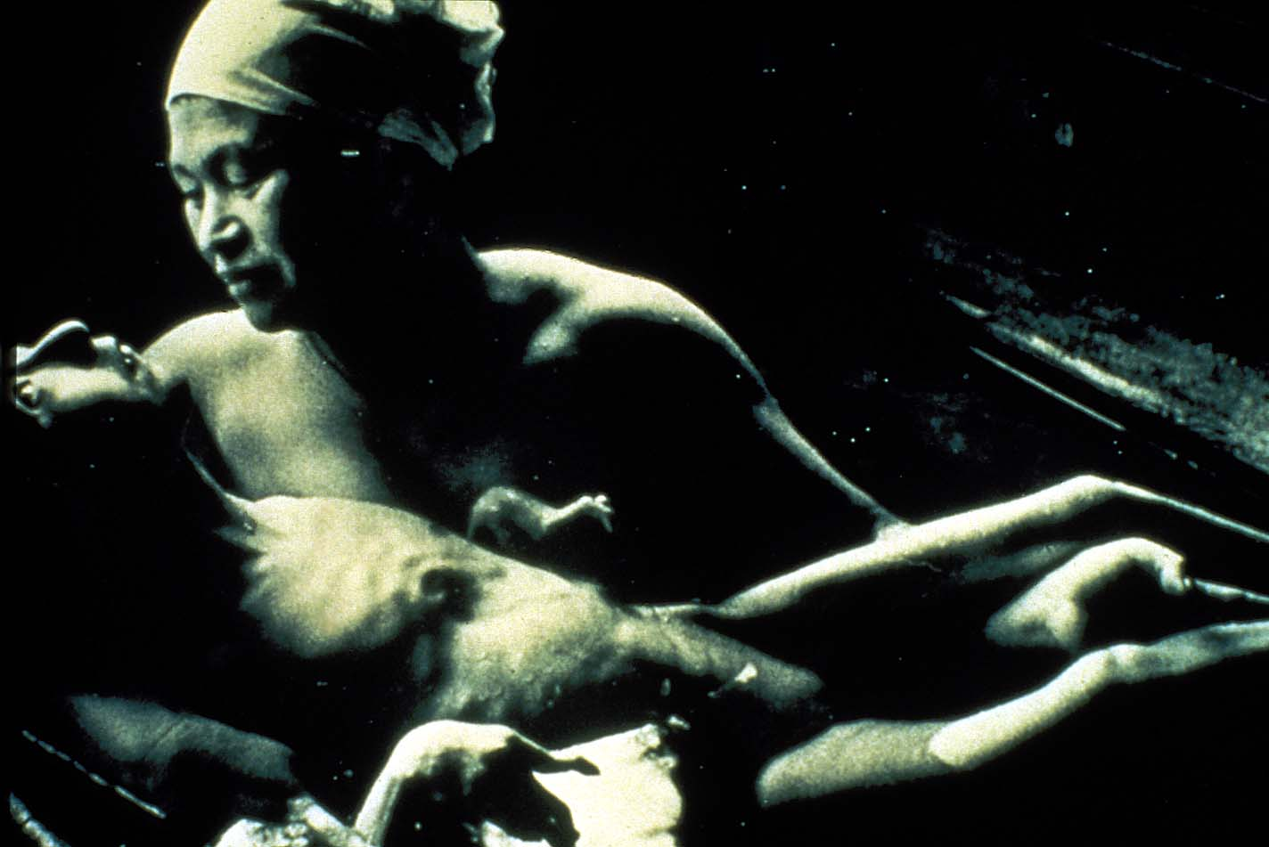
Fetal Effects of MeHg

Slide 30
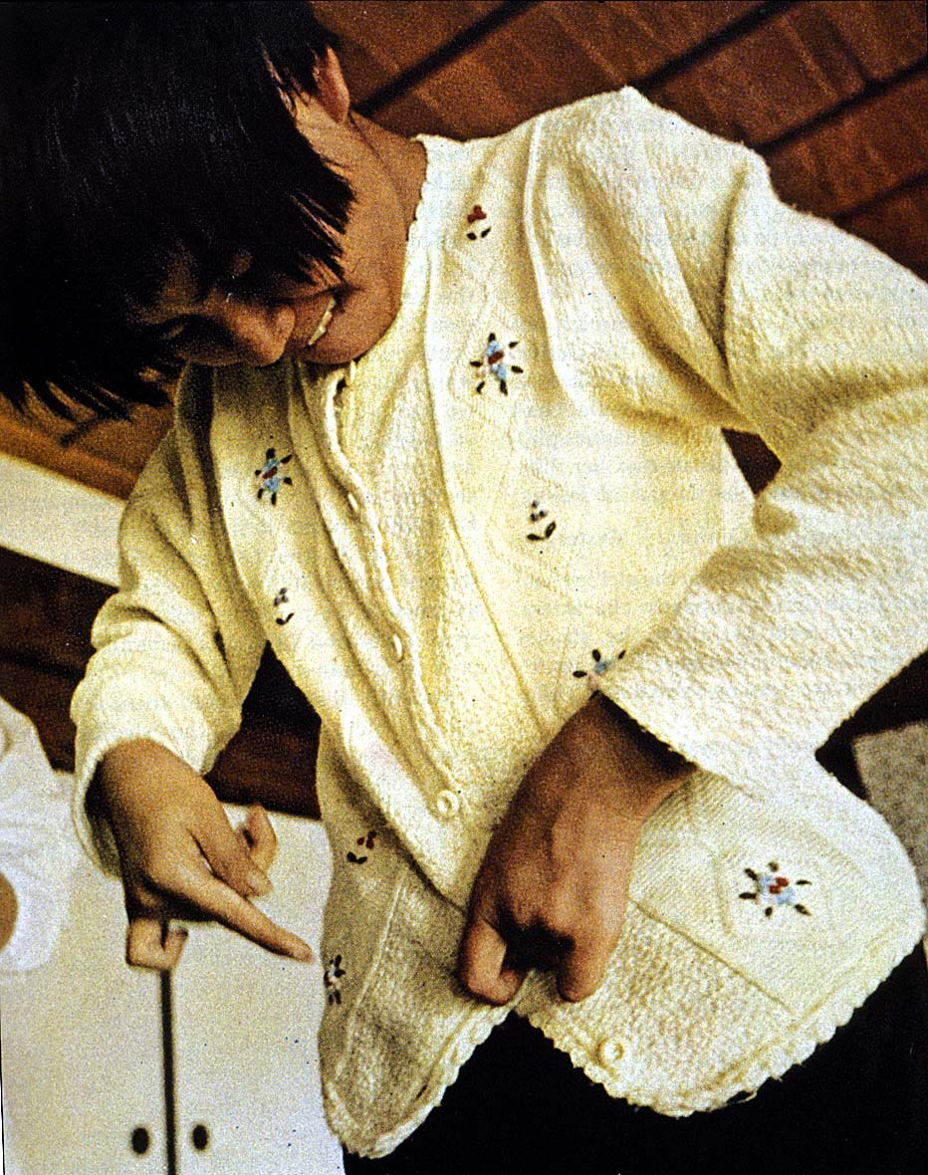
Life-Long Effects of MeHg

Slide 31
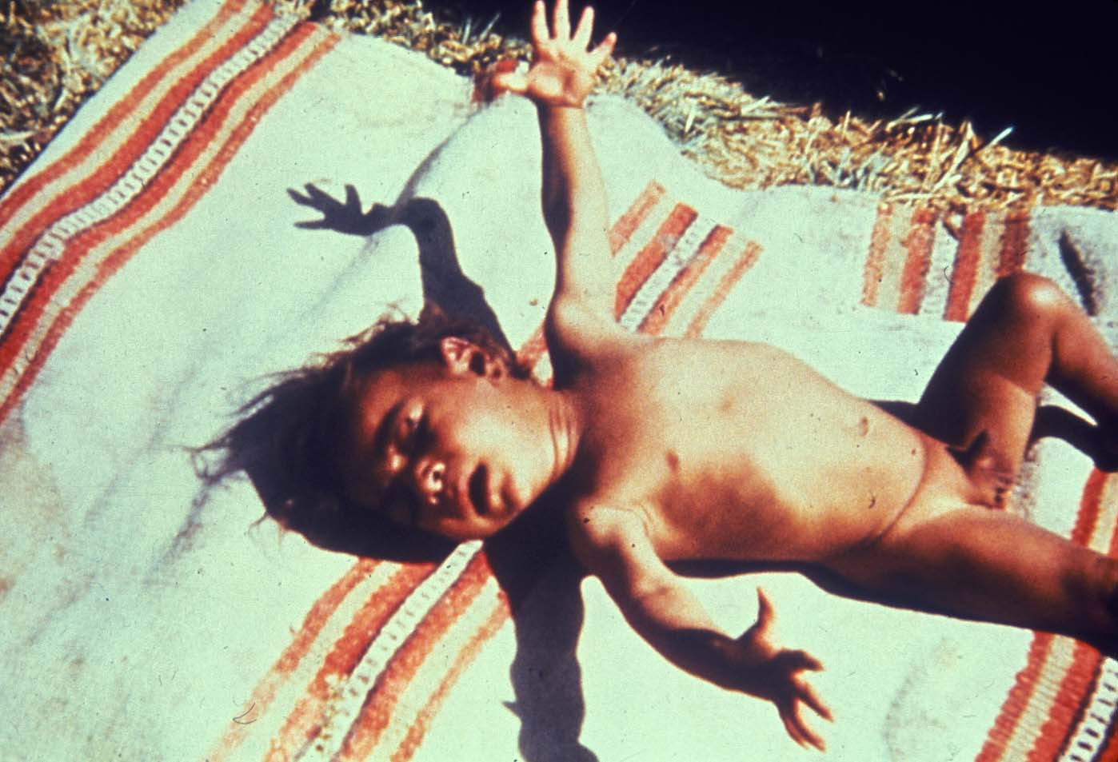
Iraq Infant - Effects of Mercury

Slide 32
Lead History
6500 BC. - Lead discovered in Turkey, first mine.
100 BC. - Greek physicians give clinical description of lead poisoning.
1904 - Child lead poisoning linked to lead-based paints.
1922 - League of Nations bans white-lead interior paint; U.S. declines to adopt
1923 - Leaded gasoline goes on sale in selected markets
1971- U.S. Lead-Based Paint Poisoning Prevention Act passed
1923 - Leaded gasoline goes on sale in selected markets
1986 - Primary phase out of leaded gas in US completed

Slide 33
Ancient Awareness
"Lead makes the mind give way."
Greek
Dioscerides - 2nd BC

Slide 34
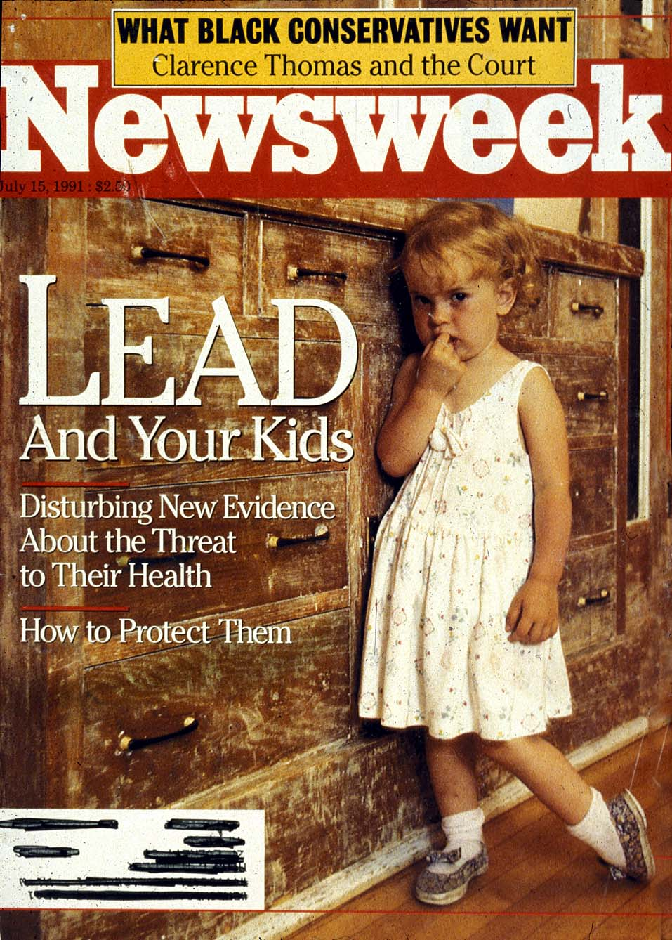
Lead In Homes

Slide 35
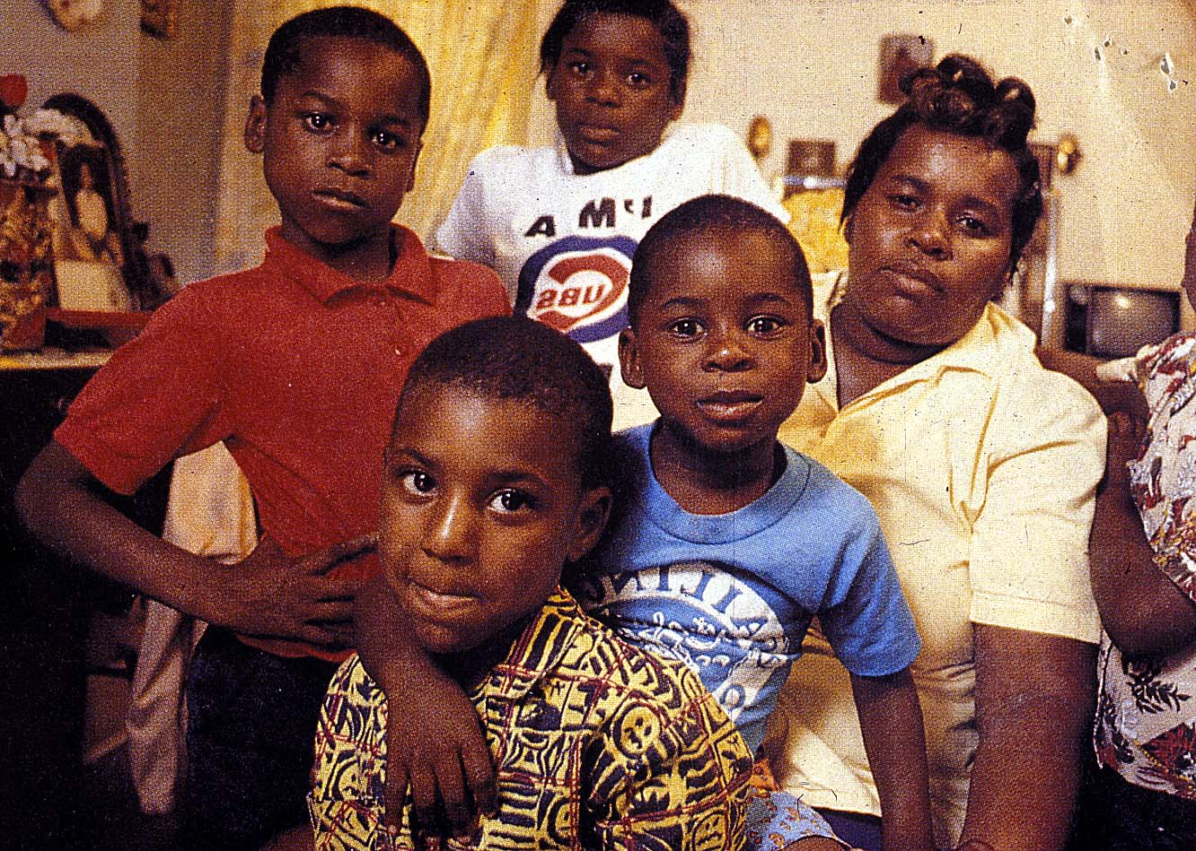
Lead in Families

Slide 36
Agency Blood Lead Levels

Slide 37
Lead Health Effects
Children more vulnerable than adults
  Orally consumed lead absorbed in place of calcium
  CHILDREN absorb 30-50% of oral lead
  ADULTS absorb 5-10% of oral lead
  Increased absorption during pregnancy
Childhood effects
  Decreased intelligence (lower grades)
  Hyperactivity (higher school dropout rate)
  Growth retardation
  Effects at blood lead levels of 10 µq/dl

Slide 38
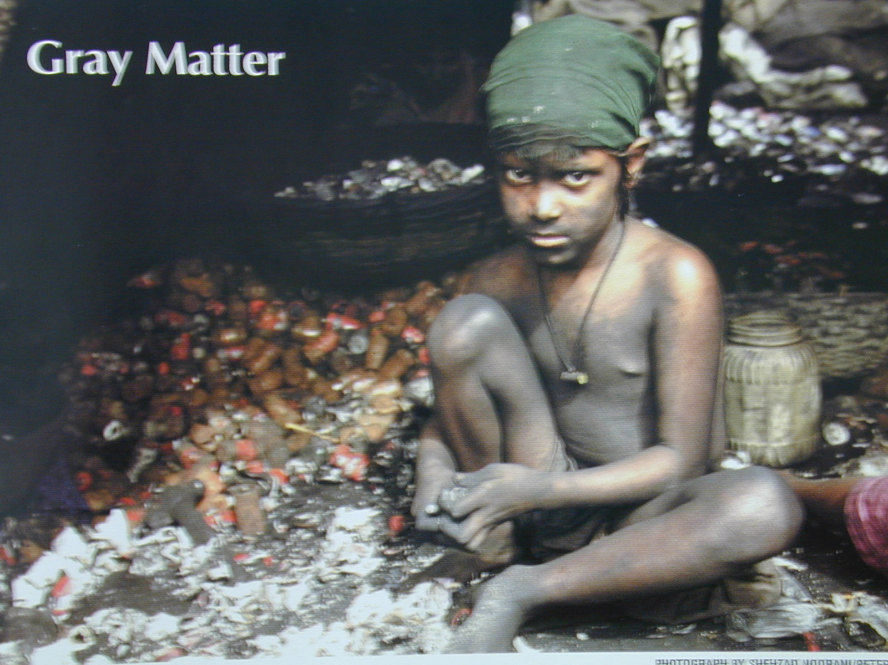
Recycling Lead

Slide 39
Who is at Risk?
Women of childbearing age
Pregnant women
Men wishing to a parent
Infants
Children

Slide 40
Exposure Issues
Home environment
Drug use
Workplace
Global and local environment

Slide 41
Regulatory Status
FDA – Reproductive and Developmental drug testing requirements
EPA – Testing requirements

Slide 42
A Small Dose of Developmental Toxicology

Slide 43
Authorship Information
This presentation is supplement to
“A Small Dose of Toxicology”
For Additional Information Contact
Steven G. Gilbert, PhD, DABT
E-mail: sgilbert@innd.org
Web: www.asmalldoseoftoxicology.org

