Slide 1
“Connecting the Dots:
Toxicological Decision-Making and Communication in 21st Century”
A Small Dose of Connecting Dots
Chapter 6 – 3rd Edition
Steven G. Gilbert, PhD, DABT
www.asmalldoseoftoxicology.org

Slide 2

A Small Dose of Toxicology 3rd Edition
Free e-book
Healthy World Press
PDF and Power- power slides for each of
29 Chapters
See: www.asmalldoseoftoxicology.org

Slide 3



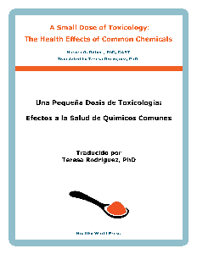

Small Dose of Toxicology
FREE
www.asmalldoseoftoxicology.org
English, Spanish, Arabic, German, Chinese

Slide 4
No Conflict of Interest
I have no conflict of interest but I am decidedly biased in thinking that everyone should have knowledge of the facts.

Slide 5

Inheriting The Future
Global Warming
Burning Coal
Coal Waste
Mercury from Coal to Fish
Nuclear waste
Chemical body burden
Chemical use
Sustainability
LEAD !! (2017)

Slide 6
Fundamental Dots
ACTION
Science
History
Ethics

Slide 7
Goals of Connecting the Dots
Broad understanding of science
Critical issues
Perspective - history
Critical thinking about issues
Using the knowledge we have
Values - Ethics
Better decision making
Help in Testifiying

Slide 8
CtD Essay
Connecting the Dots for Health – Toxic issue
No more that 3 pages – 4th page is connecting the dots diagram
Introduction
Subject – justify action
Action
One sentence action statement
Science
Brief over of science – exposure, health – vulnerable
History
Key elements of history of issue
Ethics
Justify action - autonomy, justice
Current Regulation
References and Web sites

Slide 9
Fundamental Dots

Slide 10
Science
SCIENCE

Slide 11
A Small Dose of Toxicology 2nd Edition
Free e-book
Healthy World Press
PowerPoint slides for each chapter
Including
Lead
See: www.asmalldoseoftoxicology.org

Slide 12
Small Dose of Toxicology
English
Arabic
German
Spanish
Chinese
FREE
www.smalldoseoftoxicology.org

Slide 13
History
HISTORY

Slide 14
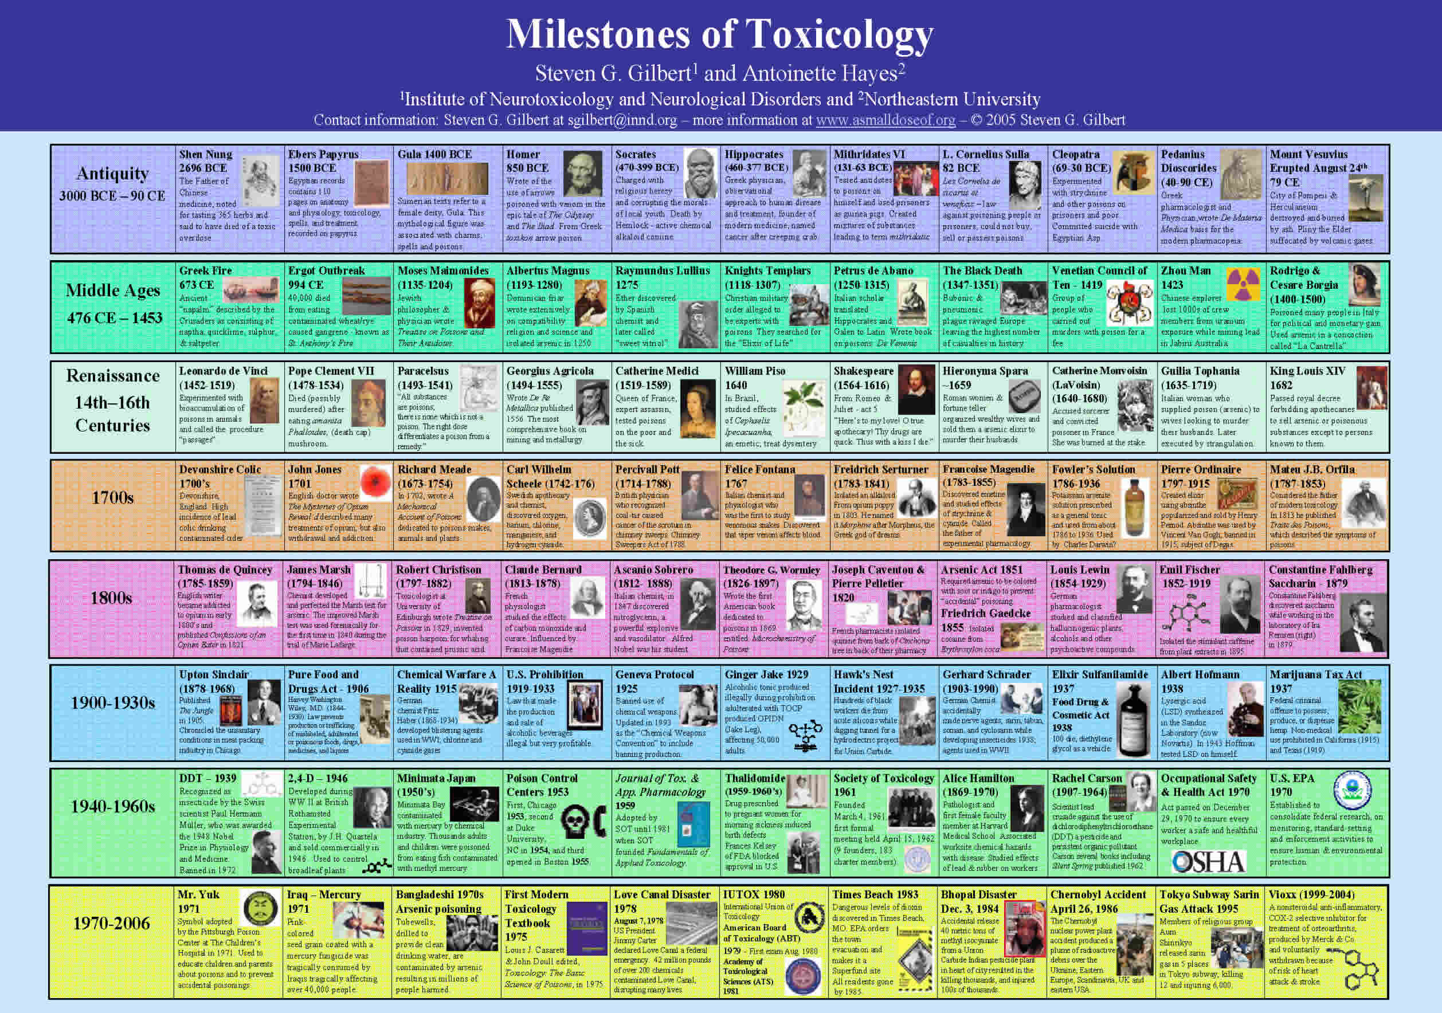
Milestones of Toxicology

Slide 15
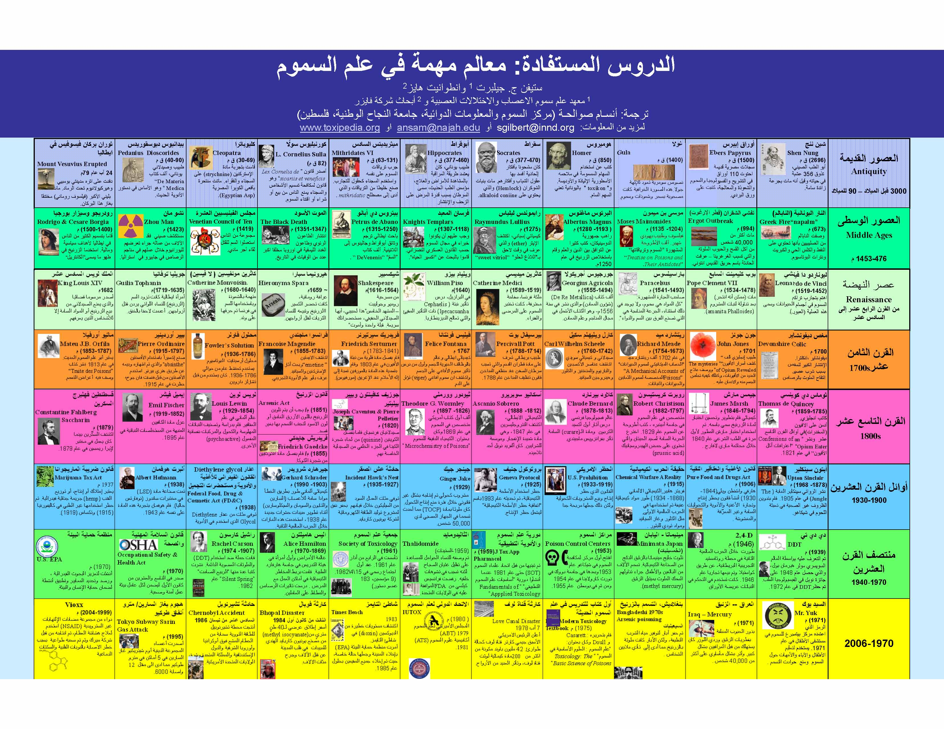
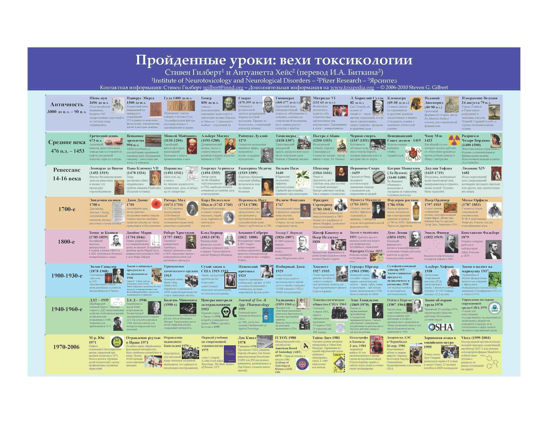
Milestones of Toxicology - Translations
Arabic
Also in:
Amharic
Arabic
Chinese (simple & traditional)
English (clickable)
French
German
Hebrew (almost done)
Italian
Japanese
Korean
Portuguese
Russian
Spanish (clickable)
Turkish
Vietnamese
Russian

Slide 16
Agency Blood Lead Levels

Slide 17
Ethics
ETHICS

Slide 18

Human & Environmental Health
“Conditions that ensure that all living things have the best opportunity to reach and maintain their full genetic potential.”
Steven G. Gilbert, 1999
Gilbert SG. Ethical, legal, and social issues: our children's future. Neurotoxicology. 2005;26:521-30.

Slide 19
OSHA does what ?
The Occupational Safety and Health Administration (OSHA) is an agency of the United States Department of Labor. Congress established the agency under the Occupational Safety and Health Act, which President Richard M. Nixon signed into law on December 29, 1970.
https://www.osha.gov

Slide 20
OSHA does what ?
OSHA's mission is to "assure safe and healthful working conditions for working men and women by setting and enforcing standards and by providing training, outreach, education and assistance".
https://www.osha.gov

Slide 21
OSHA and the States ?
OSHA's allows states to set up their own program and regulations as long they are as strict or stricter than OSHA.
WA State took this option.

Slide 22
L&I does what ?
Washington State Dept. of Labor & Industries. L&I is a diverse state agency dedicated to the safety, health and security of Washington's 2.5 million workers.
http://www.lni.wa.gov

Slide 23
L&I does what ?
L&I's Division of Occupational Safety and Health (DOSH) administers the Washington Industrial Safety and Health Act (WISHA) law by developing and enforcing rules that protect workers from hazardous job conditions.
http://www.lni.wa.gov

Slide 24
L&I does what ?
Keep Washington safe and working
Protecting the health and safety of workers
Ensuring medical care and financial help for injured workers
Protecting workers' wages, hours, breaks and more
Protecting the public from unsafe work and economic hardship
http://www.lni.wa.gov

Slide 25
Existing Inadequate Workplace Standards
Existing Inadequate Workplace Standards
OSHA regulates workplace lead exposure through two standards, the general industry standard and the construction standard. Both of these are based on scientific and medical evidence from the 1970s and do not reflect updated information regarding the hazards of low level lead exposure.

Slide 26
Existing Inadequate Workplace Standards
Existing Inadequate Workplace Standards
Examples of key inadequacies of the current standards:
Exposures of lead that result in up to 60 μg/dL BLLs (or an average of 50 μg/dL BLL on three or more tests) are allowed before medical removal is required
Workers can return to work when BLLs are as high as 40 μg/dL
The permissible enforceable limit (PEL) is set at 50 μg/m³ over 8 hours, which allows for BLLs as high as 60 μg/dL
Reliance on air lead levels as entry condition for the occupational lead standard ignores the role of ingestion in worker lead exposure

Slide 27
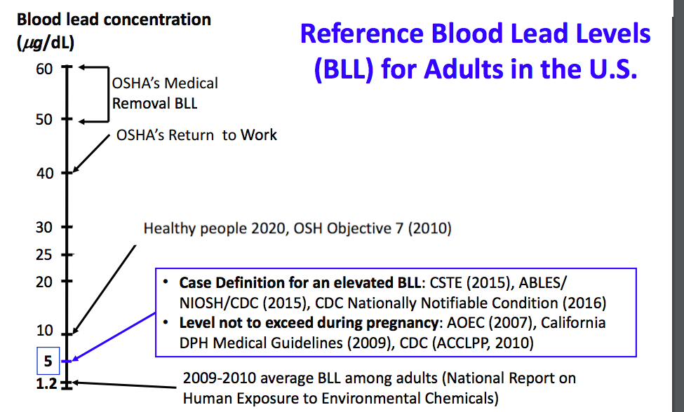
BLL for adults

Slide 28
Agency Blood Lead Levels

Slide 29
Industries reporting the highest percentage of
BLLs > 25µg/dL among workers
Manufacturing | Construction | Services | Mining
Storage battery manufacturing | Painting and wall covering contractors | Remediation services | Copper, nickel, lead, zinc mining, gold
Alumina and aluminum production and processing | Highway, street, and bridge construction | Amusement and recreation services
Nonferrous metal (except copper and aluminum) rolling, drawing, extruding, and alloying | Residential building construction | Automotive, mechanical, and electrical repair and maintenance

Slide 30
Industries with commonly reported family lead exposure
Lead smelting
Battery manufacturing/recycling
Radiator repair
Electrical components manufacturing
Pottery/ceramics
Stained glass making
Carpentry / remodeling / furniture repair
Fishing sinkers

Slide 31
Firing ranges and shooting
About 1 million U.S. law enforcement officers train at indoor ranges, while 20 million citizens engage in target shooting as a leisure activity; as of 2011 there were about 270 million civilian-owned firearms in the U.S.
The National Sport Shooting Foundation (NSSF) stated that in 2011 in the United States there were 13,049,050 handgun shooters, 13,170,417 rifle shooters, 9,713,033 shotgun shooters, and 3,730,567 muzzleloader shooters
US shooting ranges at 16,000 to 18,000 as of 2013
Laidlaw, M.A.S., Filippelli, G., Mielke, H. et al. Lead exposure at firing ranges—a review Environ Health (2017) 16: 34. doi:10.1186/s12940-017-0246-0

Slide 32
Worker populations of particular concern
What is a Worker ???
  Younger workers ages 14-21
    Organ systems are still developing
    Neurological systems especially vulnerable
  Women of reproductive age
    Implications for fetal & child exposures
  Ethnic/minority groups:
    Disproportionate exposures based on job patterns
    May have inadequate understanding of risks because of language barriers

Slide 33
Take-Home Lead Exposure:
Estimated Risks to Children
OSHA estimates of workers exposed to lead:
  General industry: 804,000 workers
  Construction industry: 838,000 workers
  Not included: potential exposure through firing/shooting ranges
Estimates of child exposures from take-home lead (based on Roscoe et al 1999):
  If we assume that 10% of all workers take lead home to their families, then 160,000 families affected by occupational lead exposure
  If we assume that one child per family is affected, then 160,000 children might be exposed through take-home lead exposure from the workplace

Slide 34
Conclusions & Recommendations
Current occupational lead standards are not protective for workers and their families.
Occupational lead standards should be updated to prevent BLLs greater than 5 µg/dL in all workers, in accordance with current scientific and medical evidence. This change would eliminate the arbitrary distinction between workers and children.
Children of workers exposed to lead on the job should receive regular BLL screening
CDC acknowledges that there is no safe level of lead. We have an ethical responsibility to protect workers and children from known hazards such as lead.

Slide 35
Lead 10 to 2
Rationale for Lowering the Blood Lead Action Level From 10 to 2 µg/dL
Steven G. Gilbert and Bernard Weiss
Neurotoxicology Vol 27/5, September 2006, pp 693-701. http://dx.doi.org/10.1016/j.neuro.2006.06.008

Slide 36
Project TENDR
Recommendations
Project TENDR recommends that the US government adopt the following national goals: ensure that, by 2021, no child has a blood lead level greater than 5 μg/dL and, by 2030, no child has a blood lead level greater than 1 μg/dL.
Project TENDR: Targeting Environmental Neuro-Developmental Risks. The TENDR Consensus Statement. Environmental Health Perspectives. Vol. 124:7 July 2016.
Bellinger DC, Chen A, Lanphear BP. Establishing and Achieving National Goals for Preventing Lead Toxicity and Exposure in Children. JAMA Pediatr. Published online May 15, 2017. doi:10.1001/jamapediatrics.2017.0775

Slide 37
Lead – Global Issue
Childhood Lead Exposure May Cost Developing Countries Nearly $1 Trillion
Results: We estimated a total cost of $977 billions of international dollars in low- and middle-income countries, with economic losses equal to $134.7 billion in Africa, $142.3 billion in Latin America and the Caribbean, and $699.9 billion in Asia. total economic loss in the range of $728.6–1162.5 billion.
Attina TM, Trasande L. 2013. Economic costs of childhood lead exposure in low- and middle-income countries. Environ Health Perspect 121:1097–1102; http://dx.doi. org/10.1289/ehp.1206424

Slide 38
Conclusion
Get engaged with the process
Visit legislative people at all levels
Translate science to policy
Write editorials and Letters
Join NGOs

Slide 39
A Small Dose of Connecting Dots

